Slide 1

CR4 – Acids and Alkalis
Name: _____________________________________
Class Code: _________________________________
Teacher: ___________________________________

Slide 2

Lesson Title | Career focus | Date when complete
Why is thinking about safety important for chemical companies? | Hazardous materials health and safety
How can we identify what is acidic or alkali? | Toxicologist
Are all acids the same acidity? | Caretaker
Why do people use vinegar to treat wasp stings? | Industrial hygienist
How is a scientific investigation planned? | Chef
What happens when a metal reacts with an acid? | Corrosion engineer
How is energy transferred during chemical reactions? | Cleaner
How is energy transferred when a substance changes state? (Part 1) | Chemical safety officer
How is energy transferred when a substance changes state? (Part 2) | Environmental Health and Safety Managers
What we have we learnt in this unit? | Emergency response specialists
SLOP:
SLOP stands for ‘Shed Loads of Practice’. When investigating expertise, the one common factor is a large amount of practice. That practice is most effective when blocked together early on.

Slide 3


CR4 – Acids and Alkalis
What you should already know | What you will be learning in this unit
Chemical reactions as the rearrangement of atoms Representing chemical reactions using formulae and using equations Explain that some changes result in the formation of new materials, and that this kind of change is not usually reversible. The differences in arrangements, in motion and in closeness of particles explaining changes of state, shape and density, the anomaly of ice water transition Conservation of materials and mass, reversibility, in melting, freezing, evaporation, sublimation, condensation and dissolving The identification of pure substances | Define acids and alkalis in terms of neutralisation reactions The PH Scale for measuring acidity/alkalinity; and indicators Reactions of acids with metals to produce a salt plus hydrogen Reactions of acids with alkali to produce a salt plus water. Energy changes on changes of state (qualitative) Exothermic and endothermic chemical reactions (qualitative) Draw straight forward conclusions from data presented Make order of magnitude calculations Construct scientific plans which will allow for reliable results to be collected Interpret frequency tables, line graphs, bar graph and pie charts
Application Tasks:
Demonstrate and deepen understanding of knowledge and disciplinary skills.
Core Knowledge:
Three questions to recap the learning objectives to secure learning for the lesson content.

Slide 4
Academic language
Word | Definition
Observe | Notice or perceive (something) and register it as being significant.
State | To express something definitely or clearly in speech or writing.
Predict | To say or estimate that a specific thing will happen
Acid | A substance with specific properties that include turning blue litmus red.
Alkali | A soluble substance with specific properties that include turning red litmus blue.
The pH Scale | Shows how acidic a substance is, it can be measured to give a numerical value.
Neutral | A substance that is neither acidic nor basic.
Base | A substance that neutralises an acid.
Neutralisation | A chemical reaction in which an acid reacts with a base to form salt and water.
Salt | A substance that is produced when an acid reacts with a base.
Ignition | The action of setting something on fire.
System | A collection of objects that can be identified (specifically the reactants and products)
Exothermic | A process where energy is transferred from the system to the surroundings.
Endothermic | A process where energy is transferred from the surroundings to the system.

Slide 5



Why is thinking about safety important for chemical companies?
Core Knowledge
By the end of this lesson, you will know:
The history behind the chemistry of acids and alkalis
Why hazardous materials health and safety officers is an important job role
Academic Language SEE IT SAY IT Write it
Word | Definition
 | dangerous and involving risk, especially to someone's health.
 | Notice or perceive (something) and register it as being significant.
 | To say or estimate that a specific thing will happen
Lesson content

Slide 9
Glossary
Waned - decrease in vigour or extent; become weaker.
Renaissance - the revival of European art and literature under the influence of classical models in the 14th–16th centuries.
Alchemist - a seemingly magical process of transformation, creation, or combination.
Corrosion - damage caused to metal, stone, or other materials by corrosion.
Categorise - place in a particular class or group.
Scholar - a specialist in a particular branch of study
Systematic - done or acting according to a fixed plan or system
Reference: Acids and Bases - History of Chemistry (explorable.com)

Slide 10
Core Knowledge
Answer the core knowledge question below in full sentences
1.__________________________________________________________________________________________________________________________________________________________________________________________________________________________________________________
2. _______________________________________________________________________________
__________________________________________________________________________________________________________________________________________________________________
3. _______________________________________________________________________________
__________________________________________________________________________________________________________________________________________________________________
Additional space

Slide 11
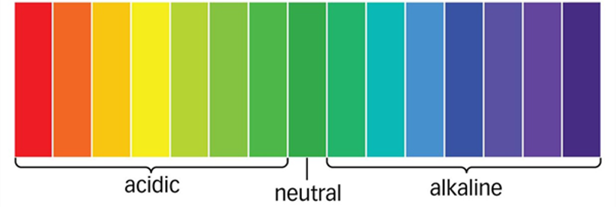
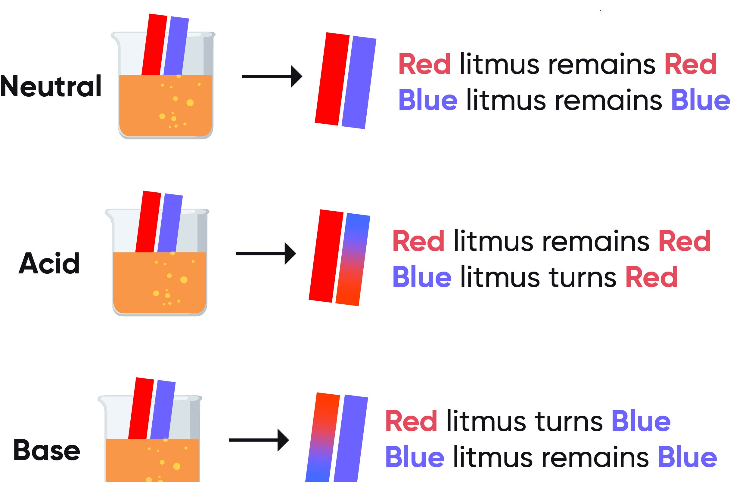
How can we identify what is acidic or alkali?
Core Knowledge
By the end of this lesson, you will know:
All substances can be classified as being acidic, basic or neutral.
Indicators are used to identify the acidity of a substance (In universal indicator acids are red, alkalis are purple and neutral is green) / (red or blue litmus paper).
Three acids are ethanoic acid (vinegar), hydrochloric acid (stomach acid) and sulphuric acid and three alkalis are ammonia, sodium hydroxide (drain cleaner) and bleach.
Academic Language SEE IT SAY IT Write it
Word | Definition
Observe | Notice or perceive (something) and register it as being significant.
Acid | A substance with specific properties that include turning blue litmus red.
Alkali | A soluble substance with specific properties that include turning red litmus blue.
Lesson content
All substances can be classified as either acidic, basic or neutral.​
Indicators are used to identify the acidity of a substance.
Indicator 1: Universal Indicator. Results can be compared against a chart
Indicator 2: Red and blue litmus paper.
Result both blue = alkali​.
Result both red = acid​.
Result both stay the same = neutral​
Three common acids are: ​
Ethanoic acid (vinegar), ​
Hydrochloric acid (stomach acid),​
Sulphuric acid (car battery acid)​
Three common alkalis are: ​
Ammonia, ​
Bleach,​
Sodium hydroxide (drain cleaner).

Slide 12

SLOP:
What is an acid? A substance with specific properties that include turning blue litmus red
2. What is an alkali? A soluble substance with specific properties that include turning red litmus blue.
3. What does red litmus paper do when it touches an acid?
4. How can you use litmus paper to show a substance is an alkali?
.
5. How does a universal indicator help us identify whether a substance is acidic or alkaline?
6. What does it mean if a substance turns green in universal indicator?
7. Give an example of a common household acid and alkali.
Application Tasks:
Substance | Litmus paper observations | Universal Indicator observations | Acid or alkali? pH?
1
2
3
4
5
6
Conclusion. Describe the conclusions can be drawn from this practical.

Slide 13
Core Knowledge
Answer the core knowledge question below in full sentences
1.__________________________________________________________________________________________________________________________________________________________________________________________________________________________________________________
2. _______________________________________________________________________________
__________________________________________________________________________________________________________________________________________________________________
3. _______________________________________________________________________________
__________________________________________________________________________________________________________________________________________________________________
Additional space

Slide 14
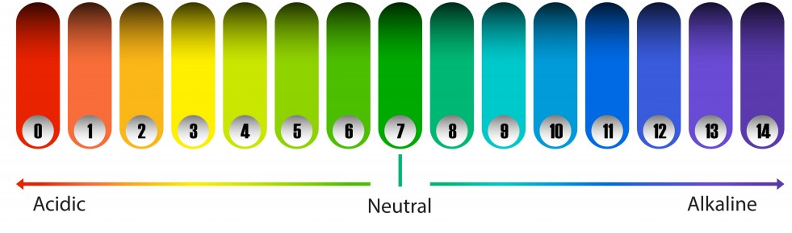
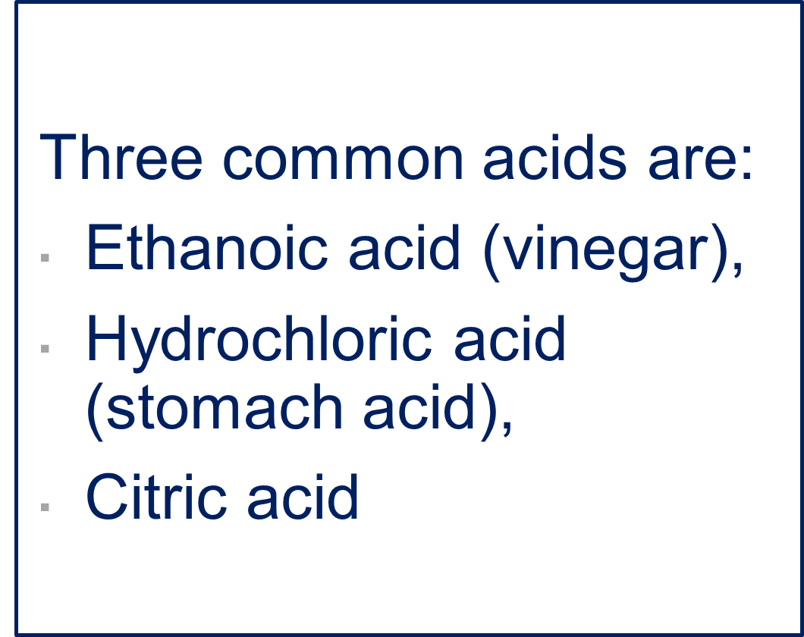
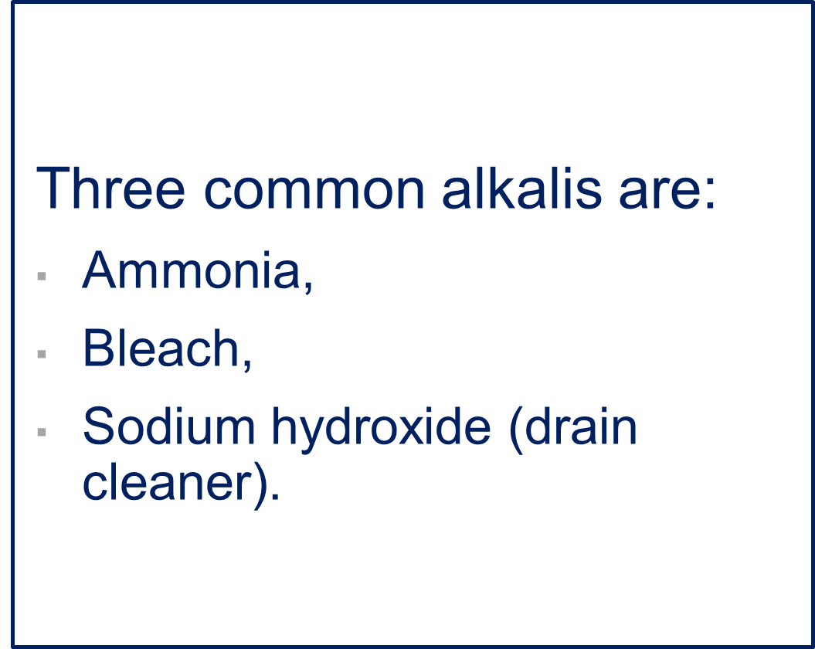
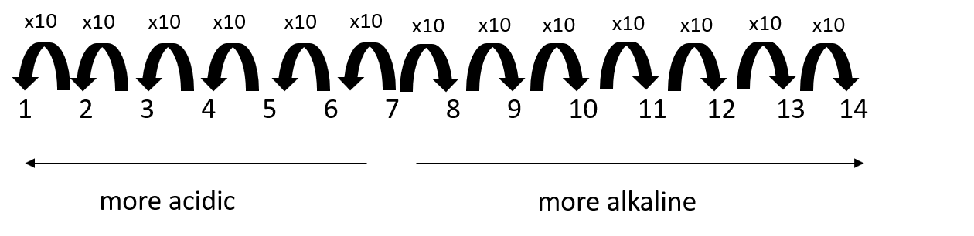
Are all acids the same acidity?
Core Knowledge
By the end of this lesson, you will know:
The pH scale shows how acidic a substance is, it can be measured to give a numerical value and ranges from 0 (very acidic) through 7 (neutral) to 14 (very alkaline).
An alkali is a soluble base.
Make order of magnitude calculations
Academic Language SEE IT SAY IT Write it
Word | Definition
 | To express something definitely or clearly in speech or writing.
 | Shows how acidic a substance is, it can be measured to give a numerical value
 | A substance that is neither acidic nor basic.
Lesson content
The pH scale shows how acidic a substance is, it can be measured to give a numerical value
It ranges from 0 (very acidic), to neutral 7, to 14 (very alkali)
Substances with a pH below 7 are acidic, such as lemon juice (pH 2) and vinegar (pH 3).
Substances above 7 are alkaline, like baking soda (pH 9) and soap (pH 10).
Water has a neutral pH of 7.
One problem with the pH Scale is that it is logarithmic, meaning that each unit represents a tenfold difference in acidity or alkalinity. This can make it challenging to grasp the magnitude of the difference between pH values.

Slide 15
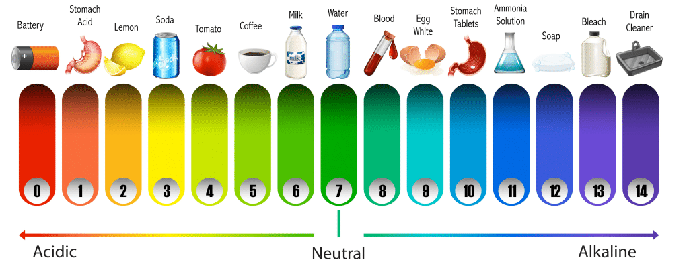
SLOP:
What is the pH scale?
2. What are the colours associated with acids and alkalis on the pH scale?
3. What is the pH number of neutral substances?
4. How does the pH scale show the order of magnitude?
5. Can you give an example of a substance with a low pH number?
6. What is the pH number of a substance that is highly alkaline?
Application Tasks:
Using the pH scale:
How much more acidic is pH 1 than pH 4?
How much more alkaline is pH 14 than pH 12?
How much less acidic is pH 6 than pH 5?
How much less alkaline is pH 9 than pH 11?
Identify two pieces of observational evidence that would allow Riley to conclude that the substance was an alkali.
_________________________________________________________________________
_________________________________________________________________________
_________________________________________________________________________
_________________________________________________________________________
2. State the pH of Riley's mystery solution. _________
3. How many times less alkali is Riley's solution than bleach? _______________________________

Slide 16
Core Knowledge
Answer the core knowledge question below in full sentences
1.__________________________________________________________________________________________________________________________________________________________________________________________________________________________________________________
2. _______________________________________________________________________________
__________________________________________________________________________________________________________________________________________________________________
3. _______________________________________________________________________________
__________________________________________________________________________________________________________________________________________________________________
Additional space

Slide 17
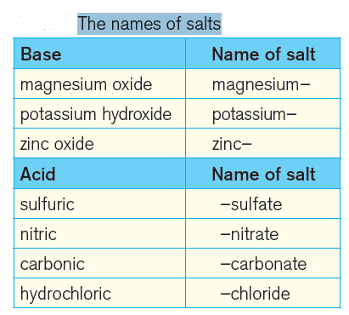
Why do people use vinegar to treat wasp stings?
Core Knowledge
By the end of this lesson, you will know:
An acid and alkali will chemically react to produce a salt and water. This is called a neutralisation reaction.
The name of the salt produced can be worked out from the names of an acid and an alkali
That the other common acids produce sulphate and ethanoate salts.
Academic Language SEE IT SAY IT Write it
Word | Definition
 | A chemical reaction in which an acid reacts with a base to form salt and water.
 | A substance that neutralises an acid.
 | A substance that is produced when an acid reacts with a base.
Lesson content
In a neutralisation reaction, an acid reacts with a
base to form a neutral solution of a salt and water.
The name of the salt depends on the names of the
acid and base which reacted together.
Salts have two part names.
The first part comes from the name of the base.
The name of the metal in the base (the first word
in the base name) becomes the first part of the
name of the salt.
The second part comes from the name of the acid.
The table on the right shows how the name of the
acid changes slightly.

Slide 18
SLOP:
1. What happens in a neutralization reaction?
2. What is a base?
3. What is a salt?
4. How are salts named?
5. Give an example of a neutralization reaction.
.
6. What is the salt formed when sulphuric acid reacts with calcium hydroxide?
7. When nitric acid reacts with potassium hydroxide, what is the resulting salt?
Application Tasks:
1. Hydrochloric acid + sodium hydroxide → Sodium chloride + ______________
2. Sulphuric acid + sodium hydroxide → _________sulphate + water
____________ acid + potassium hydroxide → potassium sulphate + water​
4. Nitric acid + calcium hydroxide → ________nitrate + ____________
5. Nitric acid + lithium hydroxide → ___________ + water
6. __________ acid + lead hydroxide → lead sulphate + ______________
7. Hydrochloric acid + zinc oxide → ______________ + water
8. Sulphuric acid + iron oxide → _______________ + water
9. Nitric acid + ____________hydroxide → potassium _____________ + ____________
10. ________________ + _________________ → Magnesium chloride + ____________
A farmer wants to make potassium chloride salt to use as fertiliser.
Which reactants should she use to make this salt?
Write the word equation for this reaction:
How could the farmer test the reaction mixture to make sure she has added enough base to neutralise the acid?

Slide 19
Core Knowledge
Answer the core knowledge question below in full sentences
1.__________________________________________________________________________________________________________________________________________________________________________________________________________________________________________________
2. _______________________________________________________________________________
__________________________________________________________________________________________________________________________________________________________________
3. _______________________________________________________________________________
__________________________________________________________________________________________________________________________________________________________________
Additional space

Slide 20
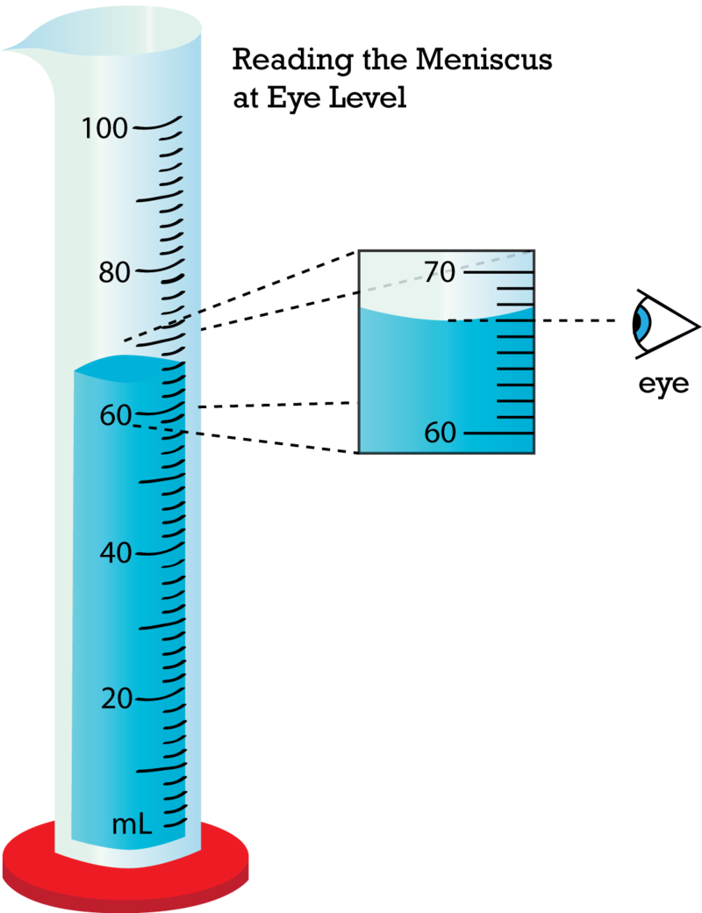
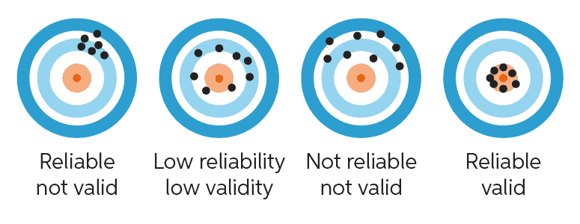
How is a scientific investigation planned?
Core Knowledge
By the end of this lesson, you will know:
An acid and alkali will chemically react to produce a salt and water. This is called a neutralisation reaction.
The name of the salt produced can be worked out from the names of an acid and an alkali.
Construct scientific plans which will allow for reliable results to be collected
Academic Language SEE IT SAY IT Write it
Word | Definition
 | Notice or perceive (something) and register it as being significant.
 | To express something definitely or clearly in speech or writing.
 | A chemical reaction in which an acid reacts with a base to form salt and water.
Lesson content
Reliability is the degree to which the result of a measurement, calculation, or specification can be depended on to be accurate.
The volume of a liquid can be determined using a measuring cylinder.
Measuring cylinders should always be read at eye level, and the volume is measured from the bottom of the meniscus (the curve of the liquid in the cylinder.

Slide 21
SLOP:
Why do we use measuring cylinders?
How do you use a measuring cylinder correctly?
Do you read from the top or bottom of the meniscus?
What does reliable mean?
If a result is reliable, is the result accurate?
Application Tasks:
Task 2: Plan an investigation
You are going to be producing a neutral solution from two unknown liquids. First you will need to work out which liquid is the acid and which is the alkali, then you will add the acid to the alkali until the solution is neutral. You will need to determine when this happens.
Justify why you will use each piece of equipment:
Measuring cylinder –
Pipette –
Universal indicator paper –
Identify the risks in this practical and explain how you will control them
3. Write a method for your practical:
Risk​ | How will it be controlled?
​ | ​
​ | ​

Slide 22
Core Knowledge
Answer the core knowledge question below in full sentences
1.__________________________________________________________________________________________________________________________________________________________________________________________________________________________________________________
2. _______________________________________________________________________________
__________________________________________________________________________________________________________________________________________________________________
3. _______________________________________________________________________________
__________________________________________________________________________________________________________________________________________________________________
Additional space

Slide 23
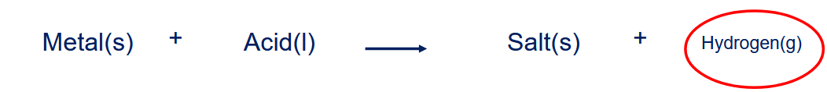
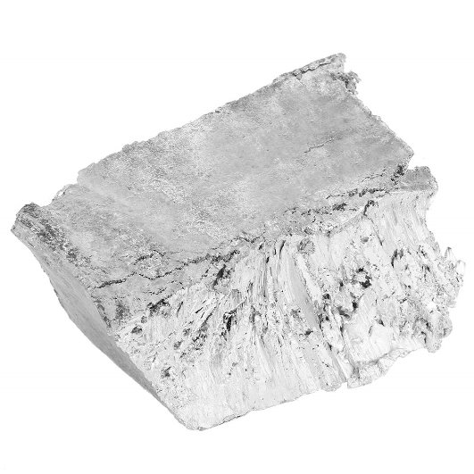
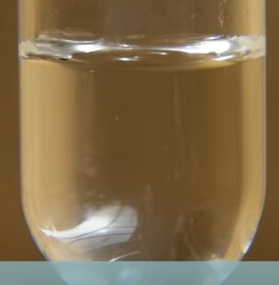
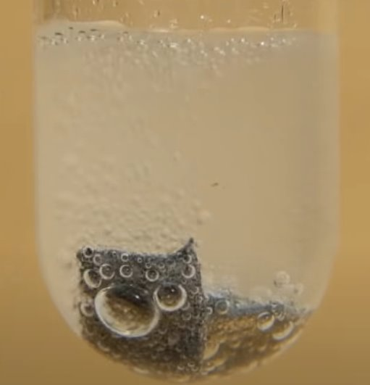
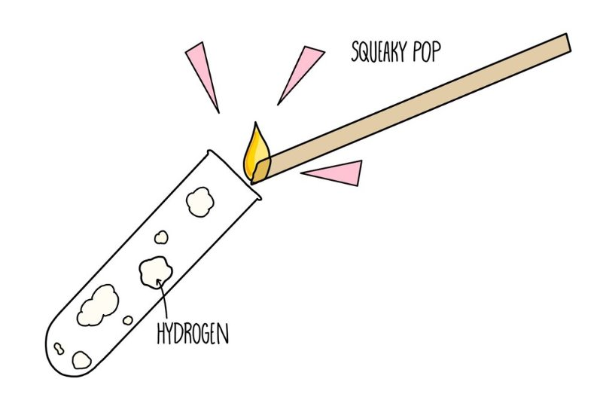
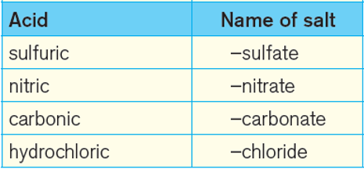
What happens when a metal reacts with an acid?
Core Knowledge
By the end of this lesson, you will know:
reactions of acids with metals to produce a salt plus hydrogen
Hydrogen makes a characteristic squeaky pop when ignited.
Academic Language SEE IT SAY IT Write it
Word | Definition
 | The action of setting something on fire.
 | Notice or perceive (something) and register it as being significant.
 | To express something definitely or clearly in speech or writing.
Lesson content
Acids chemically react with most metals and will form a salt and hydrogen.
It is possible to identify the gas produced in this chemical reaction.​
When hydrogen is ignited using a lit splint, it produces a distinctive squeaky pop sound.
Naming the salt follows the same rules as other reactions with acids which produce salts. The first part of the salt name comes from the metal (eg sodium). The second part comes from the name of the acid (eg hydrochloric acid → chloride). Together, the
two parts give the same of the salt (eg sodium chloride).

Slide 24
SLOP:
What happens when metals react with acids?
2 Which gas is formed when metals react with acids?
3. What is the test called to detect the presence of hydrogen gas?
4. How is the "squeaky pop" test performed?
5. What type of salt is formed when magnesium reacts with hydrochloric acid?
6. Which salt is produced when zinc reacts with sulfuric acid?
7. What determines the type of salt formed in the reaction of metals with acids?
Application Tasks:
Write a conclusion for your practical by answering the following questions.​
1. State which metals reacted with the acid, and which didn’t? ​
2. What did you observe that indicated a reaction was taking place?​
3. Describe how you can test the gas produced to identify it.
Metal | Observations with dilute sulfuric acid | Chemical reaction occurred? | If yes, name the salt produced
Copper (Cu)
Iron (Fe)
Zinc (Zn)
Magnesium (Mg)
Miles wants to react calcium metal and hydrochloric acid, then test the products.​
1. Predict the products made when calcium is added to hydrochloric acid.​
2. Suggest why is would be unsafe to collect too much hydrogen gas before testing for the squeaky pop sound.

Slide 25
Core Knowledge
Answer the core knowledge question below in full sentences
1.__________________________________________________________________________________________________________________________________________________________________________________________________________________________________________________
2. _______________________________________________________________________________
__________________________________________________________________________________________________________________________________________________________________
3. _______________________________________________________________________________
__________________________________________________________________________________________________________________________________________________________________
Additional space

Slide 26
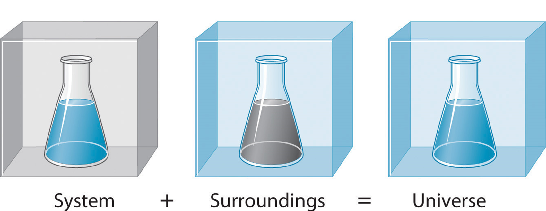
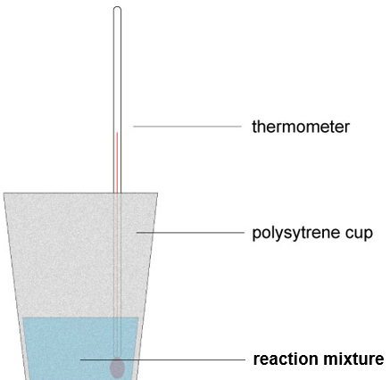
How is energy transferred during chemical reactions?
Core Knowledge
By the end of this lesson, you will know:
When a chemical reaction happens, energy is transferred to or from the surroundings​
The difference between exo and endothermic reactions​
Why a piece of equipment is appropriate for an investigation
Academic Language SEE IT SAY IT Write it
Word | Definition
 | A process where energy is transferred from the system to the surroundings.
 | A process where energy is transferred from the surroundings to the system.
 | A collection of objects that can be identified (specifically the reactants and products)
Lesson content
Energy can either exist in a system, or in the surroundings. The sum of which makes up the energy in the universe.
When chemical reactions occur, energy is transferred to or from the surroundings.
When energy is taken in from the surroundings, this is called an endothermic process. The temperature of the surroundings decreases.
When energy is given out into the surroundings, this is called an exothermic process. The temperature of the surroundings increases.
Using a thermometer to measure the temperature change of the surroundings allows us to identify whether a chemical reaction is exothermic or endothermic.
Using a polystyrene cup as an insulator allows us to prevent heat transfer through the cup. Using a lid prevents heat loss from the reaction
mixture.

Slide 27
SLOP:
What is an exothermic reaction?
Give an example of an exothermic reaction
What is an endothermic reaction?
Give an example of an endothermic reaction
How can we identify if a reaction is exothermic or endothermic?
Two chemicals are mixed together, they take in energy from the surroundings, what type of reaction is this?
Application Tasks:
Chemical Reaction | Starting Temperature (ºC) | Finishing Temperature (ºC) | Temperature Change (ºC) | Type of Energy Change
1
2
3
4
5
1. Some of the reactions you have investigated were exothermic. Explain why these reactions are exothermic.​
2. Suggest why the investigation was not carried out in a glass beaker​
​
3. Acute sports injuries are often initially treated with an ice pack to reduce pain. ​‘Instant cold’ ice packs contain ammonium nitrate and water. When the ice pack is squeezed, the two substances are released and react together. ​Use the results from your investigation to explain the energy transfer that is taking place inside the ice pack.

Slide 28
Core Knowledge
Answer the core knowledge question below in full sentences
1.__________________________________________________________________________________________________________________________________________________________________________________________________________________________________________________
2. _______________________________________________________________________________
__________________________________________________________________________________________________________________________________________________________________
3. _______________________________________________________________________________
__________________________________________________________________________________________________________________________________________________________________
Additional space

Slide 29
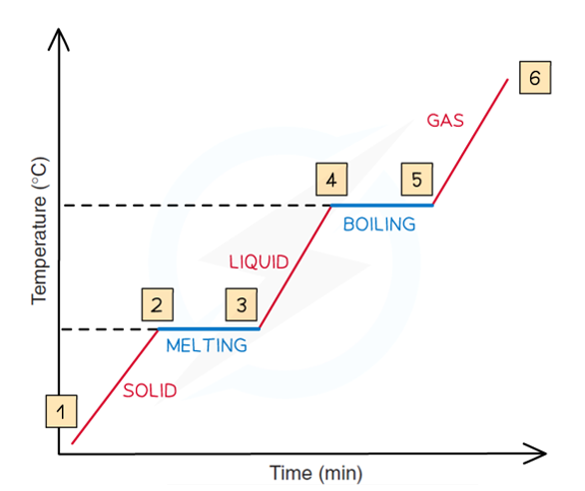
How is energy transferred when a substance changes state? (Part 1)
Core Knowledge
By the end of this lesson, you will know:
When a substance changes state, energy is transferred to or from the surroundings.
Interpret frequency tables, line graphs, bar graph and pie charts
Academic Language SEE IT SAY IT Write it
Word | Definition
 | A process where energy is transferred from the system to the surroundings.
 | A process where energy is transferred from the surroundings to the system.
 | To say or estimate that a specific thing will happen
Lesson content
When a substance changes state, energy is transferred to or from the surroundings.
- When energy is taken in from the surroundings, this is an endothermic process. As the particles gain more energy the state changes from a solid to a liquid to a gas.
- When energy is transferred to the surroundings, this is an exothermic process. As the particles lose energy the state changes from a gas to a liquid to a solid.

Slide 30
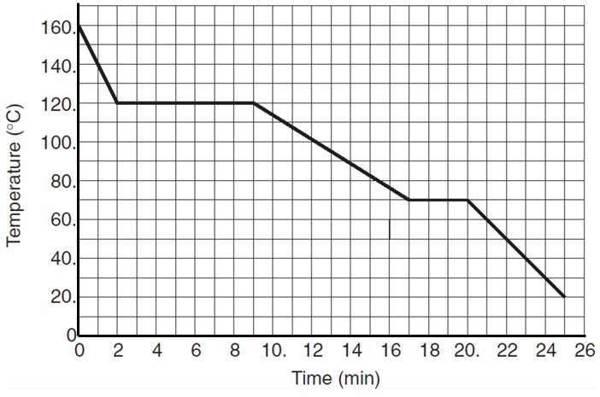
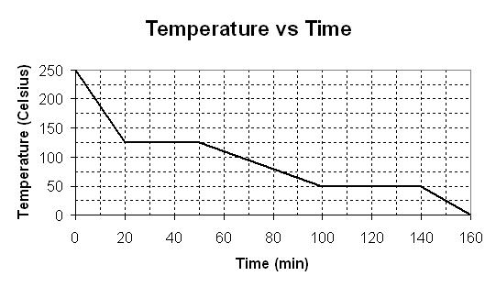
SLOP:
1. What is a cooling curve graph?
2. What does the x-axis represent on a cooling curve graph?
3. What does the y-axis represent on a cooling curve graph?
4. What does a horizontal line on a cooling curve graph indicate?
Application Tasks:
We Do – Describe a Graph
You Do – Describe a Graph

Slide 31
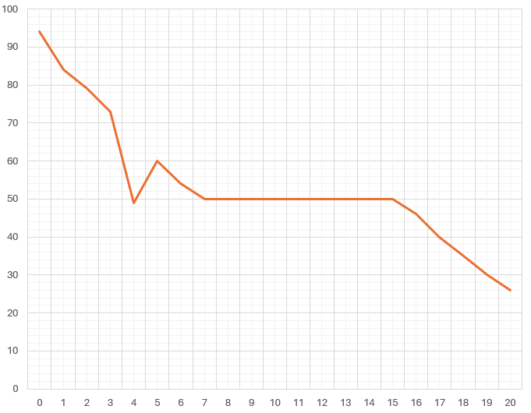
A student heated an unknown substance to 94°C before measuring the temperature over a period of 20 minutes. The substance was a liquid at 94°C.
Identify the change of state shown on the graph and whether this change is exothermic or endothermic
Complete the graph to include axis labels
Circle the anomalous result.
A student is given a table showing melting points of different substances.
Identify the which the unknown substance is most likely to be.
Explain your answer.
Substance | Melting Point (°C)
Stearic Acid | 70
Acetic Acid | 30
Tri-chloroacetone | 50

Slide 32
Core Knowledge
Answer the core knowledge question below in full sentences
1.___________________________________________________________________________________________________________________________________________________________________________________________________________________________________________________________________________________________________________________________________
2. _______________________________________________________________________________
__________________________________________________________________________________________________________________________________________________________________
_______________________________________________________________________________
_________________________________________________________________________________
Additional space

Slide 33
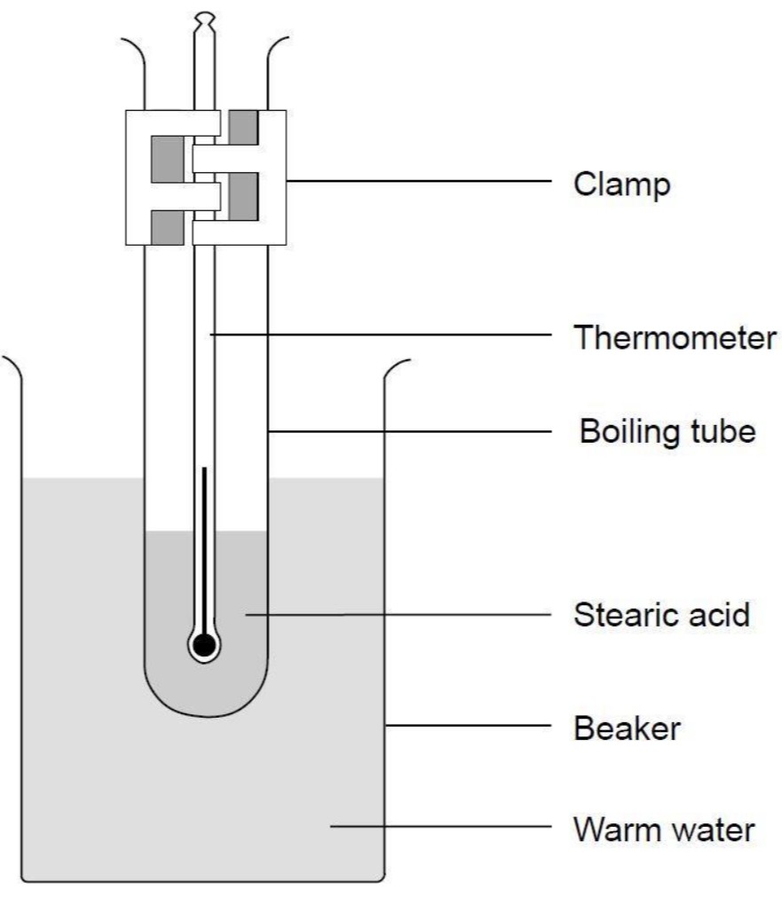
How is energy transferred when a substance changes state? (Part 2)
Core Knowledge
By the end of this lesson, you will know:
When a substance changes state, energy is transferred to or from the surroundings.
Interpret frequency tables, line graphs, bar graph and pie charts
Academic Language SEE IT SAY IT Write it
Word | Definition
 | A process where energy is transferred from the system to the surroundings.
 | A process where energy is transferred from the surroundings to the system.
 | Notice or perceive (something) and register it as being significant.
Lesson content
When a substance changes state, energy is transferred to or from the surroundings.
- When energy is taken in from the surroundings, this is an endothermic process. As the particles gain more energy the state changes from a solid to a liquid to a gas.
- When energy is transferred to the surroundings, this is an exothermic process. As the particles lose energy the state changes from a gas to a liquid to a solid.

Slide 34
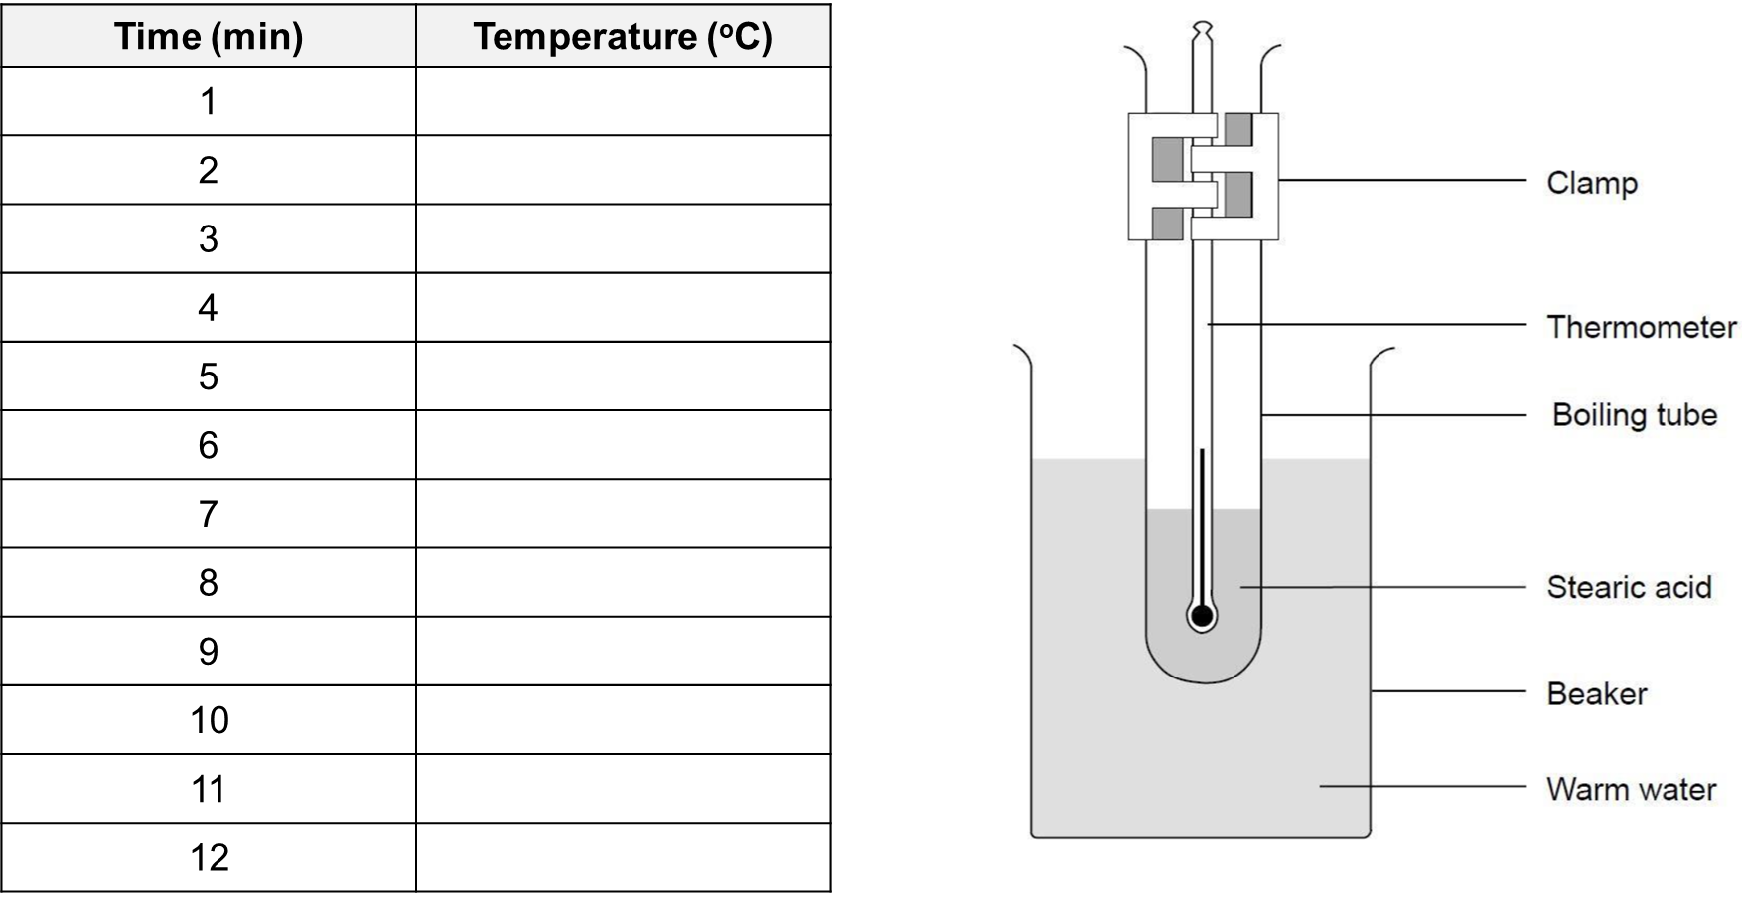
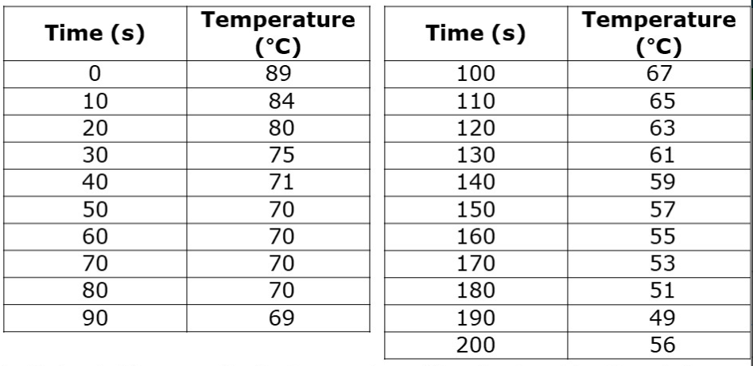
Application Tasks:
Class Practical
When you have completed your graph:
Describe what happened to the temperature as the substance cooled down
This data represents a substance freezing. Label the part of the graph where it is a liquid.
Using your graph, suggest the melting point of this substance

Slide 35
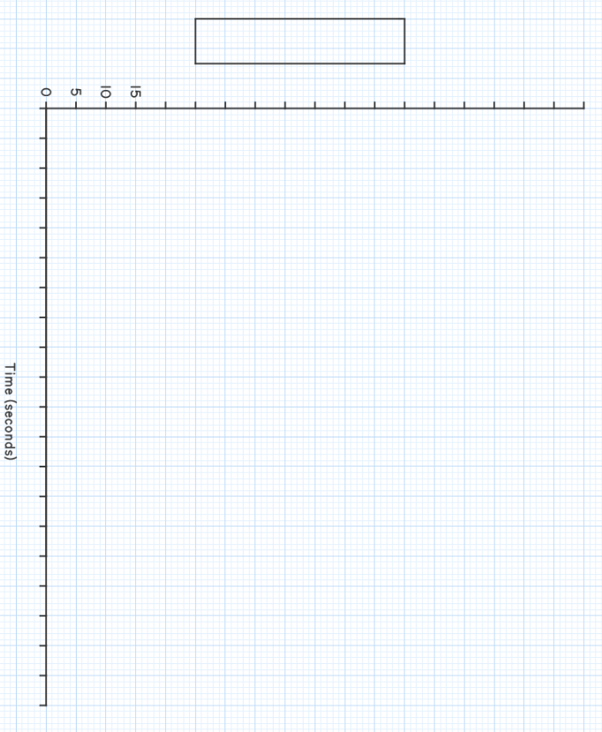
Rotate your booklet
Scale Plot Label Axis Trendline

Slide 36
Core Knowledge
Answer the core knowledge question below in full sentences
1.___________________________________________________________________________________________________________________________________________________________________________________________________________________________________________________________________________________________________________________________________
2. _______________________________________________________________________________
__________________________________________________________________________________________________________________________________________________________________
_______________________________________________________________________________
_________________________________________________________________________________
Additional space

Slide 37
What we have we learnt in this unit?
Core Knowledge
By the end of this lesson, you will know:
Some areas of strength and weakness in this unit​
About moral dilemmas to do with this unit on cells
Academic Language SEE IT SAY IT Write it
Word | Definition
 | A substance that neutralises an acid.
 | A substance that is produced when an acid reacts with a base.
 | A collection of objects that can be identified (specifically the reactants and products)
Lesson content

Slide 38
Post-Diagnostic Test

Slide 39
Post-Diagnostic Test

Slide 40
Post-Diagnostic Test

Slide 41
Core Knowledge
Answer the core knowledge question below in full sentences
1.__________________________________________________________________________________________________________________________________________________________________________________________________________________________________________________
2. _______________________________________________________________________________
__________________________________________________________________________________________________________________________________________________________________
3. _______________________________________________________________________________
__________________________________________________________________________________________________________________________________________________________________
Additional space

Slide 42
Additional space

Slide 43
Additional space

Slide 44

Scale Plot Label Axis Trendline

Slide 45
Scale Plot Label Axis Trendline

