Slide 1

THB9 – The Digestive System
Name: _____________________________________
Class Code: _________________________________
Teacher: ___________________________________

Slide 2
"Science knows no country, because knowledge belongs to humanity, and is the torch which illuminates the world.” Louis Pasteur
Lesson Title | Career focus | Tick when complete
Can we grow safe and nutritious food in space? | Nutritional Scientist
Is fast food bad for you? | Chef
Why do I need fibre in my diet? | Food and Beverage Quality Assurance
How many calories do I need a day? | Personal Trainer
How do I know what’s in my food? | Food Scientist
What are the consequences of an unhealthy diet? | Nutritionist and Dietician
How does my body break down food? | Gastroenterologist
What are the role of enzymes in digestion? | Chocolatier
Why is childhood obesity a problem? | Personal Trainer

Slide 3
The Digestive System
What you should already know | What you will be learning in this unit
Identify that animals, including humans, need the right types and amounts of nutrition, and that they cannot make their own food; they get nutrition from what they eat. Describe the simple functions of the basic parts of the digestive system in humans. The hierarchical organisation of multicellular organisms: from cells to tissue to organs to systems to organisms. | Content of a healthy diet; carbohydrates, lipids, (fats and oils), proteins, vitamins, minerals, dietary fibre and water, and why each is needed. Calculations of energy requirements in a health daily diet. The consequences of imbalances in the diet, including obesity, starvation, and deficiency disease. The tissues and organs of the human digestive system, including adaptations to function and how the digestive system digests food (enzymes simply and biological catalysts). The importance of bacteria in the human digestive system. Identify simple advantages of working together on experiments or investigations Use appropriate sampling techniques and/or scientific procedures to collect data Draw straight forward conclusions from data presented

Slide 4
Academic language
Word | Definition
Name | Write the name of something
Label | Identify something on a diagram
Evaluate | Suggest things that are good and things that are bad about something
(Kilo)calorie | A unit of measurement used to show how much energy there is in food
Biuret | A type of reagent (chemical) that changes colour in the presence of protein
Enzyme | A biological catalyst (chemical) that breaks down substances into smaller parts
Lipid | A word used to describe fats and oils
Malnutrition | A condition where someone does not get enough of a certain substance in their diet that can make them unwell
Oesophagus | The muscular tube that carries food from the mouth to the stomach
Pancreas | An organ in the body that makes enzymes and insulin, aiding in digestion
Reagent | A chemical that can be used to indicate if there are certain nutrients in that substance
Carbohydrate | Carbohydrates are made up of sugar molecules joined together in long chains.
Protein | Proteins are compounds made up of amino acid molecules.
Vitamins | A group of nutrients that are needed in very, very small amounts for the body but are essential for our system
Mineral | A naturally occurring, inorganic substance, with a characteristic chemical composition and atomic structure
Fibre | Plant material that cannot be digested by the human body.
Malnutrition | Condition when your diet does not contain the right amount of nutrients or too many of the wrong nutrients.

Slide 5




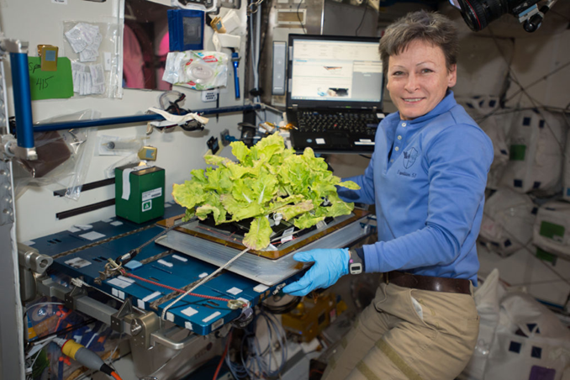
Date: ________________
Can we grow safe and nutritious food in space?
Core Knowledge
By the end of this lesson, you will know:
The potential roles of a nutritional scientist
How the research into food science is being used to grow food in space
The importance of food safety
Academic Language SEE IT SAY IT Write it
Word | Definition
 | Write the name of something
 | Identify something on a diagram
 | Suggest things that are good and things that are bad about something
Lesson content
Did you know that astronauts in space can grow their own safe and nutritious food? It's true! In space, where there is no soil or sunshine, they use special techniques to cultivate their meals. Let's explore how they do it.
Instead of soil, astronauts use a special soil-free substance called hydroponics. They plant seeds in this material and provide them with water and nutrients. The plants grow their roots into the water, absorbing all the necessary nutrients they need. But without gravity, the water doesn't flow properly, so air bubbles are used to make sure the roots get enough oxygen.
To replace sunlight, astronauts use special LED lights that emit the right wavelengths for plant growth. These lights provide energy for photosynthesis, just like the sun does on Earth. It's like having an indoor garden in space!
By growing their own food, astronauts can have fresh fruits and vegetables during their long missions. It's important to eat a balanced diet to stay healthy in space, and growing their own food helps them do just that.

Slide 6
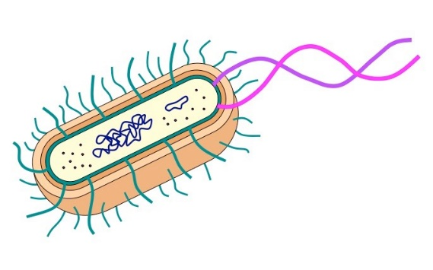
Pre-assessment
Section 1:
Complete the diagram below to show the levels of organisation in multicellular organisms using some the words in the box below:
Cell |  |  |  |  |  | Organ System
Organism | Species | Membrane
Organ | Tissue | Nucleus
2. Using the diagram, identify if the statements are true or false.
Statement | T/F
The letter A identifies the cell wall. It is responsible for maintaining the shape of the cell and protection
The letter B is labelling the nucleus. This is where the DNA is stored in the bacterial cell.
Letter C represents the cytoplasm. This is where the energy is released in the cell.
The letter D identifies the cell membrane. It is the part of the cell that allows substances to diffuse into and out of the cell
A
B
C
D
3. This is a paragraph about what happens to the oxygen in our lungs when we breathe in. Complete the paragraph by filling in the missing words using some of the words in the box.
oxygen | higher | carbon dioxide | air | bronchiole
diffusion | lungs | alveoli | lower | blood
When we breathe in, the air goes to the tiny air sacs called ___________ in our lungs. This is where the gas exchange takes place.
When we breathe in, the _________ in the air in our lungs is at a much ___________ concentration that the oxygen in our blood. For this reason, it will move by ____________ from the high concentration in the _________, to the low concentration in the _______________.

Slide 7
Pre-assessment
Section 1 continued:
4. State the role of teeth in digestion.
_______________________________________________________________________________
_______________________________________________________________________________
5. Name as many food groups as you can.
_______________________________________________________________________________
_______________________________________________________________________________
6. Identify one part of the digestive system and describe its function.
_______________________________________________________________________________
_______________________________________________________________________________
_______________________________________________________________________________
_______________________________________________________________________________

Slide 8
Pre-assessment
Section 2:

Slide 9
Reading Task

Slide 10
Glossary
Crop – a plant that is grown as food; also, an amount of such a plant harvested at one time.
Diversity – the variety of different species of organisms occupying the same habitat. Higher diversity indicates there are more species present in an area.
DNA isolation – a technique used to separate DNA from the rest of a cell’s contents. Cells are first broken apart to reach that DNA in the nucleus. Then the DNA is separated from the rest of the cell parts using chemicals that force the DNA to clump together. Finally, the unwanted cell parts are washed away, leaving only DNA.

Slide 11
Glossary
Foodborne pathogens – bacteria, viruses or other microorganisms that grow on food and can cause illness in the humans who eat them. The Food and Drug Administration (FDA) tests for common foodborne pathogens like E. coli and Salmonella in commercially available food.
Micronutrients – vitamins and nutrients that organisms need in very small amounts. Examples are calcium, iron, zinc, potassium, vitamin K, vitamin C and manganese.
Veggie – plant growth chamber on the International Space Station where light and airflow can be automatically controlled.
Task 1: Questions for the Video
Q1: Why is it important for rugby players to have a healthy diet?
__________________________________________________________________________________________________________________________________________________________________
Q2: What are some foods that are important for rugby players to include in their diet?
__________________________________________________________________________________________________________________________________________________________________
Q3: How does eating a balanced diet help rugby players with their performance on the field?
__________________________________________________________________________________________________________________________________________________________________
Q4: Why is it important for rugby players to stay hydrated?
__________________________________________________________________________________________________________________________________________________________________
Q5: Why should rugby players limit sugary drinks and snacks in their diet?
__________________________________________________________________________________________________________________________________________________________________
Core Knowledge
Answer the core knowledge question below in full sentences
1._________________________________________________________________________________________________________________________________________________________________
2. _______________________________________________________________________________
_________________________________________________________________________________
3. _______________________________________________________________________________
_________________________________________________________________________________

Slide 12
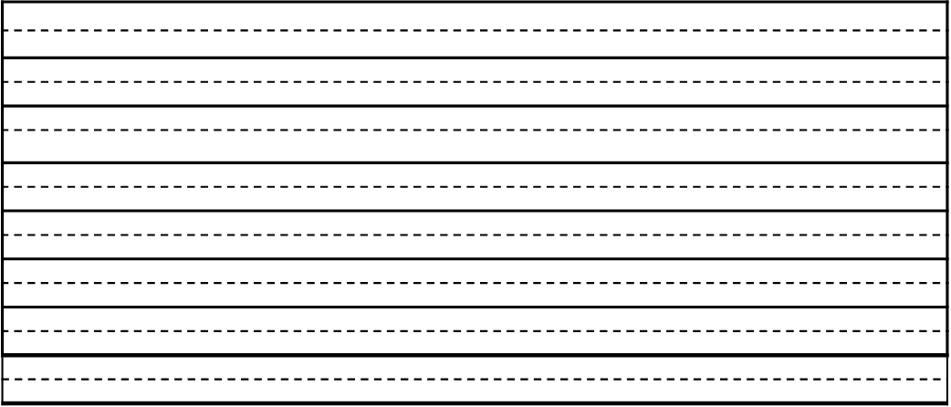
Additional space

Slide 13
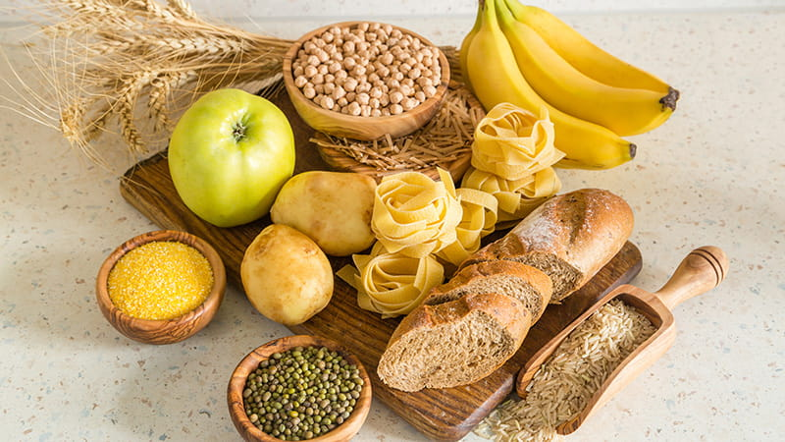
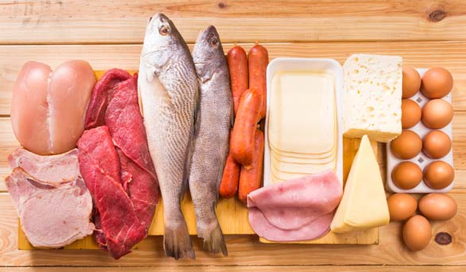
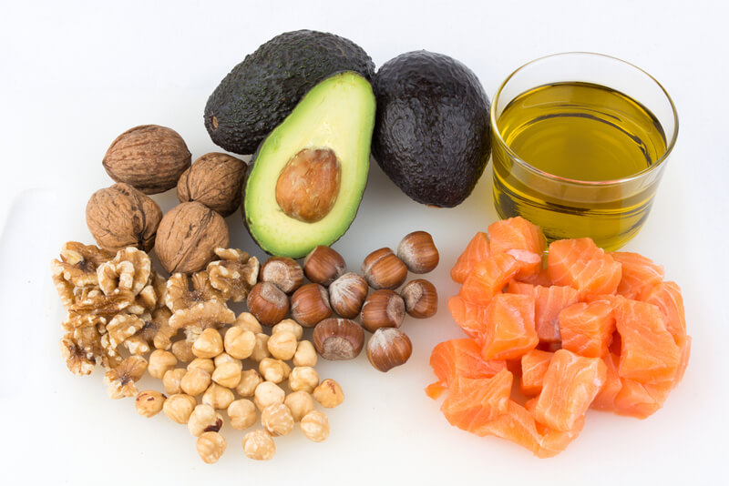
Date: ________________
Is fast food bad for you?
Core Knowledge
By the end of this lesson, you will know:
Carbohydrates are the main source of energy in our diet.
Lipids (fats and oils) are needed for energy, insulation and to make the membranes of cells.
Proteins are needed to help us grow and repair parts of our body.
Academic Language SEE IT SAY IT Write it
Word | Definition
 | Are made up of sugar molecules joined together in long chains.
 | A word used to describe fats and oils
 | Compounds made up of amino acid molecules.
Lesson content
Food Groups
There are lots of nutrients that are essential to our survival.
In this lesson, we are going to focus on the main three.
Carbohydrates
Provide energy for things like movement and to keep us warm
Proteins
Needed to make new cells and repair damage to tissues, such as muscles
Lipids (fats and oils)
Provide energy and are used to make things in the body like cell membranes

Slide 14
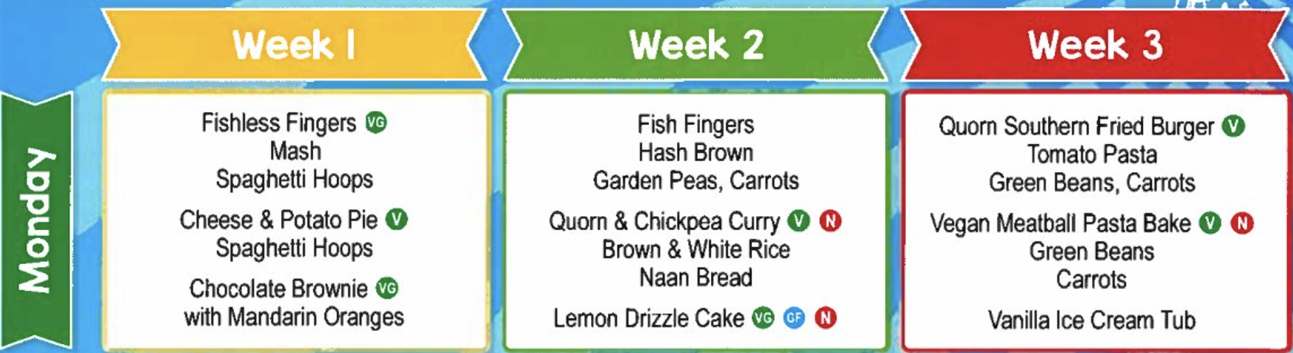
SLOP
What is the function of a carbohydrate?
Give an example of a source of carbohydrate
What is the function of protein?
Give an example of a source of protein
What is the function of fat?
Give an example of a source of fat
Application of knowledge
Task 1:
Here is a menu from a primary school
Evaluate the menu for each day.
Consider whether the daily offering has the correct balance of protein, carbohydrates and fats.
Week 1:
Week 2:
Week 4:
Task 2:
Pick one week to change the menu in an effort to improve the balance.
________________________________________________________________________________
________________________________________________________________________________________________________________________________________________________________________________________________________________________________________________________________________________________________________________________________________________________________________________________________________________

Slide 15
Core Knowledge
Answer the core knowledge question below in full sentences
1.__________________________________________________________________________________________________________________________________________________________________________________________________________________________________________________
2. _______________________________________________________________________________
__________________________________________________________________________________________________________________________________________________________________
3. _______________________________________________________________________________
__________________________________________________________________________________________________________________________________________________________________
Additional space

Slide 16
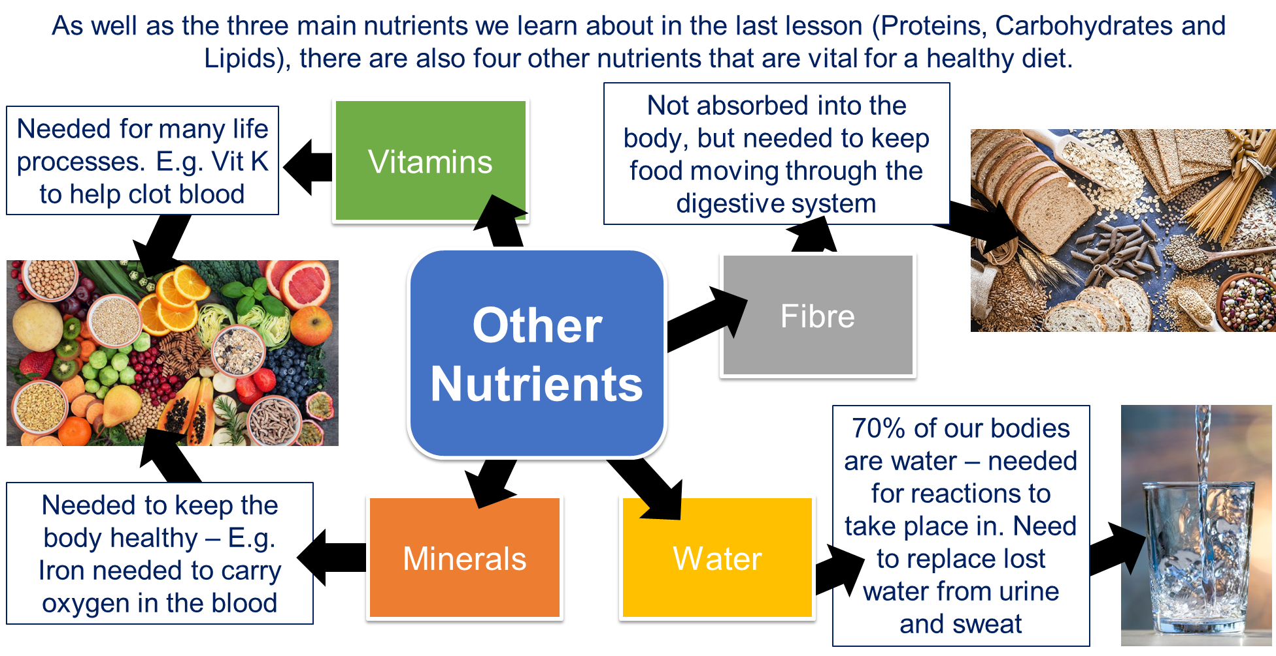
Date: ________________
Why do I need fibre in my diet?
Core Knowledge
By the end of this lesson, you will know:
Vitamins and Minerals are needed to life process and to keep the body healthy.
Dietary fibre is needed to keep food moving through the digestive system – keeping it healthy
Water is needed for reactions to take place in the body.
Academic Language SEE IT SAY IT Write it
Word | Definition
 | A group of nutrients that are needed in very, very small amounts for the body but are essential for our system.
 | A naturally occurring, inorganic substance, with a characteristic chemical composition and atomic structure
 | Plant material that cannot be digested by the human body.
Lesson content
Other nutrients

Slide 17
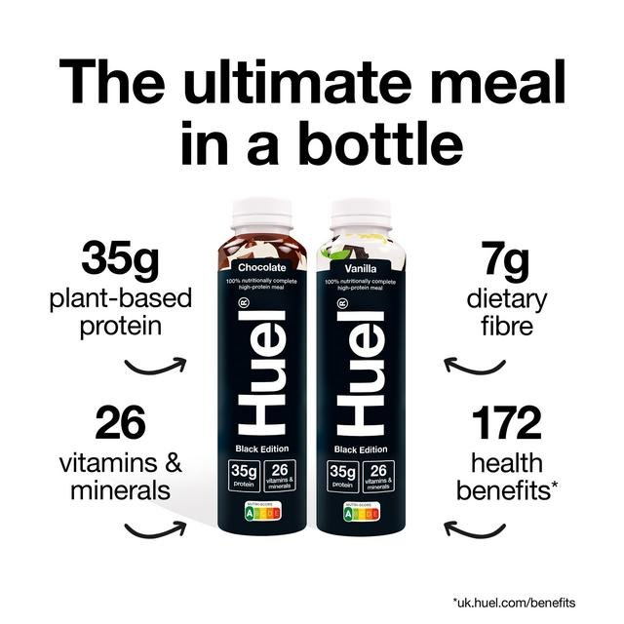
SLOP: Complete the table
Task 1:
Nutrient | Why do we need it? | What foods is it found in?
Water
Vitamins
Minerals
Fibre
Application of Knowledge
Task 1: Evaluate the benefits of drinking 'a meal in a bottle' such as Huel.
What parts of a balanced diet does Huel meet?
Task 2: Name anything missing from the information you have seen
Task 3: How have Huel catered to many different dietary requirements?
Task 4: Why do you think this drink became so popular so quickly?

Slide 18
Core Knowledge
Answer the core knowledge question below in full sentences
1.__________________________________________________________________________________________________________________________________________________________________________________________________________________________________________________
2. _______________________________________________________________________________
__________________________________________________________________________________________________________________________________________________________________
3. _______________________________________________________________________________
__________________________________________________________________________________________________________________________________________________________________
Additional space

Slide 19
Additional space

Slide 20


Daily Energy Requirements in a Healthy Diet
Date: ________________
How many calories do I need a day?
Core Knowledge
By the end of this lesson, you will know:
In general, men need more energy in their diet (2500 kcal) than women (2000 kcal).
Your lifestyle and where you live will have an impact on how much energy you need in your diet.
How to do calculations of energy requirements in a health daily diet.
Academic Language SEE IT SAY IT Write it
Word | Definition
 | A unit of measure of energy
 | A unit of measurement used to show how much energy there is in food
 | A quantity that is conserved - it cannot be created or destroyed
Lesson content
Remember, food is an example of a chemical energy store
There is a certain amount of energy your body needs in a day for you to function.
When we describe the amount of energy food has, we talk about kilocalories (kcal) or kilojoules (kJ).
In conversation, we often refer to kilocalories as calories.
The image shows the average daily kcal for men and women as recommended by the NHS.
Women need approximately 2000 kcal per day
Men need approximately 2500 kcal per day

Slide 21
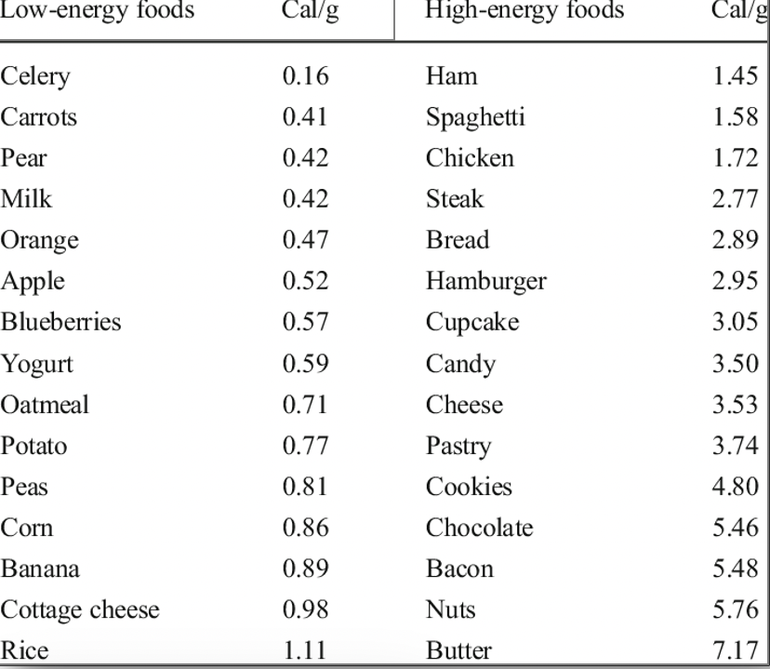
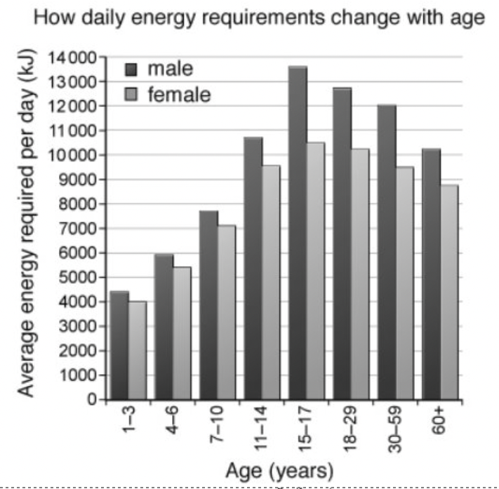
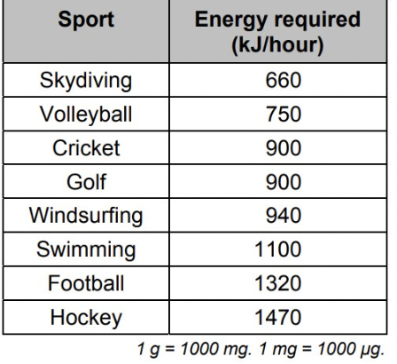
Application of knowledge
Task 1:
The table shows the calories per gram of food eaten.
Here is a list of food that was eaten by 4pm:
Breakfast – 120g banana, 2 x 80g slices of bread,
5g butter, 150g glass of milk
Lunch – Ham and cheese sandwich containing 25g ham,
50g cheese, 2 x 80g slices of bread, 5g butter, a large
(110g) cupcake, glass of water
Snacks – 200g apple, 5 x 12g cookies
Calculate the total calories consumed by 4pm
How many calories would you have 'left' to consume if you are an average male (2500 kcal) and an average female (2000 kcal)
Extension: Evaluate the food eaten by this person by 4pm
Task 2
Using the graph:
Describe how people's energy needs change from birth to old age
Do men or women need more energy?
Suggest a reason why the real amount of energy needed by a female might be more than a male in the same age range
Thin people often develop 'middle aged spread' in their 40s.
This is a polite way of saying that they have started to
become overweight. Suggest why this often happens to
people when they reach 'middle age.'
Using the table:
How much energy is required for 2 hours of swimming?
Explain why the real amount of energy for 2 hours of
swimming may be more or less than the value you calculated in part a.
Explain what happens if a person's food contains more energy than they required.
Explain why a pregnant woman requires more calories than a woman who is not pregnant.

Slide 22
Core Knowledge
Answer the core knowledge question below in full sentences
1.__________________________________________________________________________________________________________________________________________________________________________________________________________________________________________________
2. _______________________________________________________________________________
__________________________________________________________________________________________________________________________________________________________________
3. _______________________________________________________________________________
__________________________________________________________________________________________________________________________________________________________________
Additional space

Slide 23
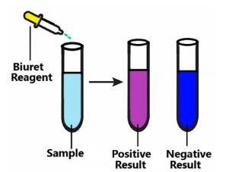
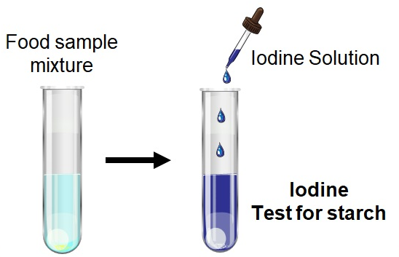
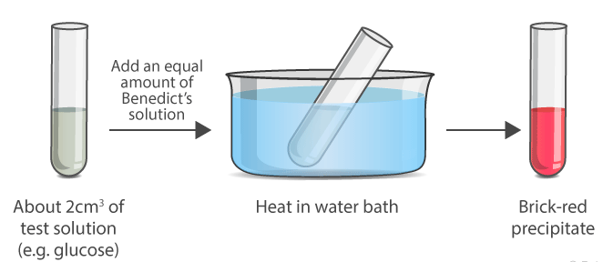
Date: ________________
How do I know what’s in my food?
Core Knowledge
By the end of this lesson, you will know:
Chemicals called reagents can indicate the presence of a specific food substance when they change colour
Academic Language SEE IT SAY IT Write it
Word | Definition
 | A chemical that can be used to indicate if there are certain nutrients in that substance
 | A type of reagent (chemical) that changes colour in the presence of protein
Lesson content
Food Tests
When you were learning about acids and alkalis, you learnt about the role of universal indicator.
Here, it changed colour to identify if a solution was acid or alkali.
In this lesson, we are going to use different chemicals to indicate the presence of some of the different nutrients we have been learning about.
There are three different tests we are going to be looking at.
In each case, if there is a change of ‘colour’, it means that that nutrient is present.
Test for Protein
Mix with a chemical called Biuret. Turns purple if protein present
Test for Starch
Mix with a chemical called iodine. It will go blue/black if present
Test for Sugar
Mix with a chemical called Benedict’s solution and heat. It will go brick red if present

Slide 24
Application of knowledge
Task 1:
Name of the food I am testing: …………………………………………………………………………………………..
 | Test with iodine solution | Test with biuret solution | Test with ethanol solution | Test with Benedict’s solution
Predict What do you think the result of each test will be?
Explain Explain why you think you will see these results.
Now test the food in each tube using the test solutions
Observe What was the result of each test?
Explain Were your predictions correct? If not, how would you explain what you observed?

Slide 25
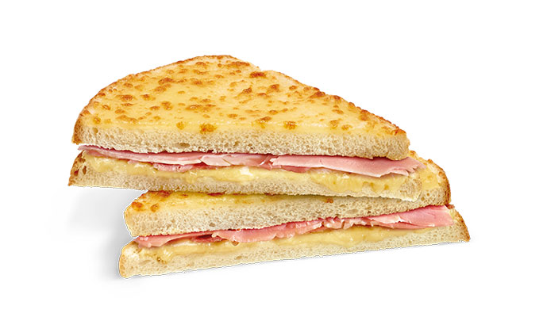
SLOP: Complete the table
Test for... | Chemical | Colour changes from | To…
Starch |  | Orange/brown | Blue/black
Sugar
Protein
Fat
Application of knowledge
Name the food groups present in this ham and cheese toastie.
Describe which tests you would expect a positive result for. What would a positive result look like?

Slide 26
Core Knowledge
Answer the core knowledge question below in full sentences
1.__________________________________________________________________________________________________________________________________________________________________________________________________________________________________________________
_______________________________________________________________________________
__________________________________________________________________________________________________________________________________________________________________ ____________________________________________________________________________________________________________________________________________________________________________________________________________________________________________________________________________________________________________________________________
__________________________________________________________________________________________________________________________________________________________________
Additional space

Slide 27
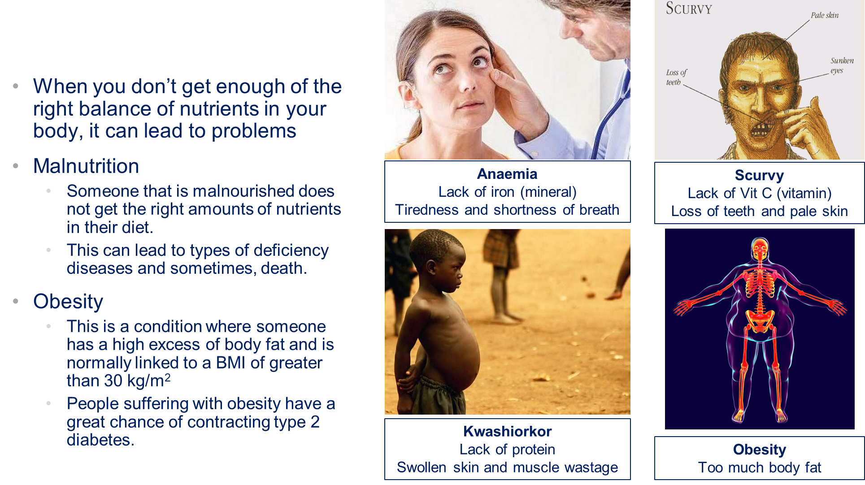
What are the consequences of an unhealthy diet?
Date: __________
Core Knowledge
By the end of this lesson, you will know:
Describe some health issues caused by an unhealthy diet.
Interpret data to identify trends.
Academic Language SEE IT SAY IT Write it
Word | Definition
 | A condition where someone does not get enough of a certain substance in their diet that can make them unwell.
 | Abnormal or excessive fat accumulation that presents a risk to health.
 | Condition when your diet does not contain the right amount of nutrients or too many of the wrong nutrients.
Lesson content

Slide 28
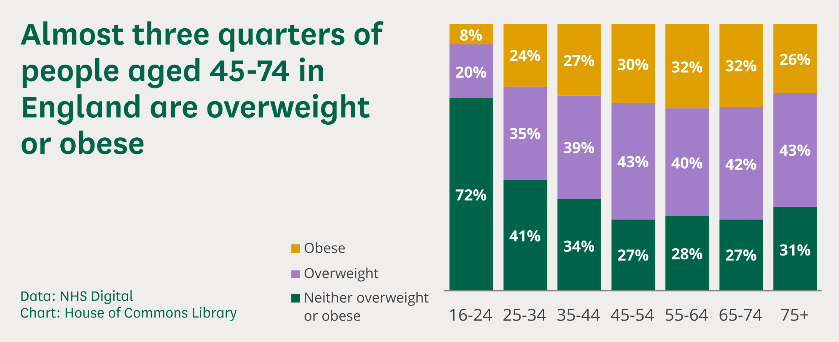
SLOP:
Define the term malnutrition.
What causes scurvy?
Which mineral is deficient in anaemia?
Which disease can develop due to obesity?
Which disease can be caused by a lack of protein?
Application of Knowledge
Questions
1. What conclusion could you draw from the data you are given here about people in the UK.
____________________________________________________________________________
2. Suggest why there is a smaller proportion of overweight and obese people over 75 years old
_____________________________________________________________________________

Slide 29
Core Knowledge
Answer the core knowledge question below in full sentences
1.__________________________________________________________________________________________________________________________________________________________________________________________________________________________________________________
2. _______________________________________________________________________________
__________________________________________________________________________________________________________________________________________________________________
Additional space

Slide 30
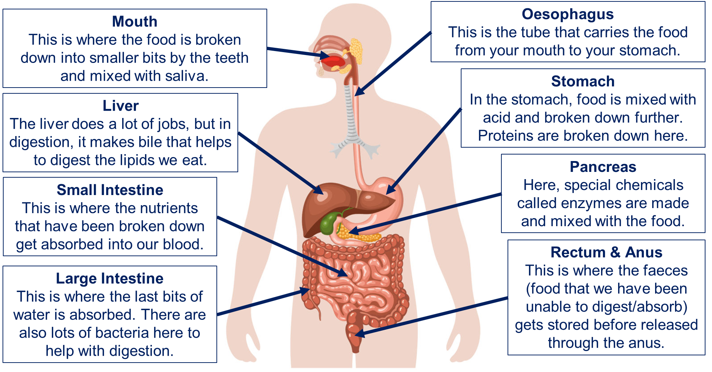
Date: ________________
How does my body break down food?
Core Knowledge
By the end of this lesson, you will know:
Teeth are used to break up food into smaller pieces for digestion.
The oesophagus is the tube that carries the food from the moth to the stomach.
The stomach contains acid that kills bacteria, and churns food to make it smaller.
The small and large intestine is where nutrients and water is absorbed into the blood stream.
Academic Language SEE IT SAY IT Write it
Word | Definition
 | An organ in the body that makes enzymes and insulin, aiding in digestion
 | A biological catalyst (chemical) that breaks down substances into smaller parts
 | The muscular tube that carries food from the mouth to the stomach
Lesson content
The Digestive System

Slide 31
SLOP
State the name of the part of the digestive system where food is broken down by saliva.
State the name of the part of the digestive system where nutrients are absorbed
What happens in the stomach during digestion?
What is absorbed from food in the large intestine?
State the name of the part of the digestive system where enzymes are mixed with food
What is the name of the tube that carries food from the mouth to the stomach?
State the name of the part of the digestive system where faeces is stored
Application of Knowledge
Describe and explain the journey of a ham and cheese toastie through the digestive system.
Include:
Names of organs involved
Digestive processes involved in each organ
Names of the food groups broken down at each stage
How different factors might affect how well the digestive system works – for example, how might poor dental health (tooth loss, tooth decay) affect the initial breakdown of food? What impact would this have on the rest of the digestion process?
_____________________________________________________________________________
_____________________________________________________________________________
_____________________________________________________________________________
_____________________________________________________________________________
_____________________________________________________________________________
_____________________________________________________________________________
_____________________________________________________________________________
_____________________________________________________________________________
_____________________________________________________________________________
_____________________________________________________________________________
_____________________________________________________________________________
_____________________________________________________________________________
_____________________________________________________________________________
_____________________________________________________________________________
_____________________________________________________________________________
_____________________________________________________________________________
_____________________________________________________________________________
_____________________________________________________________________________
_____________________________________________________________________________

Slide 32
Core Knowledge
Find it, fix it! Spot the mistakes and correct them
Food is first chewed by the teeth, this is an example of chemical digestion. | Most digestion takes place in the stomach. | Digestion is the process where large soluble molecules are broken down into small insoluble ones.
Enzymes are needed to help digest food. These are part of the mechanical digestion of food. | The main role of the stomach acid is to digest food after it is swallowed. | The function of the large intestine is to absorb the small, soluble molecules into the bloodstream.
Additional space

Slide 33
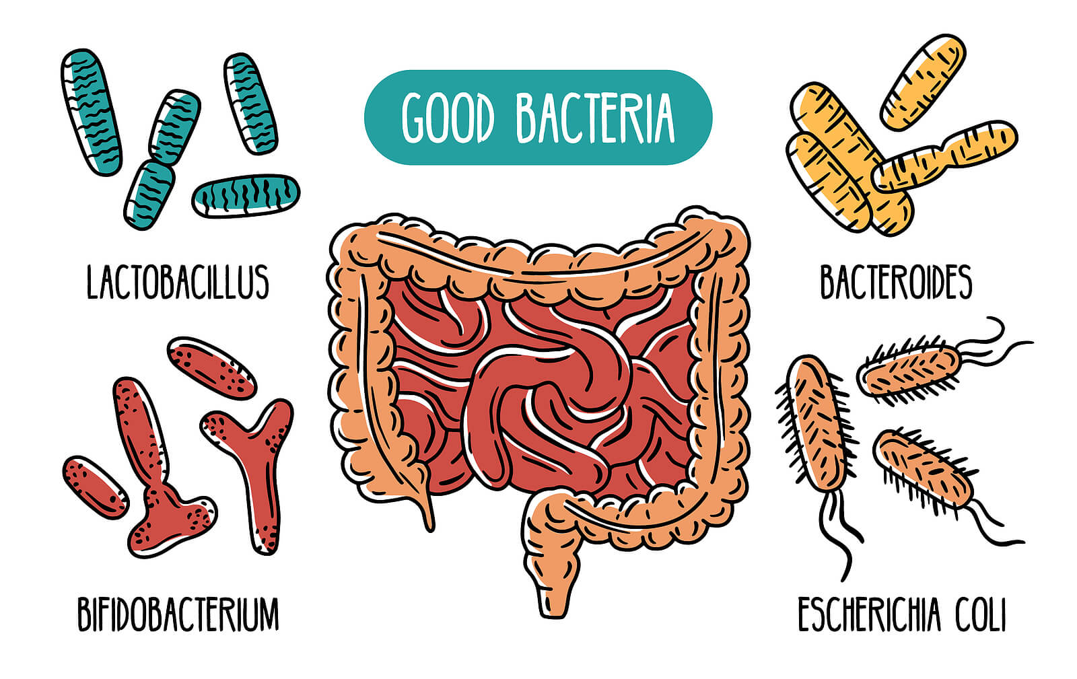
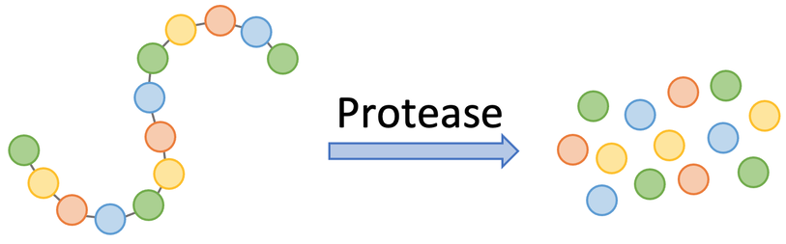
Helping Digestion
Date: ________________
What are the role of enzymes in digestion?
Core Knowledge
By the end of this lesson, you will know:
Describe the role of enzymes in digestion​
State the three main enzymes involved in digestion​
Academic Language SEE IT SAY IT Write it
Word | Definition
 | Enzyme that breaks down carbohydrates
 | Enzyme that breaks down lipids (fats)
 | Enzyme that breaks down proteins
Lesson content
There are two important things within our digestive system that help us break down the food we eat
Enzymes – these are types of chemical made in different parts of our digestive system that break up large molecules into smaller molecules.
Gut bacteria – these are bacteria found in the large intestine that help to break down some of the food we can’t – like beans.
Large food molecule
ENZYME
Smaller food molecules

Slide 34
SLOP:
What is an enzyme?
Where are gut bacteria found?
Name the three types of unicellular organisms
Application of knowledge
Enzyme Practical
Task 1: Draw a table to collect your results
Method:
Put 5 cm³ of the enzyme in to 4 boiling tubes
On the spotting tile, add 2 drops of iodine to each dimple
Add 5 cm³ of the first starch solution to the boiling tube
After 20 seconds, mix and take a small sample, adding two drop to an iodine sample.
Keep doing this until the iodine stops changing colour – this will show when all the starch is broken down.
Record the time, then repeat for the next starch solution.
Testing Enzyme Action:
You are going to test how quickly an enzyme called amylase breaks down starch
You will be given difference concentrations of starch and some amylase enzyme
You will also be given some iodine and a spotting tile.

Slide 35
Task 2: Review the practical activity​
Describe the trend (pattern) in your results​
Name the independent variable in the investigation​
Name the control variables you used in the investigation​
Evaluate your method – what went well? What could have been improved?
Core Knowledge
Answer the core knowledge question below in full sentences
1.__________________________________________________________________________________________________________________________________________________________________________________________________________________________________________________
2. _______________________________________________________________________________
__________________________________________________________________________________________________________________________________________________________________
3. _______________________________________________________________________________
__________________________________________________________________________________________________________________________________________________________________

Slide 36
Additional space

Slide 37
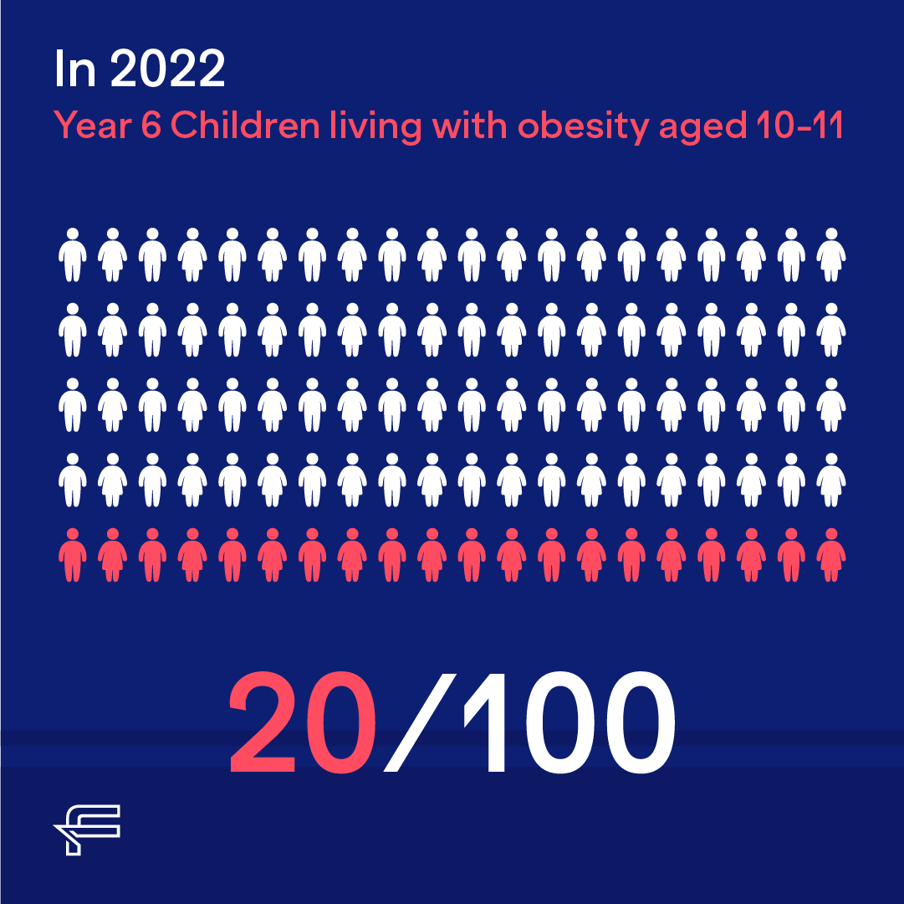
Title: Why is childhood obesity a problem?
Date: ________________
Lesson 10
Core Knowledge
By the end of this lesson, you will know:
Some areas of strength and weakness in this unit
The issues surrounding childhood obesity.
The importance of making informed decisions when choosing a diet.
Academic Language SEE IT SAY IT Write it
Word | Definition
 | Write the name of something
 | Identify something on a diagram
 | Suggest things that are good and things that are bad about something
Lesson content
Childhood Obesity
Let's talk about childhood obesity in the UK. It's essential to stay healthy and happy, so we need to understand this issue. Childhood obesity is when kids weigh more than they should for their age and height. It can lead to health problems like diabetes and heart issues. But don't worry, we can prevent it! Stay active by playing games and sports you love. Eat lots of fruits, veggies, and whole grains – they're yummy and good for you! Limit sugary treats and drinks. Remember, being healthy is about feeling great inside and out! Keep smiling and stay fit!

Slide 38
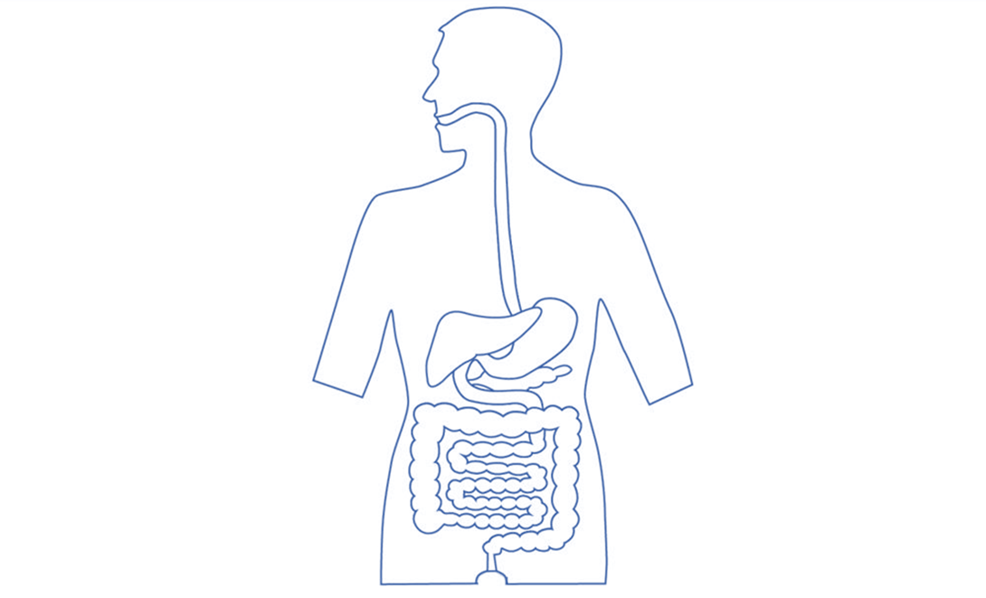
Unit assessment
Draw one line from the part of the digestive system to its function. (2)
Type of drug
Stomach
Small intestine
Effect
This is where the majority of the nutrients are absorbed into the body
This is where the food is stored before it starts getting digested
Churns and mixes the food we eat with acid
This is where the gut bacteria are found
2. From the list below, choose two correct statements about the role of lipids (fats and oils) in our diet. (2)
Statement | ✓
Very high levels are needed to give us the energy we need to function
We need lots of these to help us grow and repair any damage to our body
These are needed to make new cell membranes when we are growing new cells.
We don’t need much, because they provide a lot of energy in small quantities.
3. Name two diseases that you could get from being malnourished.
_______________________________________________________________________________
_____________________________________________________________________________[2]
4, Label the stomach, the large intestine, the pancreas and the oesophagus on the diagram below. (2)

Slide 39
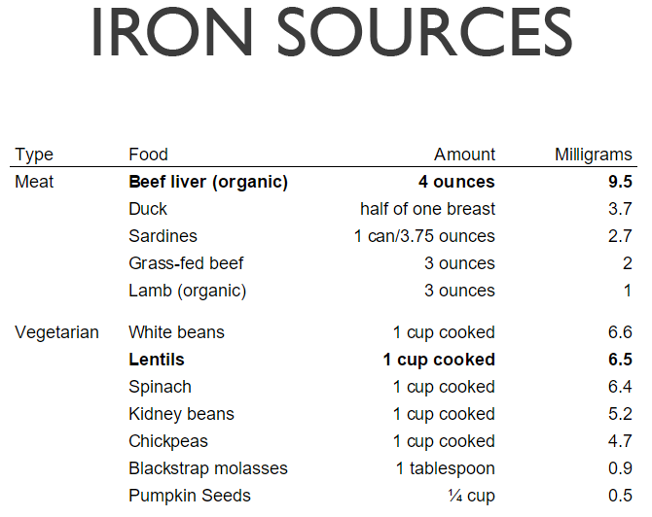
Unit assessment
5. Describe the role of enzymes in digestion.
____________________________________________________________________________________________________________________________________________________[2]
6. Iron is a vital mineral required for a healthy diet. When you do not get enough iron, you can develop a deficiency disease called anaemia.
Look at the information in the table.
Suggest why people that eat a vegetarian diet are more likely to become anaemic.
____________________________________
____________________________________
____________________________________
_____________________________________________________________________ [1]
7. Special chemicals called reagents are often used in investigations to see if certain nutrients are present in food. These chemicals change colour to show if the nutrient you are testing is present.
A group of students wanted to test the pizza they bought in the canteen to see what nutrient were present. The table shows the results they got.
Name of reagent | Nutrient it tests for | Starting colour | Ending colour
Benedicts Solution | Sugars | Blue | Blue
Biuret Solution | Protein | Blue | Purple
Iodine Solution | Starch | Orange | Very dark blue

Slide 40
Q7 Continued
The students concluded:
“The pizza they serve at school is very healthy. It has protein which gives us energy, and it does not have any fat.”
Evaluate the students’ conclusion to their experiment.
_____________________________________________________________________________
_____________________________________________________________________________ _____________________________________________________________________________
_____________________________________________________________________________ _____________________________________________________________________________
___________________________________________________________________________ [3]
8. Suggest something they could do to improve their investigation.
_____________________________________________________________________________
___________________________________________________________________________ [2]

Slide 41
Reading Task
Paragraph title | Extract from Guardian Newspaper Article (16/11/21) Childhood obesity in England soars during pandemic |  | Question
 | 5 10 15 20 | Thousands of children are facing “serious” and even “devastating” consequences as a result of weight gain during the pandemic, experts warn, as “alarming” figures reveal one in four 10- and 11-year-olds in England are obese. Health leaders are calling for a “relentless drive” to boost child health as official NHS data lays bare for the first time how child obesity levels have soared during lockdowns. The National Childhood Measurement Programme, which measures obesity prevalence among school-age pupils in reception class and year 6, found obesity levels rocketed in both year groups by more than 4 percentage points between 2019-20 and 2020-21. Officials said the “significant” single-year increase in prevalence was the highest rise since the programme began 15 years ago. | How many 10– and 11-year-olds in England are obese? Obesity levels have increased by more than 4 percentage points in which year groups that were studied?
 | 22 26 | The figures show that almost one in seven children are already obese when they begin primary school in England. Among reception-aged children, those aged four and five, the rates of obesity rose from 9.9% in 2019-20 to 14.4% in 2020-21. By the time they are aged 10 or 11, more than a quarter are obese, according to NHS Digital. In just 12 months, the rate is up from 21% in 2019-20 to 25.5% in 2020-21. | How many children are obese when they begin primary school? By how much have obesity levels risen in 12 months for children aged 10 or 11?
 | 30 35 40 45 | Dr Max Davie, officer for health improvement at the Royal College of Paediatrics and Child Health, said lockdowns “may have been a key factor” in the rise in obesity rates. “This sharp increase in obesity levels across childhood is alarming,” he said. Caroline Cerny, from the Obesity Health Alliance, said the figures highlighted “the need for a relentless drive on improving children’s health”. “There are several aspects of the pandemic that are likely to have contributed to this increase in child obesity levels,” she said. “But it is very clear from data showing increases in sales of confectionery, biscuits and fast food that junk food companies used the opportunity to keep their unhealthy products centre stage in children’s minds. We need to break the junk food cycle to improve children’s health.” | What may have been a factor in the rise of obesity rates? What did the data show that was a cause in the increase in child obesity levels?

Slide 42
 | 50 56 61 | Boys had a higher prevalence of obesity than girls for both age groups, according to the figures. The proportion of children who were a healthy weight dropped between 2019-20 and 2020-21. Overall, the proportion either overweight or obese was 27.7% in reception and 40.9% in year 6. It means four in 10 children leaving primary school are at increased risk of serious health conditions. Nikki Joule, the policy manager at Diabetes UK, warned of potentially devastating consequences as a result of weight gain during the pandemic. | Who have a higher prevalence of obesity? Boys or girls? What are four in 10 children leaving primary school at increased risk of? What disease are you at increased risk of if you are obese? Where are children twice as likely to be obese?
 | 64 70 75 80 | “This new data, which shows that two-fifths of children aged 10-11 in England are living with overweight and obesity is hugely concerning, and it underlines why urgent action is needed to improve children’s health,” she said. “Living with obesity significantly increases your risk of type 2 diabetes, a condition which is known to have more severe and acute consequences in children and young people.” Children living in poorer areas are twice as likely to be obese than those living in wealthier neighbourhoods, the figures also revealed. In reception-aged children, 20.3% in the most deprived areas are obese compared with 7.8% in the least deprived. In year 6 pupils, the proportion who are obese ranged from 33.8% among those living in the most deprived areas to 14.3% in the least deprived.
 | 83 90 | “Left unchecked, obesity can have other very serious consequences, ranging from diabetes to cancer,” said Amanda Pritchard, NHS England’s chief executive. The scheme “aims to prevent children and young people enduring a lifetime of ill-health”. Tam Fry, the chairman of the National Obesity Forum, said the figures would “likely end any hope” that the government would succeed in its mission to halve childhood obesity in England by 2030. | By how much do the Government want to reduce child obesity by 2030?
Glossary
-Pandemic – a widespread occurrence of an infectious disease over a whole country or the world at a particular time.
-Prevalence – the total number of individuals in a population who have a disease or health condition at a specific period.
-Paediatrics – relating to the branch of medicine dealing with children and their diseases.

Slide 43
Glossary
-Confectionery – sweets
-Type 2 diabetes - Type 2 diabetes is a common condition that causes the level of sugar (glucose) in the blood to become too high. It's caused by problems with a chemical in the body (hormone) called insulin. It's often linked to being overweight or inactive, or having a family history of type 2 diabetes.
-Deprived - suffering a severe and damaging lack of basic material and cultural benefits.
Core Knowledge
Answer the core knowledge question below in full sentences
1.__________________________________________________________________________________________________________________________________________________________________________________________________________________________________________________
2. _______________________________________________________________________________
__________________________________________________________________________________________________________________________________________________________________
Additional space
Additional space

Slide 44
Additional space

Slide 45
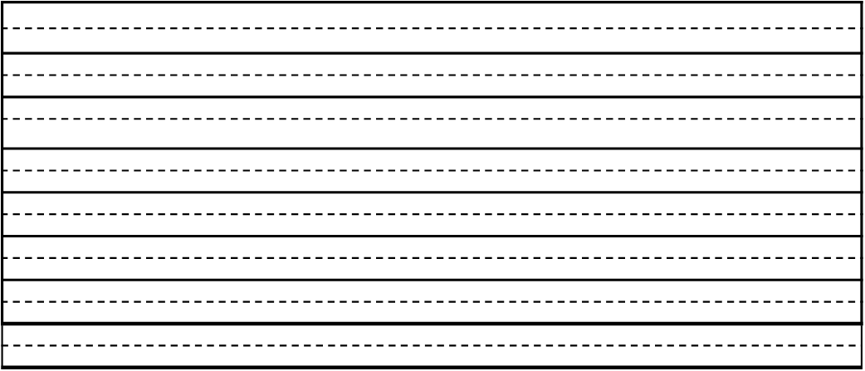
Additional space

Slide 46
Additional space

Slide 47
Additional space

Slide 48
Additional space

Slide 49

Scale Plot Label Axis Trendline

Slide 50
Scale Plot Label Axis Trendline

