Slide 1

BBL1 – Animal Cells
Name: _____________________________________
Class Code: _________________________________
Teacher: ___________________________________

Slide 2



Lesson Title | Career focus | Date when complete
What did Robert Hooke discover? | Biomedical Science
How are animal cells structured? | Microbiologist
How are livings things organised? | Surgeon
How can you observe an animal cell? Part 1 | Cellular biologist
How can you observe an animal cell? Part 2 | Virologist
How is the skeleton structured? | Prosthetic limb designer
How do joints allow our skeleton to move? | Physiotherapist
How do muscles move the skeleton? | Sport scientist
How are muscles and bones connected? | Developmental biologist
What we have we learnt in this unit? | Biomedical Science
SLOP:
SLOP stands for ‘Shed Loads of Practice’. When investigating expertise, the one common factor is a large amount of practice. That practice is most effective when blocked together early on.
Application Tasks:
Demonstrate and deepen understanding of knowledge and disciplinary skills.
Core Knowledge:
Three questions to recap the learning objectives to secure learning for the lesson content.

Slide 3
The Building Blocks of Life
What you should already know | What you will be learning in this unit
Identify, name, draw and label the basic parts of the human body and say which part of the body is associated with each sense. identify that humans and some other animals have skeletons and muscles for support, protection and movement. Identify and name the main parts of the human circulatory system. Describe the life process of reproduction in animals (humans). recognise that living things produce offspring of the same kind, but normally offspring vary and are not identical to their parents. Forces measured in Newtons, measurements of stretching or compression as force is changed. Recognise that some mechanisms, including levers, pulleys and gears, allow a smaller force to have a greater effect. | The function of the cell membrane, cytoplasm, nucleus, and mitochondria. The hierarchical organisation of multicellular organisms: from cells to tissue to organs to systems to organisms. That cells as the fundamental unit of living organisms, including how to observe, interpret and record cell structure using a light microscope. The structure and function of the human skeleton, to include support, protection, movement and making blood cells. That Biomechanics is the interaction between skeleton and muscles, including the measurement of force exerted by different muscle groups. The function of muscles and examples of antagonistic muscles. That scientists using a model (cell diagram) to describe the structure of something we can’t see with the naked eye. The strengths and weaknesses of models. How to identify possible risks to yourself or others. How to Identify a suitable piece of equipment or information source to address a specific question. How to construct and interpret bar charts. How to draw straightforward conclusions from data presented.

Slide 4
Academic language
Word | Definition
Cell | The fundamental unit of living organisms
Cell Membrane | A barrier between the internal cell and it’s surroundings that controls the movement of substances into and out of the cell.
Cytoplasm | A jelly-like fluid inside the cell that is the site of chemical reactions.
Nucleus | A large sub-cellular structure that contains the DNA/Genetic Material needed to control the cell
Mitochondria | A sub-cellular structure that transfers/releases energy for the cell
Unicellular/Multicellular | An organism that is made of one cell only/many kinds of cells
Tissues | A part of an organ that is formed of many similar cells carrying out a similar function.
Microscope | A piece of equipment (apparatus) that is used to see microscope objects – things that are too small to see with the naked eye
Specimen | The terms used to describe something that we might observe under a microscope
Eyepiece Lens | The part of the microscope that the user puts their eye to that magnifies the image of the specimen you are observing
Objective Lens | One of three or four lenses of the microscope that are closest to the specimen to help magnify the image by different amounts
Cover Slip | A very small, thin piece of glass that is put on top of a specimen before viewed under a microscope
Methylene Blue | A chemical that is used to stain animal cells so you can see some of the key features better
Biomechanics | The understanding of how living organisms move, including the structures that help them do so
Antagonistic Muscles | A pair of muscles that work together to bring about movement at a joint (E.g.: Biceps and Triceps)
Tendon | A strong tissue that connects a muscle to a bone
Biomedical science | This is the study of how the human body works, what can go wrong, and how to fix it. It involves looking at cells, tissues, and organs to understand diseases and develop new treatments
Function | The specific job or role that something has.
Specialised cell | A cell that has a unique shape and features to perform a specific job in the body.

Slide 5



What did Robert Hooke discover?
Core Knowledge
By the end of this lesson, you will know:
The potential roles of a Biomedical Scientist
Who Robert Hooke was, and the roles he played in early Biomedical Science
That microscopes can be used to draw images of things that can’t be seen with a naked eye
Academic Language SEE IT SAY IT Write it
Word | Definition
 | A piece of equipment (apparatus) that is used to see microscope objects – things that are too small to see with the naked eye
 | This is the study of how the human body works, what can go wrong, and how to fix it. It involves looking at cells, tissues, and organs to understand diseases and develop new treatments
 | The role or job something has.
Lesson content

Slide 6
Pre-assessment
Section 1:
1. Humans are a type of animal called a mammal. Name two other types of animals.
_________________________________________________________________________
2. Link the senses below with the correct part of the body responsible for that sense:
3. Name two parts of the human circulatory system.
_________________________________________________________________________
4. Tick the box to show which of the following statements are true about the skeletal system:
All animals have a skeleton made of bone.
Bones are attached to muscles to help them move.
Skeletons are needed for protection, support, and movement.
There are over 500 bones in the human body.
Only humans have an internal skeleton.
5. If there was one group of animals that had 25 animals in it, and there was another group that was 4 times bigger, how many animals would be in the second group?
_________________________________________________________________________
6. How do muscles work to move parts of your body?
_________________________________________________________________________
_________________________________________________________________________
7. What is a force, and what units are used to measure forces?
_________________________________________________________________________
8. Name two places on your body that you would find a joint.
_________________________________________________________________________
Sense |  | Part of the Body
Sight |  | Nose
Smell |  | Skin
Taste |  | Ears
Sound |  | Eyes
Touch |  | Tongue

Slide 7
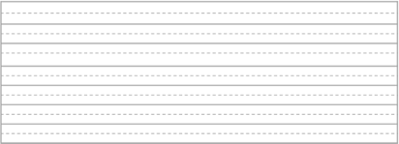
Misconception Correction

Slide 8
Reading Task
Paragraph title | A brief History of Robert Hooke |  | Paragraph summary
 | 5 10 | Robert Hooke was born on the 18th July 1635 in Freshwater on the Isle of Wight. He was one of four children. His father died in 1648, leaving Hooke £40 (a lot of money at the time). He moved to London to be a painter’s apprentice, but he soon left the apprenticeship and instead attended Westminster School. In 1653 Hooke went to Oxford University to study experimental science. | How old was Hooke when he started at Oxford University?
 | 15 20 | In 1655 Hooke began working for the scientist Robert Boyle. He was asked to design and make special air pumps for one of Boyle’s experiments, which eventually led to the discovery of Boyle’s Law. He worked with Boyle for seven years and afterwards, in 1662, at the age of 27, became the Curator of Experiments at the Royal Society. Hooke was elected to the position of ‘fellow’ of the Royal Society in 1663. | In what way did Hooke help with the discovery of Boyle’s Law?
 | 25 | Hooke worked in a wide range of scientific fields, including microbiology, physics and geometry, as well as being a very accomplished architect. He is most famous for his work on elasticity (which led to the discovery of Hooke’s Law) and on microscopy and astronomy. | List all the Scientific areas Hooke was famous for.
 | 30 35 40 | In 1965, Hooke published a book called Micrographia, which became a hugely successful publication. Micrographia means ‘small drawings’ and included many sketches of things Hooke had seen through his microscope, such as a flea, snow, mould and cork. Many people were not convinced by his sketches as they thought it all looked too strange to be real! His work on microbiology (looking at microscopic organisms) led to his description of cells being part of every living thing. This discovery also led Hooke to (correctly) suggest that fossils were the remains of things that had once been alive. | What is the meaning of “micrographia”? What did Hooke say fossils were?

Slide 9
Paragraph title | A brief History of Robert Hooke |  | Paragraph summary
 | 45 50 | On top of being a successful scientist, Hooke was also a well-respected architect. He designed many buildings, although few remain today, and was heavily involved in the rebuilding of London after the Great Fire of 1666. He held the position of Surveyor to the City of London. It was Hooke’s architectural work that made him a wealthy man. Robert Hooke died in London on March 3, 1703. He was 67 years old. | What does an architect do? How many years after the great fire of London did Hooke die?
Glossary
Apprentice: Someone that works for someone and learns how to do the job from them
Curator: Someone that looks after/keeps collections
Fellow: A member of a “learned society”
Publication: A book or article that gets written and shared with the world.
Architect – someone who designs new buildings and the spaces around them, and work on the restoration and conservation of existing buildings
Core Knowledge
Answer the core knowledge question below in full sentences
1._________________________________________________________________________________________________________________________________________________________________
2. _______________________________________________________________________________
_________________________________________________________________________________
3. _______________________________________________________________________________
_________________________________________________________________________________

Slide 10
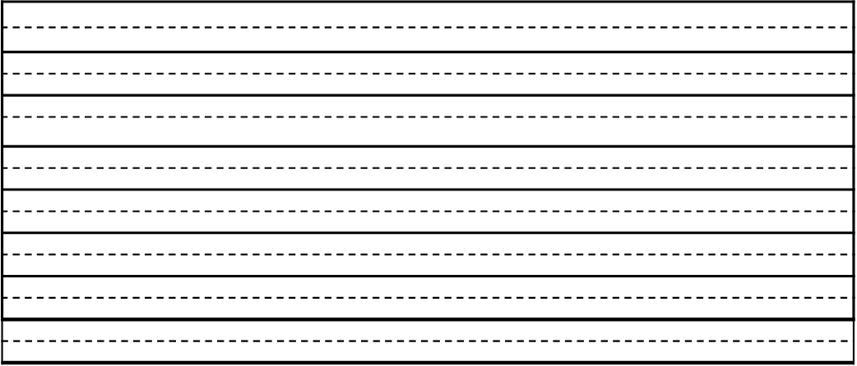
Additional space

Slide 11
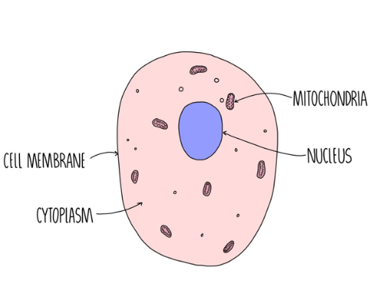
How are animal cells structured?
Core Knowledge
By the end of this lesson, you will know:
The function of the cell membrane.
The structure and function of the cytoplasm.
The function of the nucleus.
The role of the mitochondria.
Academic Language SEE IT SAY IT Write it
Word | Definition
 | A barrier between the internal cell and its surroundings that controls the movement of substances into and out of the cell.
 | A jelly-like fluid inside the cell that is the site of chemical reactions.
 | A large sub-cellular structure that contains the DNA/Genetic Material needed to control the cell
 | A sub-cellular structure that transfers/releases energy for the cell
Lesson content
Welcome to the fascinating world of animal cells! Today, we will embark on a journey to explore the basic structure and functions of these remarkable building blocks of life.
The function of the cell membrane is to control the movement of substances into and out of the cell​.
The cytoplasm is the jelly-like substance found in cells where reactions happen​.
The nucleus is the part of the cell that stores the genetic material of the cell​.
The function of the mitochondria is to transfer energy.

Slide 12
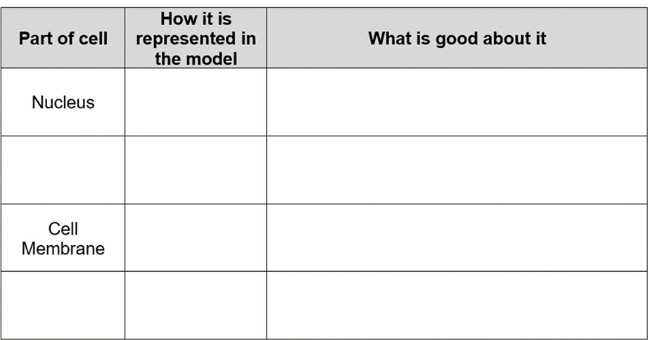
Application of knowledge
What are the main organelles in an animal cell?
What is the function of the cell membrane in an animal cell?
How do animal cells obtain energy to survive?
What is the role of the nucleus in an animal cell?
What is the role of the cytoplasm in an animal cell?
SLOP:
Application Tasks:
Task 1: Model Cell Evaluation
Task 2: Create a detailed analogy comparing the components of an animal cell to parts of a city, school, or any system with distinct parts that work together.
You can discuss your ideas in pairs or small groups.
You must include a comparison for the following parts of the cell;
Nucleus, Cytoplasm, Cell Membrane and Mitochondria.

Slide 13
Core Knowledge
Answer the core knowledge question below in full sentences
1.__________________________________________________________________________________________________________________________________________________________________________________________________________________________________________________
2. _______________________________________________________________________________
__________________________________________________________________________________________________________________________________________________________________
3. _______________________________________________________________________________
__________________________________________________________________________________________________________________________________________________________________
Additional space- Describe the structure of an animal cell (6 marks)

Slide 14
Additional space

Slide 15
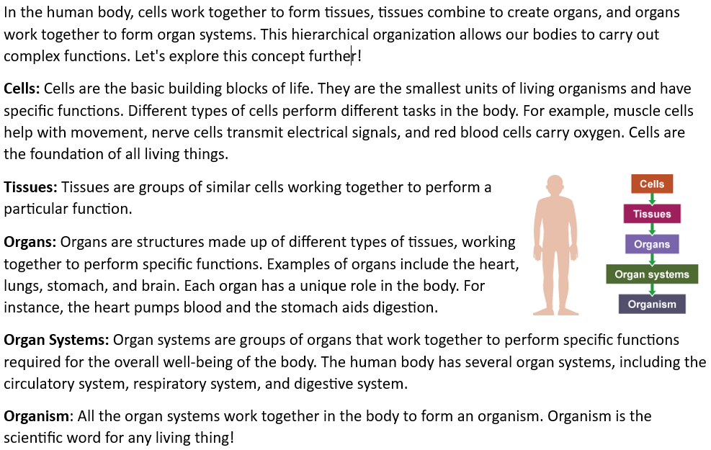
How are livings things organised?
Core Knowledge
By the end of this lesson, you will know:
How multicellular organisms are structured.
The meaning of the terms: cell, tissue, organ, organ system and organism.
Academic Language SEE IT SAY IT Write it
Word | Definition
 | An organism that is made of one cell only/many kinds of cells
 | A part of an organ that is formed of many similar cells carrying out a similar function.
 | A cell that has specific structures to carry out a function.
 | To say what something is like.
Lesson content

Slide 16
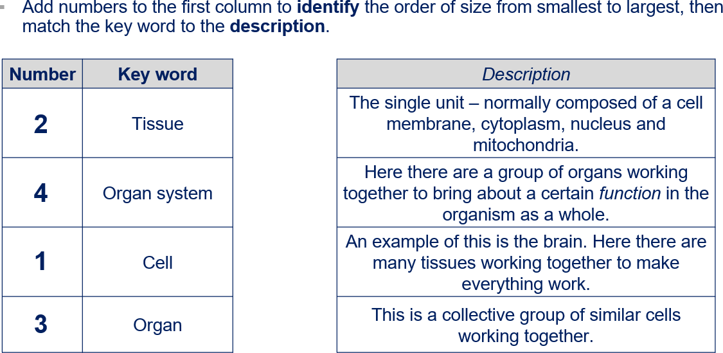
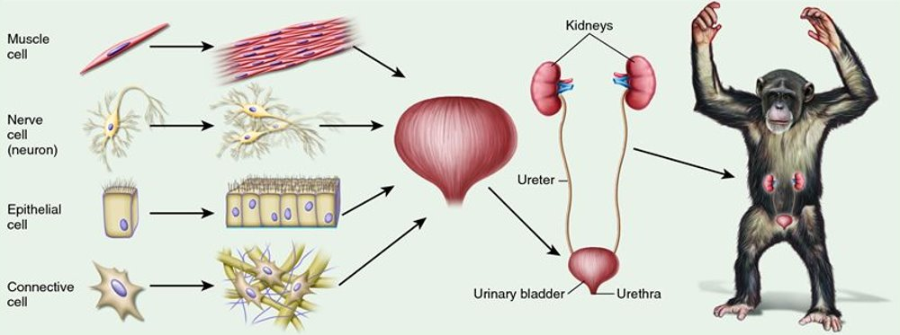
Application of knowledge
What are the different levels of organisation in animals?
What are some examples of different types of animal tissues?
How do organs contribute to the overall function of an animal's body?
Can you name 3 organs in your own body and explain what they do?
What is an organ system, and how does it help animals carry out specific functions?
SLOP:
Application Tasks:
Task 3: Study the diagram on the board.
Use the information in the diagram to describe the function of the muscle cell in the formation of the Chimpanzee as an example of an organism. ​
_________________________________________________________________________________________________________________________________________________________________________________________________________________________________________________________________________________________________________________________________________________________________________________________________________________________________________________________________________________________________________________________________________________________________________________________________________________________________________________________________________________________________________________________________________________________________

Slide 17
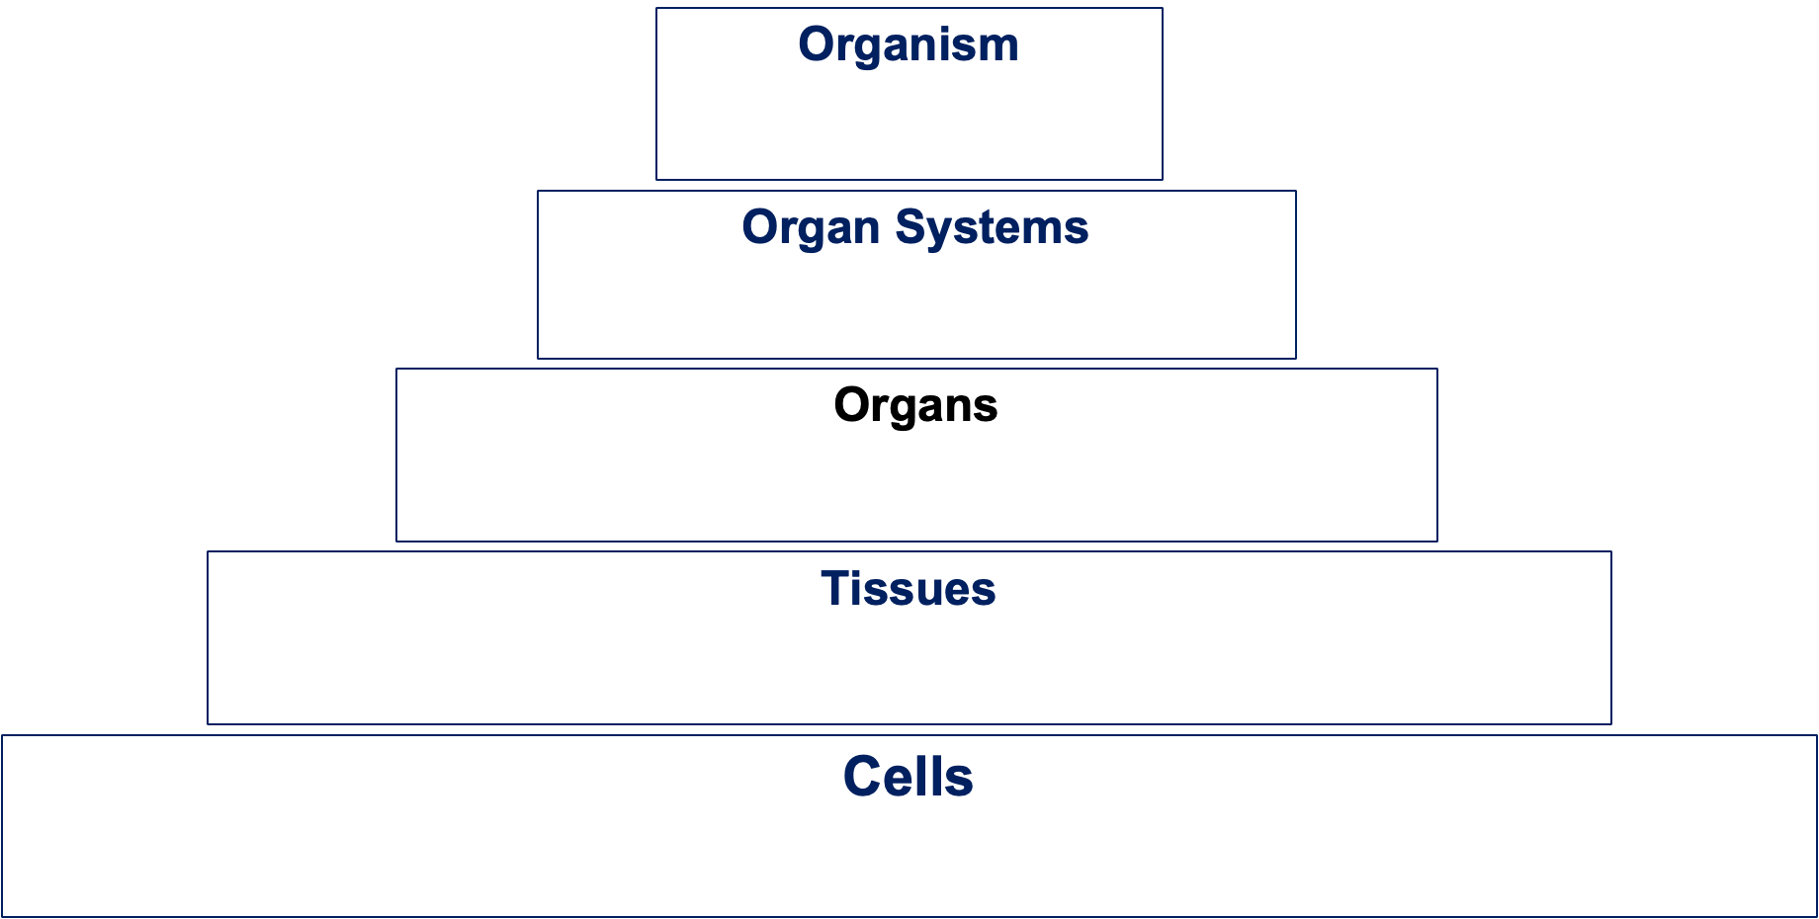
Application of knowledge
Task 4: Decide whether the words on the board are a cell, tissue, organ, organ system or and organism.
Place your choices in the hierarchy table below.

Slide 18
Core Knowledge
Answer the core knowledge question below in full sentences
1.__________________________________________________________________________________________________________________________________________________________________________________________________________________________________________________
2. _______________________________________________________________________________
__________________________________________________________________________________________________________________________________________________________________
3. _______________________________________________________________________________
__________________________________________________________________________________________________________________________________________________________________
Additional space

Slide 19
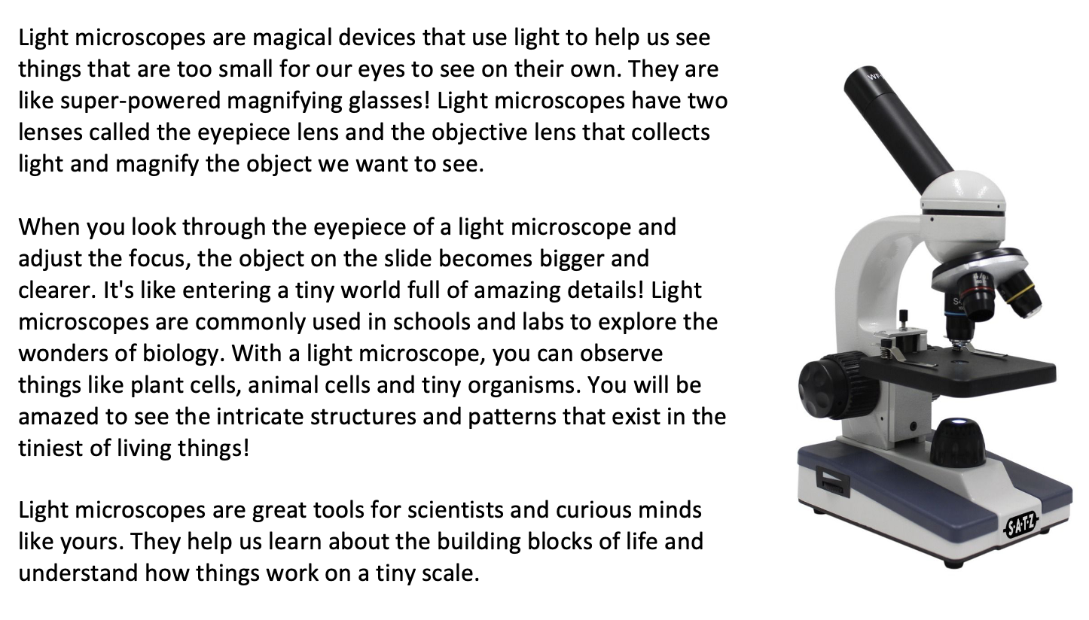
How can you observe an animal cell? (Part 1)
Core Knowledge
By the end of this lesson, you will know:
That a light microscope can be used to view objects that are too small to see with the naked eye
The key parts of the microscope including the: stage, eyepiece lens, objective lens, focussing wheel.
Academic Language SEE IT SAY IT Write it
Word | Definition
 | A piece of equipment (apparatus) that is used to see microscope objects – things that are too small to see with the naked eye
 | The terms used to describe something that we might observe under a microscope
 | The part of the microscope that the user puts their eye to that magnifies the image of the specimen you are observing
 | One of three or four lenses of the microscope that are closest to the specimen to help magnify the image by different amounts
Lesson content

Slide 20
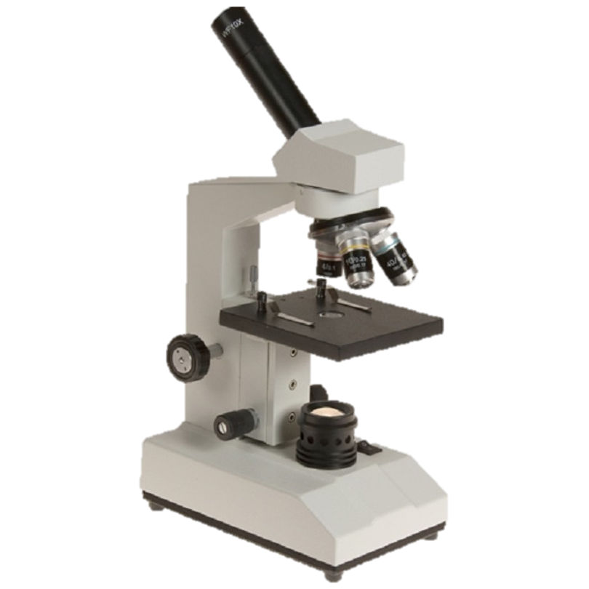
Application of knowledge
How does a light microscope help us see things that are too small for our eyes?
Which parts of a light microscope collect and magnify the light?
Can you name one thing you could look at under a light microscope?
How do you adjust the focus of a light microscope?
What are some safety precautions you should follow when using a light microscope?
SLOP:
Task 2: Label the different parts of the microscope:
Application Tasks
Task 3: You will be given a range of microscope images generated under the light microscope.
For each image you must do the following:
▪Describe how you would adjust the light microscope to make the image easier to see.
▪State any cell organelles that can be seen in the image.
▪You could state an organelle that cannot be seen.

Slide 21
Core Knowledge
Answer the core knowledge question below in full sentences
1.__________________________________________________________________________________________________________________________________________________________________________________________________________________________________________________
2. _______________________________________________________________________________
___________________________________________________________________________________________________________________________________________________________________________________________________________________________________________________
Additional space

Slide 22
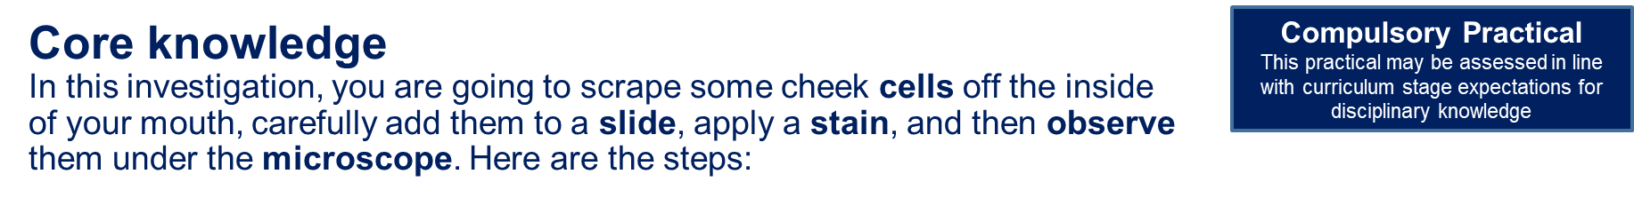
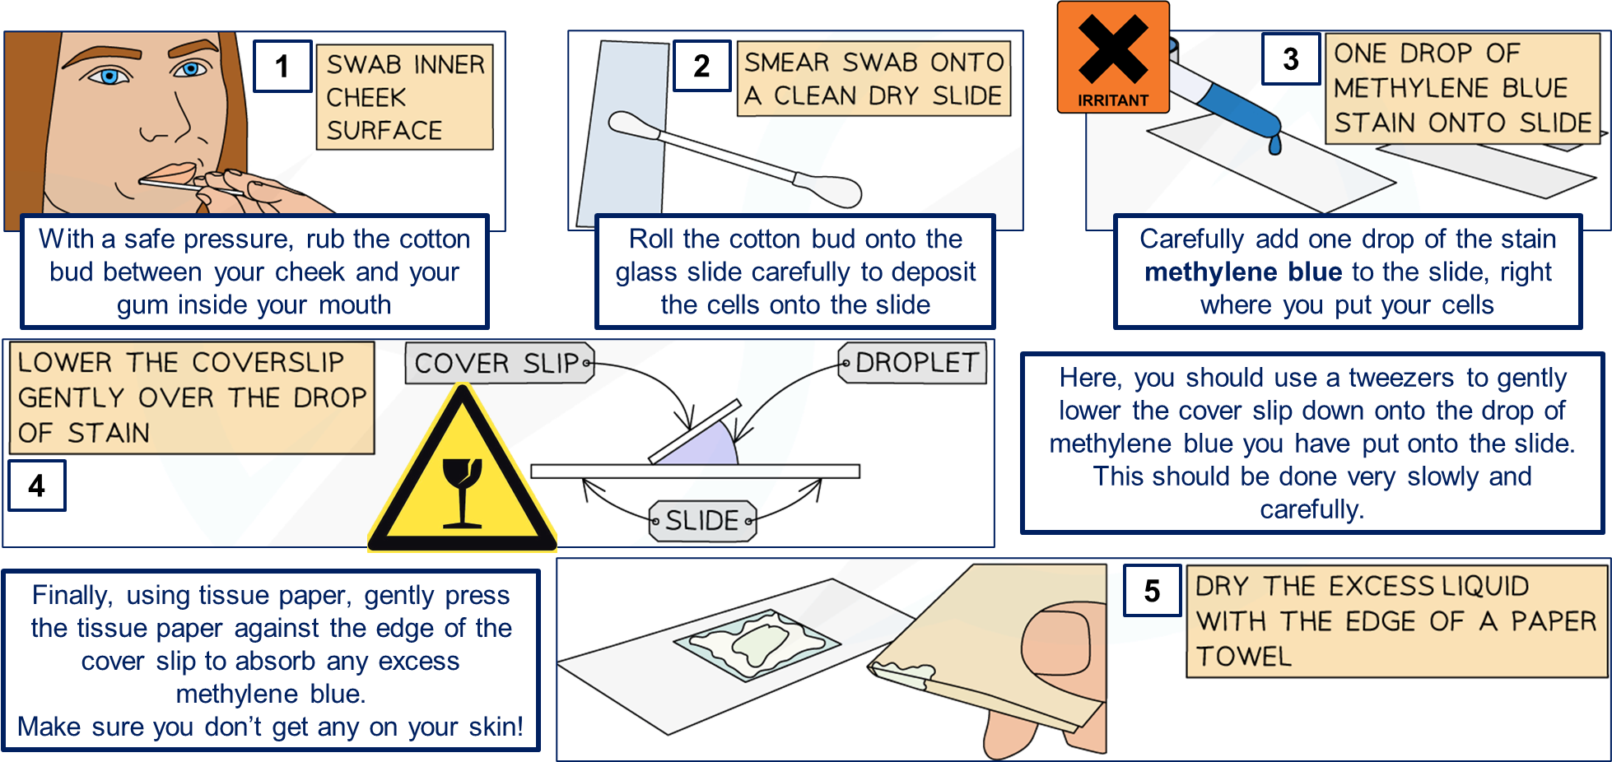
How can you observe an animal cell? (Part 2)
Core Knowledge
By the end of this lesson, you will know:
Cells as the fundamental unit of living organisms, including how to observe, interpret and record cell structure using a light microscope
A light microscope can be used to view objects that are too small to see with the naked eye
Identify the key parts of the microscope to include the: stage, eyepiece lens, objective lens, focussing wheel.
Academic Language SEE IT SAY IT Write it
Word | Definition
 | A piece of equipment (apparatus) that is used to see microscope objects – things that are too small to see with the naked eye
 | The terms used to describe something that we might observe under a microscope
 | The part of the microscope that the user puts their eye to that magnifies the image of the specimen you are observing
 | One of three or four lenses of the microscope that are closest to the specimen to help magnify the image by different amounts
Lesson content

Slide 23
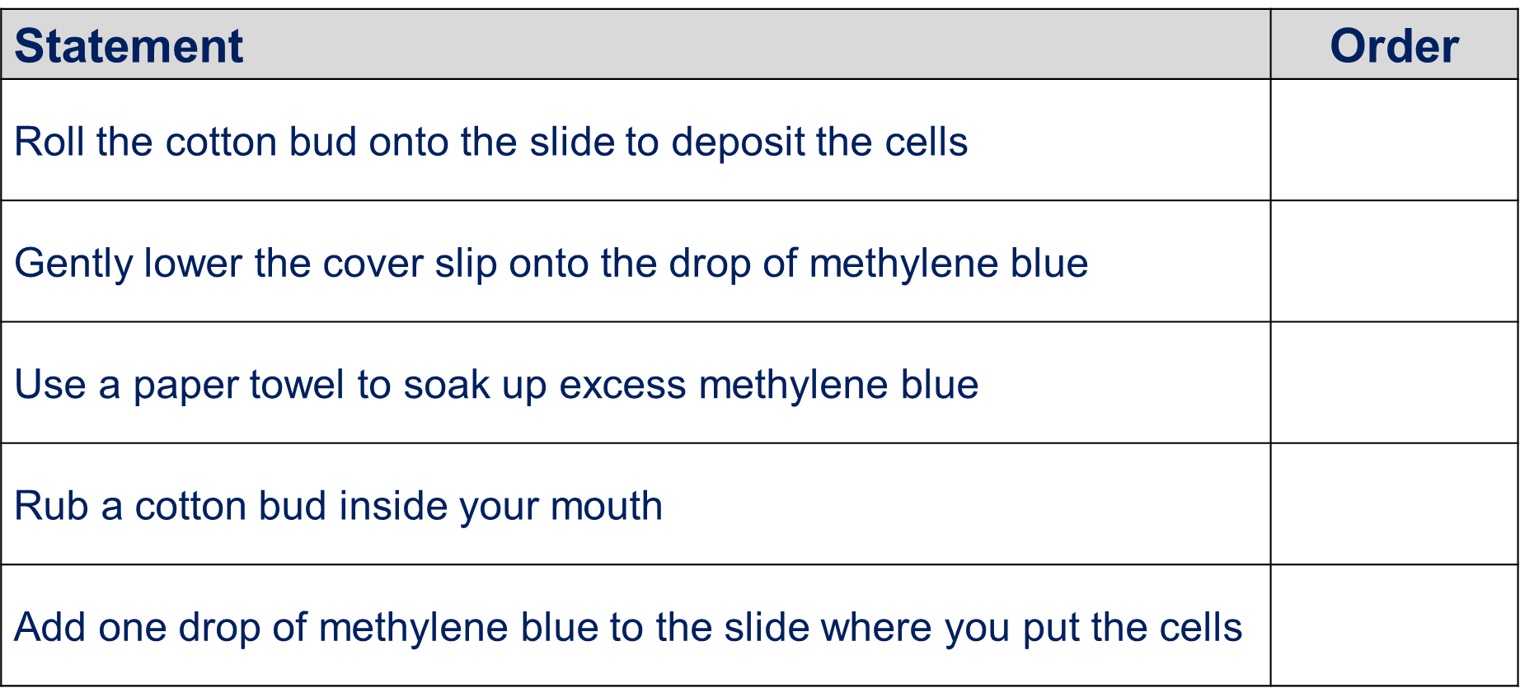
Application of knowledge
Q: What is a microscope?
Q: Why would someone use a microscope to observe cheek cells?
Q: How can cheek cells be obtained for microscopic observation?
Q: What is the purpose of staining cheek cells before observation?
Q: What types of stains can be used to observe cheek cells?
SLOP:
Application Tasks:
Task 3: Here is a method to describe how to make skin cell slides.
You must read through the method carefully and highlight the errors in the method.
Make corrections for the errors you find.
Use a clean cotton ball to gently scrape the inside of your cheek to collect some cells. Avoid pressing too hard to prevent damaging the cells.
Place a small drop of oil in the centre of a clean glass slide. Carefully rub the cotton bud on the slide to transfer the cheek cells into the water drop. Add one or two drops of salt solution or methylene blue stain onto the water drop. These stains help make the cell structures more visible under the microscope. Gently lower a coverslip onto the slide, making sure to avoid adding air bubbles.
Turn on the light microscope and place the slide on the stage. Use the stage clips to move the slide in place. Adjust the eyepiece lens to suit your vision.
Begin with the lowest objective lens (usually 400x). Use the coarse focusing wheel to bring the cells into view. Adjust the focus slowly until the image is sharp. Once the cells are clearly visible, switch to a higher objective lens (100x or 10x) to get a closer look. Use the fine focusing wheel to refine the image.
Look for different parts of the cell, such as the nucleus and cell wall. Draw what you see, labelling the key parts of the cells.
Turn off the microscope, remove the slide, and dispose of it properly. Don’t wash your hands after handling the cells and chemicals.

Slide 24
Core Knowledge
Answer the core knowledge question below in full sentences
1.__________________________________________________________________________________________________________________________________________________________________________________________________________________________________________________
2. _______________________________________________________________________________
__________________________________________________________________________________________________________________________________________________________________
3. _______________________________________________________________________________
__________________________________________________________________________________________________________________________________________________________________
Additional space

Slide 25
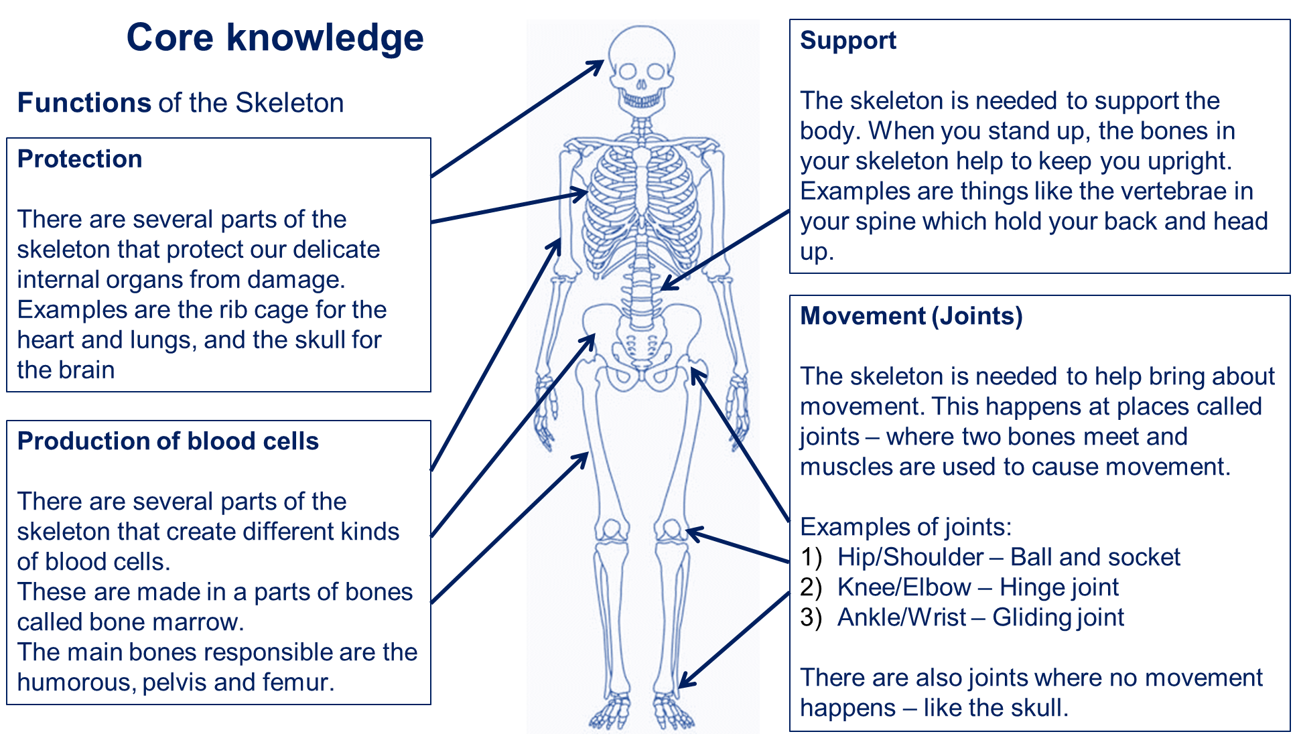
How is the skeleton structured?
Core Knowledge
By the end of this lesson, you will know:
The structure and function of the human skeleton, to include support, protection, movement and making blood cells
The three main functions of the human skeleton are protection, production of blood cells and support
The place where two bones meet is called a joint
Academic Language SEE IT SAY IT Write it
Word | Definition
 | The understanding of how living organisms move, including the structures that help them do so
 | The role or job something has
 | To say what something is like
Lesson content

Slide 26
Application Tasks:
What is the skeleton?
How many bones are there in the human body?
What is the strongest bone in the body?
What is the smallest bone in the body?
What is the purpose of the skull?
What are joints?
What is the purpose of the ribcage?
SLOP:
You are a prosthetic limb designer, you must design a prosthetic limb for a patient who has lost a leg.
The limb must:
Support the weight of the body.
Allow movement, especially at the knee joint.
Protect the remaining part of the leg from further injury or strain.
Task Steps | Tick
Step 1: Research the structure of the human leg, focusing on bones like the femur, tibia, and fibula, and the knee joint.
Step 2: Sketch your prosthetic design, labelling the key parts that mimic the human skeleton's function.
Step 3: Write a paragraph explaining how your design meets the three main functions of the skeleton: support, movement, and protection of remaining tissues.
Step 4: Be ready to share your design to the class, explaining your choices.

Slide 27
Core Knowledge
Answer the core knowledge question below in full sentences
1.__________________________________________________________________________________________________________________________________________________________________________________________________________________________________________________
2. _______________________________________________________________________________
__________________________________________________________________________________________________________________________________________________________________
3. _______________________________________________________________________________
__________________________________________________________________________________________________________________________________________________________________
Additional space

Slide 28
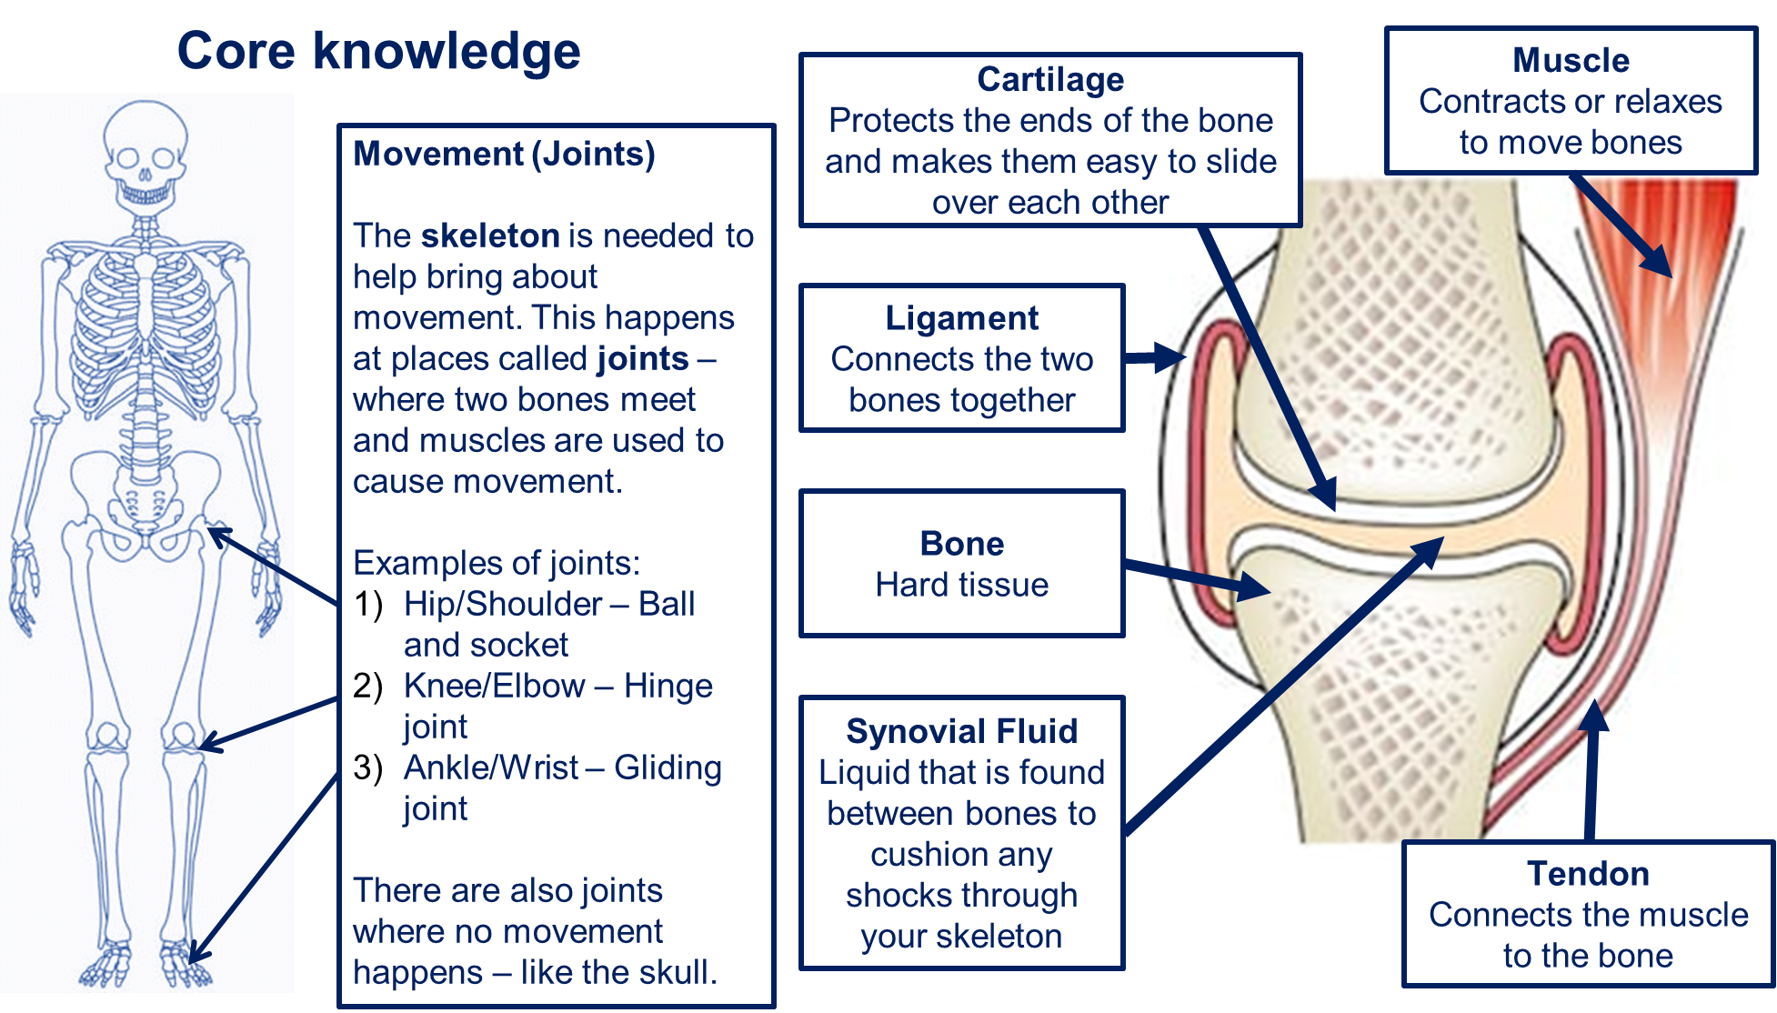
How do joints allow our skeleton to move?
Core Knowledge
By the end of this lesson, you will know:
The interaction between skeleton and muscles, including the measurement of force exerted by different muscle groups
Muscles are attached to bones with tendons to help them move
A muscle will contract to exert a force on a bone and bring about movement around a joint
Academic Language SEE IT SAY IT Write it
Word | Definition
 | The understanding of how living organisms move, including the structures that help them do so.
 | A strong tissue that connects a muscle to a bone
 | connects two or more bones together.
Lesson content

Slide 29
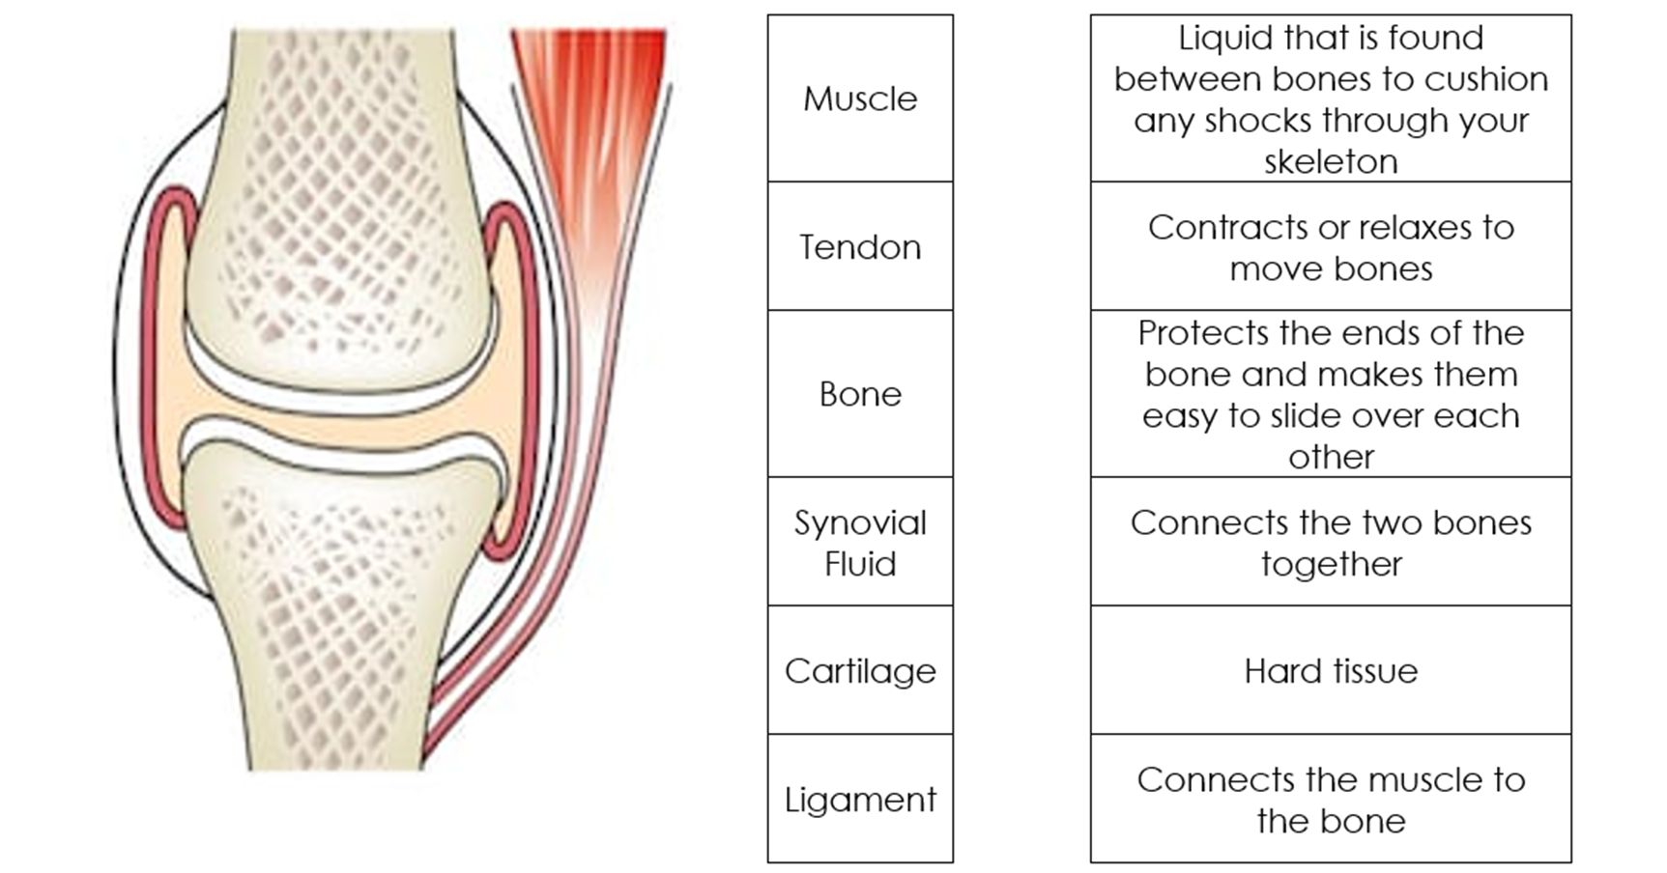
Application Tasks:
Draw a line to connect the part of the joint to the correct label and then another line to the correct definition
Q: What is a joint?
Q: What are the three main types of joints?
Q: What is an example of a hinge joint and how does it work?
Q: What are some examples of ball-and-socket joints?
Q: How can we keep our joints healthy?
SLOP:
Select a Joint – As guided on your table.
Measure Range of Motion - Using a protractor or ruler, measure the range of motion for your selected joint. For example, how far can your elbow bend (flexion) or straighten (extension)?
Identify Muscles Involved - Discuss and record which muscles are responsible for moving the joint in the ways you measured. For instance, your biceps contract to flex the elbow.
Compare with Peers - Compare your joint measurements with those of your classmates. Consider why there might be differences in flexibility or range of motion.
Record Your Findings - Document your measurements, muscle groups involved, and the potential relevance to physical therapy on the provided table.

Slide 30
Application Tasks:
Joint | Type of Joint | Type of movement | Degrees of Movement | Can you name a single muscle involved?
Knee
Elbow
Hip
Wrist
Ankle
Shoulder

Slide 31
Core Knowledge
Answer the core knowledge question below in full sentences
1.__________________________________________________________________________________________________________________________________________________________________________________________________________________________________________________
2. _______________________________________________________________________________
__________________________________________________________________________________________________________________________________________________________________
3. _______________________________________________________________________________
__________________________________________________________________________________________________________________________________________________________________
Additional space

Slide 32
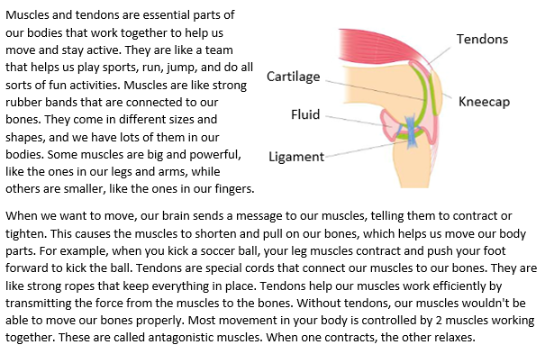
How do muscles move the skeleton?
Core Knowledge
By the end of this lesson, you will know:
- That muscles are attached to bones with tendons to help them move
- That a muscle will contract to exert a force on a bone and bring about movement around a joint
- That most movement in the body is controlled by two muscles that work together – these are called antagonistic muscles
Academic Language SEE IT SAY IT Write it
Word | Definition
 | The understanding of how living organisms move, including the structures that help them do so
 | A pair of muscles that work together to bring about movement at a joint (E.g.: Biceps and Triceps)
 | A strong tissue that connects a muscle to a bone
Lesson content

Slide 33
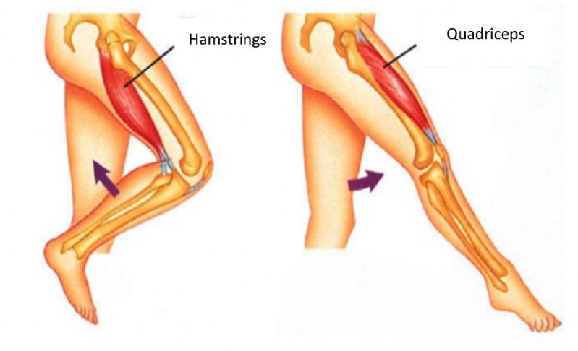
Application of knowledge
Task 1: SLOP
What is the main job of muscles in our bodies?
Name the 2 muscles in the upper arm.
What role do tendons play in the body?
What is an antagonistic muscle pair?
Task 2:
The diagram shows the two muscle groups responsible for the movement of the lower leg forward and backward.
Use the information given in the diagram to describe how these are an example of an antagonistic pair.
________________________________________________________________________________________________________________________________________________________________________________________________________________________________________________________________________________________________________________________________________________________________________________________________________________________________________________________________________________________________
Task 3: Carry out the practical and record your results in the table below:
Task 4: Use your results to plot a bar chart on the next page.
Remember to SPLAT your graph.
S cale
P lot
L abel
A xis
T rendline
The independent variable should be on the x-axis, the mean force should be on the y-axis.
Muscle | Maximum force exerted (N)
Muscle | Trial 1 | Trial 2 | Trial 3 | Mean
Bicep
Tricep
Forearm

Slide 34

Scale Plot Label Axis Trendline

Slide 35
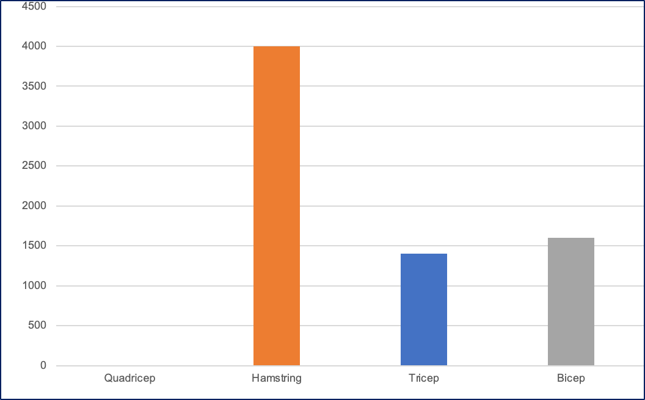
Application of knowledge
A student measured the force exerted by different pairs of antagonistic muscles using a Newton scale.
1. Their quadricep exerted a force of 2000N. Complete the graph to show this, including adding axis labels.
2. Identify which antagonistic pair exerts the highest combined force.
3. Considering the function of this muscle pair, suggest why this is.

Slide 36
Core Knowledge
Answer the core knowledge question below in full sentences
1.__________________________________________________________________________________________________________________________________________________________________________________________________________________________________________________
2. _______________________________________________________________________________
__________________________________________________________________________________________________________________________________________________________________
3. _______________________________________________________________________________
__________________________________________________________________________________________________________________________________________________________________
Additional space

Slide 37
Additional space

Slide 38
How are muscles and bones connected?
Core Knowledge
By the end of this lesson, you will know:
The structure and function of the human skeleton including support, protection, movement and making blood cells.
How the muscles and skeleton interact.
The function of muscles and examples of antagonistic muscle pairs.
Academic Language SEE IT SAY IT Write it
Word | Definition
 | To be able to establish or indicate what something is.
 | To say what something is like.
 | The role or job something has.
Lesson content
To be prefilled by teacher from PowerPoint*

Slide 39
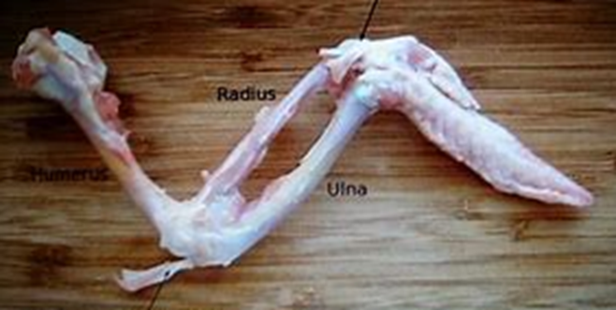
Application of knowledge
Task 1: SLOP
What is the name of the bones found in the lower arm?
Why do muscles need to work together to bring about movement?
What is the role of a tendon?
Why are dissections useful to scientists?
What safety precautions do you need to take when carrying out a dissection?
Task 2: Label what each part of the chicken wing represents in the human arm.
Task 3: Complete a risk assessment for the dissection.
Hazard | Risk | Control Measures
1.
2.
3.

Slide 40
Core Knowledge
Answer the core knowledge question below in full sentences
1.__________________________________________________________________________________________________________________________________________________________________________________________________________________________________________________
2. _______________________________________________________________________________
__________________________________________________________________________________________________________________________________________________________________
3. _______________________________________________________________________________
__________________________________________________________________________________________________________________________________________________________________
Additional space

Slide 41
Additional space

Slide 42
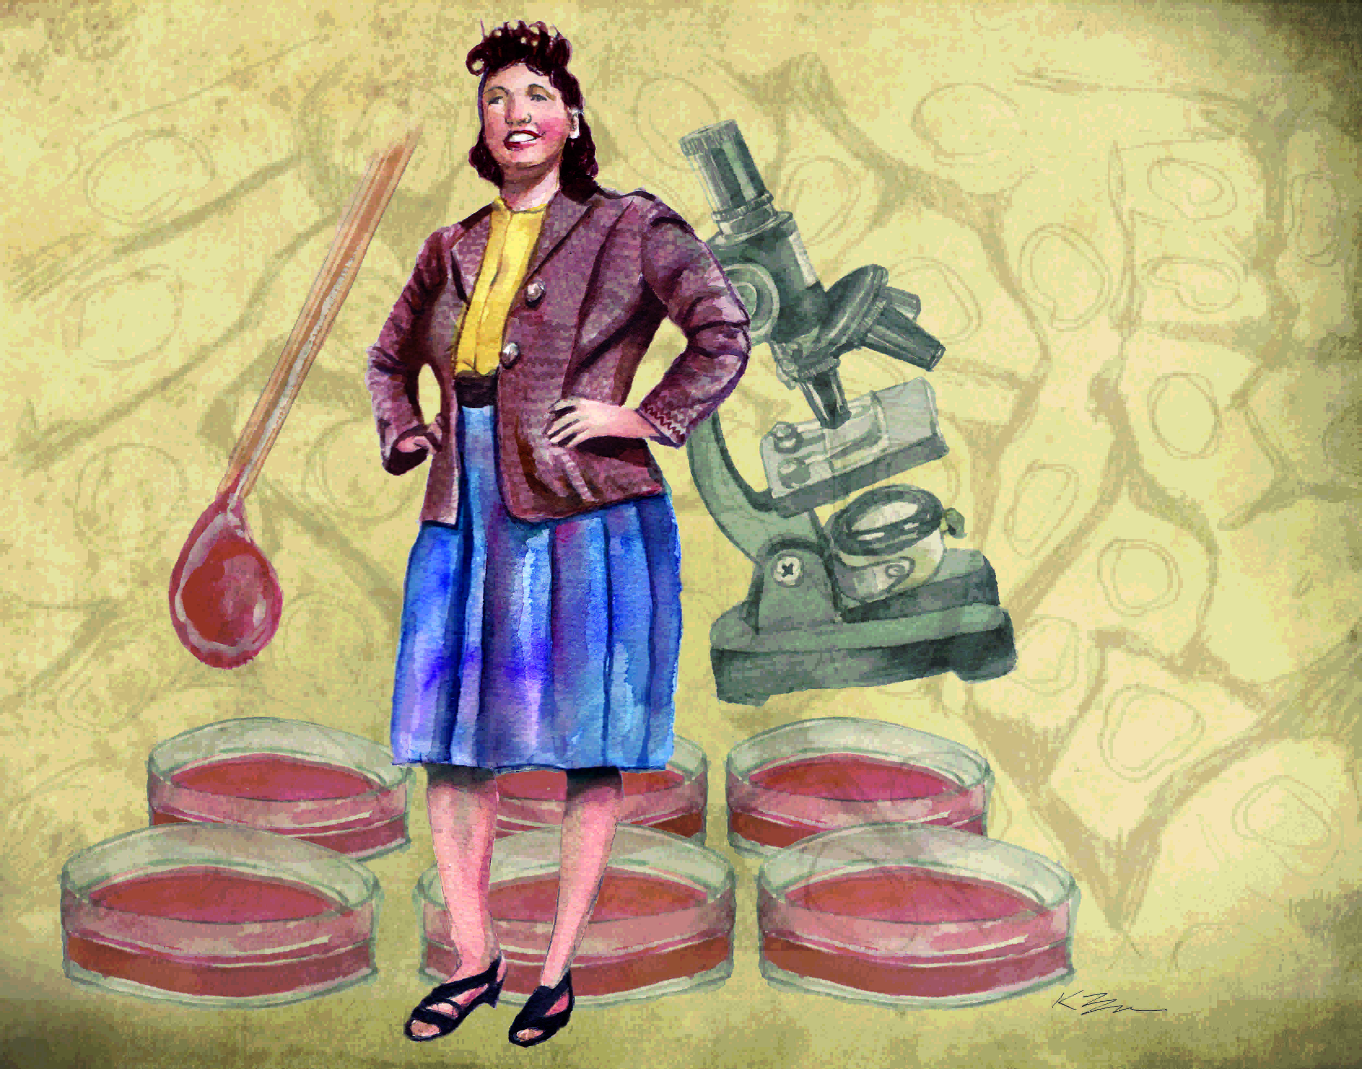
Title: __________________________________________________________
Lesson 10
Core Knowledge
By the end of this lesson, you will know:
Some areas of strength and weakness in this unit
About moral dilemmas to do with this unit on cells
Academic Language SEE IT SAY IT Write it
Word | Definition
 | Be able establish or indicate what something is.
 | The role or job something has
 | To say what something is like
Lesson content
Henrietta Lacks was a woman whose cells were taken without her permission and became very special because they can keep growing and dividing in a lab forever. These cells are called HeLa cells. Scientists use them for important medical research, like finding new treatments for diseases. However, it is not right that her cells were taken without her knowing or agreeing to it. This raised ethical concerns because people should have control over what happens to their bodies. Scientists now have guidelines to make sure people's rights are protected when using their cells for research.

Slide 43
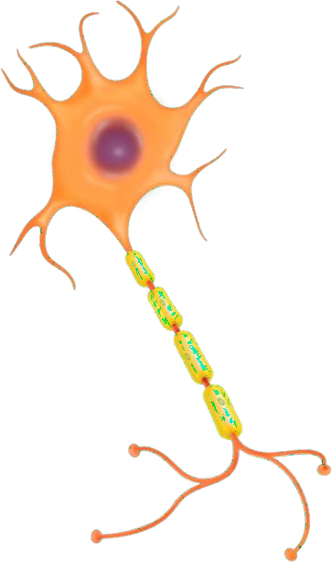
Unit assessment
D
C
A
B

Slide 44
Unit assessment
8
9
10

Slide 45
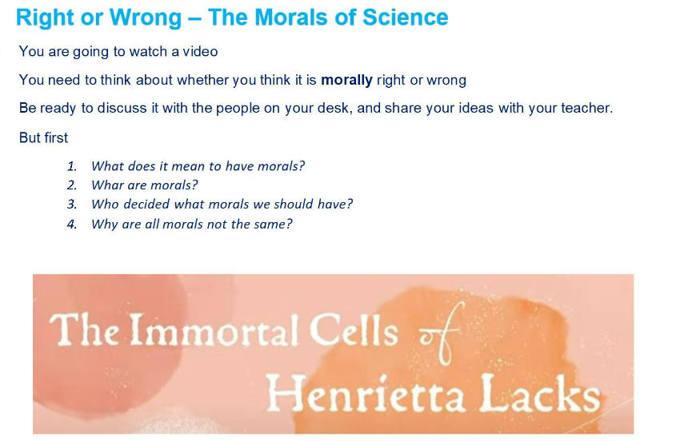
Core Knowledge
Answer the core knowledge question below in full sentences
1._________________________________________________________________________________________________________________________________________________________________
2. _______________________________________________________________________________
_________________________________________________________________________________
3. _______________________________________________________________________________
_________________________________________________________________________________

Slide 46
Additional space

Slide 47
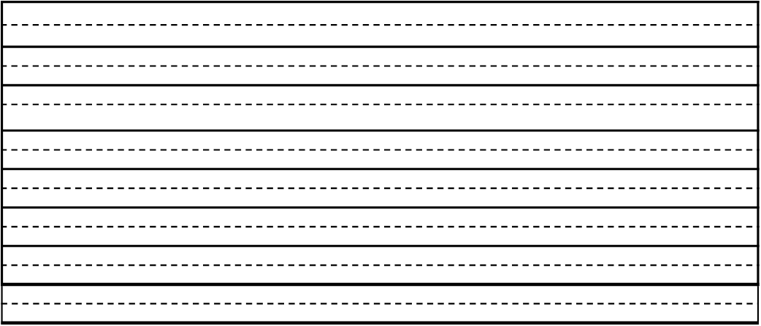
Additional space

Slide 48
Additional space

Slide 49
Scale Plot Label Axis Trendline

Slide 50
Scale Plot Label Axis Trendline

