Slide 1
Y9
Independent Work
Complete the following activities

Slide 2
Week 8 – Quote explosions for Catherine
‘sits on her heels’ beside Eddie.
What does this show us about her status?
How does it also show Catherine as quite child-like?
‘almost in tears because he disapproves’
What does this show the audience about how Catherine relies on Eddie?
What does it show us about Eddie’s praise towards Catherine?
‘[Catherine] strikes a match and holds it to [Eddie’s] cigar’
How might this be seen as a strange action between niece and uncle?
What can you analyse about the violent verb?
Why is it important that it is Catherine lighting Eddie’s cigar and not the other way around?

Slide 3
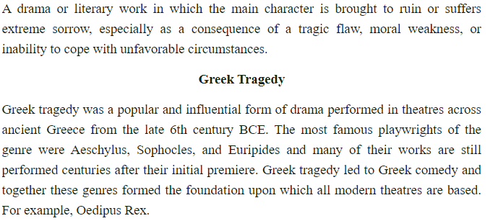
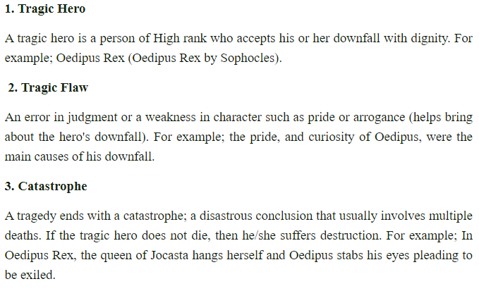
Week 3 – The Conventions of Greek Tragedy
Task: Read through the article and summarise the key information in the summary box (on page 2). You will be tested on this in class by your class teacher.
Glossary
Convention: something that is expected to occur within a text.
The Five Key Features of a Greek Tragedy

Slide 4
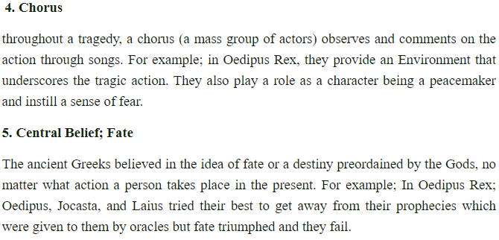
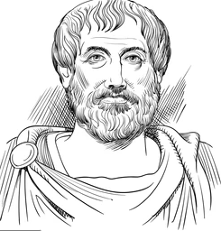
Aristotle was a Greek philosopher in Ancient Greece whose ideas still continue to influence many aspects of our lives today. In the surviving parts of his work titled Poetics, he discusses the dramatic form with a particular emphasis on tragedy and epic poetry. Aristotle proposes the idea of the tragic hero in his work and determines that this character, present in all tragedies, possesses particular attributes that correlate with the plot. These are:
Aristotle’s Rules of the Tragic Hero
Anagnorisis: a moment of realisation for the character
Catharsis: the sensations of pity and fear invoked by the tragedy (literally translating to ‘the purging of emotion’)
Hamartia: a character’s fatal flaw (literally translates to ‘to miss the mark’)
Hubris: an excess of pride or arrogance
Peripeteia: a reversal of fortune, usually a downturn
Summary of key information:

Slide 5
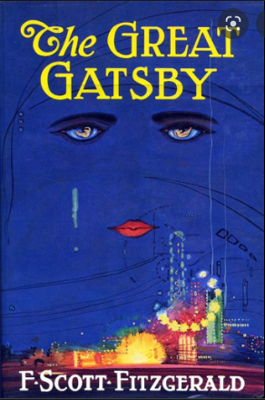
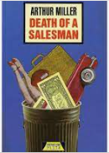
Week 4 – Wider Reading: Tragic Heroes in Literature JFD
A Tragic Hero - A tragic hero is a type of character in a tragedy, and is usually the protagonist. Tragic heroes typically have heroic traits that earn them the sympathy of the audience, but also have flaws or make mistakes that ultimately lead to their own downfall.
Aristotle and the Tragic Hero - The ancient Greek philosopher Aristotle was the first to define a "tragic hero." He believed that a good tragedy must evoke feelings of fear and pity in the audience, since he saw these two emotions as being fundamental to the experience of catharsis (the process of releasing strong or pent-up emotions through art). As Aristotle puts it, when the tragic hero meets his demise, "pity is aroused by unmerited misfortune, fear by the misfortune of a man like ourselves."
Aristotle strictly defined the characteristics that a tragic hero must have in order to evoke these feelings in an audience. According to Aristotle, a tragic hero must: be virtuous, be flawed and suffer a reversal of fortune.
To sum up: Aristotle defined a tragic hero rather strictly as a man of noble birth with heroic qualities whose fortunes change due to a tragic flaw or mistake (often emerging from the character's own heroic qualities) that ultimately brings about the tragic hero's terrible, excessive downfall.
The Modern Tragic Hero - Over time, the definition of a tragic hero has relaxed considerably. It can now include:
Characters of all genders and class backgrounds. Tragic heroes no longer have to be only nobles, or only men.
Characters who don't fit the conventional definition of a hero. This might mean that a tragic hero could be regular person who lacks typical heroic qualities, or perhaps even a villainous or semi-villainous person.
Nevertheless, the essence of a tragic hero in modern times maintains two key aspects from Aristotle's day:
The tragic hero must have the sympathy of the audience.
The tragic hero must, despite their best efforts or intentions, come to ruin because of some tragic flaw in their own character.
Task: Below are book cover images of literary texts that can be classed as tragedies.
For each text, research:
What is the text about?
Who is the tragic hero?
What is their fatal flaw?

