Slide 1
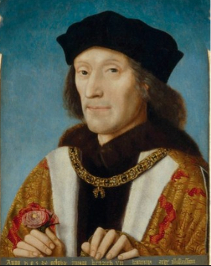
Henry VII’s background
Claim was weak – through his mother (an illegitimate line from John of Gaunt). Had been in exile since the age of 14 Spent time in Brittany. Became very cautious and calculating. Ecame King in 1485 after the Battle of Bosworth. He only won the Battle due to Sir William Stanley betraying Richard and attacking Richard as he rode out to face Henry.
Henry VII’s immediate consolidation of power.
Quickly crowned king. Signified the approval of the Church and of God himself. Nobility had to swear an oath of loyalty. Rebellion defined as sin against god and crime against the state. This happened before Parliament met and before his marriage.
Married Elizabeth of York in January 1486. United the Houses of York and Lancaster. The birth of Arthur in September 1486 established a dynasty.
Summoned Parliament which passed Act of Attainders against those who fought against Henry and granted Henry tunnage and poundage (traditional customs duties)
He went on a progress (tour of the country) to show himself. He would hear petitions and grant justice and favours to demonstrate royal power and presence.
Rewarded his supporters John de Vere – Earl of Oxford Lord Stanley – Earl of Derby Jasper Tudor – Duke of Bedford and given control of the council of Wales (technically under Arthur Tudor) Sir William Stanley – Lord High Chamberlain John Morton – Lord Chancellor (1486-1500) and later Archbishop of Canterbury and Cardinal.
Dealt with opponents by dating his reign to 21st August, the day before the Battle of Bosworth. He imprisoned Yorkists with better claims such as the Earl of Warwick (who was imprisoned in the Tower of London)
Dynastic threats
Viscount Lovell and the Staffords (1486) Lovell tried to raise a rebellion in Richard’s heartlands of North Riding of Yorkshire. Stafford tried to raise a rebellion in the Midlands. Easily crushed as there was little enthusiasm for the rebellion.
Lambert Simnel and the Earl of Lincoln Simnel pretended to be the Earl of Warwick under John de la Pole, the Earl of Lincoln’s leadership. Crowned as King of Ireland in 1487. Henry demonstrated the real Earl of Warwick! Lincoln fled to Burgundy and persuaded Margaret to pay for a force of mercenaries. Henry VII released the Earl of Northumberland (who had fought for Richard at Bosworth) to control the north again (this undermined Richard’s power base of support and ensured the Yorkist Howards would be loyal as Northumberland was part of their family) Henry took to the battlefield at Stoke and won showing again God’s favour. Henry was scared as he feared betrayal. Few joined Simnel’s army. Enabled Henry to see who was not loyal. Simnel sent to work in the royal kitchens. Henry had Elizabeth crowned as Queen of England (after this most support for usurpers came from abroad)
Perkin Warbeck 1491 - Warbeck claimed to be Richard, Duke of York (one of the missing princes in the Tower) 1491 – at Charles’ court in France until forced to flee due to the Treaty of Etaples. Fled to Burgundy under Margaret’s protection. 1495 attempted to land in England but this failed – Henry had found out due to Clifford who had infiltrated Warbeck’s group. This also revealed Sir William Stanley was plotting against Henry. 1496 – Scottish invaded with Warbeck – border raids but fled when James made peace with Henry and agreed that James would marry Henry’s daughter Margaret. 1497 – tried to exploit the Cornish Rebellion by landing in Cornwall shortly after the failed rebellion. Crushed and Henry allowed him to stay at court, until he tried to flee whereupon he was sent to the Tower. After trying to escape with the Ear of Warwick afterwards they were both executed.
Edmund de la Pole, Earl of Suffolk ‘the White Rose’ Edmund de la Pole fled to Burgundy in 1498, later returned and fled again to the HRE in 1501. Treaty of Windsor in 1506 had him returned and imprisoned in the Tower. Henry VII took no further action, but he was executed in 1513 by Henry VIII.
Henry VII’s strengths and weaknesses upon his accession.
Strengths | Weaknesses
The death of many nobles meant their lands had returned to the crown. Those below the nobility (ie the gentry, merchants and landowning farmers) wanted peace so were willing to support the recovery of royal power. Henry was an adult and had proved himself as a successful soldier. No family rivalry who may usurp him. His obscure Welsh origins and years of exile in France meant he had few personal enemies. | Henry’s claim to the throne was weak – he only really had it through conquest – this would not guarantee his safety. Henry was viewed by many as another usurper. The house of York lived on through the de la Pole brothers: John (Earl of Lincoln) and Edmund (Earl of Suffolk). They had a claim to the throne as strong as Henry. Margaret of Burgundy was Edward IV’s sister and married to the Duke of burgundy, England’s biggest trading partner.
Henry VII – Establishing his dynasty.
Yorkshire Rebellion 1489
Sparked by resentment of taxation granted by Parliament in 1489 to raise £100,000 to finance English forces in Brittany. (traditionally only the South paid for war to do with France)
There had also been poor harvest in the Northern Shires in 1488.
Earl of Northumberland was murdered – his retainers abandoned him as he had abandoned Richard III at Bosworth (showing latent Yorkist feelings)
The leader of the Yorkshire rebels was Sir John Egremont – an illegitimate member of the Percy family. The Earl of Northumberland was the head of the legitimate Percy family. Therefore showing some element of local issues also present
Henry planned to come north to deal with it but sent Surrey to crush it. Surry did and hanged several ringleaders. Most of the money was not collected.
Considered a loyal rebellion – no real attempt to overthrow Henry VII.
Cornish Rebellion 1497
Triggered by the need for fund for war against Scotland. (traditionally only the North paid for War against Scotland)
Had 15,000 rebels and were led by Lord Audley
Local nobles were unable/unwilling to stop it showing weakness in government.
The rebels made it all the way to Blackheath, just outside London, the traditional place of expressing grievance. They complained against ‘evil councillors’ such as Morton and Bray, not the King himself, showing it to be a ‘loyal’ rebellion.
Henry had to withdraw Daubeney and his troops from the border with Scotland to deal with this threat.
Rebellion crushed by the troops and leaders like Audley were executed.

Slide 2
Controlling the Nobility – the nobility had had a lot of power during the war of the roses, for example the Earl of Warwick was known as the ‘Kingmaker’. Henry had to ensure he was the most powerful person in the realm.
Attainders passed by Parliament – declared a noble guilty of treason without trial. Stripped nobles of their titles and land 138 passed (51 in the period 1504-1509) 46 reversed to secure gratitude and loyalty. | Patronage = titles/land to reward people. Henry rewarded some key followers eg John de Vere (Earl of Oxford) and Jasper Tudor (Duke of Bedford.) Henry was reluctant to make new nobles – this caused vacant lands to be his a stop a powerful group who could challenge him. Rewarded people lower down the social scale – eg Sir Reginald Bray Lack of patronage was a reason why Lord Audley joined the Cornish rebels in 1497.
Financial controls bond – place them in debt to the crown (if they misbehave they pay the money) In Henry’s last decade 2/3 nobles were under bond. Eg Lord Burgavenney placed under a bond of £5000 to repay over 10 years. Council Learned in Law collected these debts. | Attacks on Retaining Retaining = keeping large numbers of men as personal staff (Henry feared these could be used a armies) Passed laws in 1485 and 1504 against illegal retaining. 1504 law - £5 per month per illegal retainer. 1507 – Lord Burgavenney fined £70,000 for illegally retaining 471 men. Margaret Beaufort was fined for illegal retaining.
Finances – Henry was caution with money. He moved finance from the exchequer to the chamber where he signed each page the accounts himself. He also avoided costly foreign policy ventures.
Ordinary – bulk of income |  | Extraordinary
Crown Lands gained extra through attainders 1486 Act of Resumption gained all land granted away in War of the Roses. Bray administered Crown lands At the start of Henry’s reign income dropped to £12,000 but was £42,000 by the end. | Feudal Dues Wardship +livery – king looking after a minor’s lands and livery when he inherited them Marriage – right to arrange tenant’s daughters’ marriages. Sir John Hussey organised this – increasing income from £350 to £6000 | Bonds and recognisances eg Earl of Westmoreland paid £10,000 after Battle of Bosworth Council Learned in Law collected these debts. |  | Loans and Benevolences Organised by royal council for help in specific circumstances. Enforced by Council Learned in law eg in 1491 when £48,000 was collected for war.
 |  | Clerical Taxes special tax on clergy as they didn’t pay normal tax. Also sold offices eg £300 for Archdeacon of Buckingham – this was called simony. (forbidden but widely practised)
Customs Duties Granted by Parliament/ Introduced certificates for coastal trade. Updated the Book of Rates twice. Income increased from £33,000 - £40,000 | Legal Dues Payments from fines and attainders Eg Sir William Stanley fined £9000 and £1000 each year thereafter. | Feudal Dues Entitled to gifts upon special occasions. Eg £30,000 for when Arthur reached knighthood in 1504 despite dying 2 years before. | Parliamentary taxes Special grants of tax to finance royal policies like war. ‘ fifteenths and tenths’ based on value of movable property. Not popular and triggered rebellions in 1489 and 1497 Parliament made him promise not to collect more after 1504.
Henry VII – government
Star Chamber: A court of law set up by Henry VII in 1487 to prosecute anyone behaving in a lawless or rebellious manner. The Royal Council made the judgements. Could be used against the nobility.
Government
Council Advised the king, administered realm on King’s behalf and made legal judgements. Made up of nobles (eg Daubeney and Dynham, but nobles rarely part of the working council), Churchmen (eg Morton and Fox) and laymen, often lawyers (eg Bray, Empson and Dudley) Average of 7 councillors per meeting. No established rules and procedures but was permanent with core membership. ‘professional’ councillors often stayed in London to deal with legal administrative matters when Henry was away. No clear rules and guidance for proceedings. | Council Learned in Law an offshoot of the Council. Developed in 2nd half of the reign. Maintained King’s revenue and prerogative rights. Sorted bonds and recognisances. Caused frustration and anger but was an expression of the King’s will. Dudley’s account book showed only £30,000 was actually paid of the of the recorded £220,000 that was ‘collected’. | Court and Household Had to be magnificent to show of the King’s wealth and power. The focus of personal monarchy The place of patronage – either from the King or from influential courtiers/advisors. Lord Chamberlain controlled the Chamber (Sir William Stanley’s treason in 1495 was a massive shock) After 1495 Henry often retreated to the more private Chamber. Some key members of the Court were key advisors – eg Margaret Beaufort. | Parliament 2 main functions. Pass taxation and laws. Only 7 parliaments called – 5 in the first 10 years and 2 in the remaining 14. First 2 passed attainders to control opponents and the Act of Resumption Granted tax in 1487, 1489-90, 1491-92 and 1497. Yielded £203,000 total. Final parliament in 1504 limited the demand for taxes showing some issues. Parliament passed Acts against illegal retaining for Henry. Generally Parliament gave Henry what he needed. | Nobility Still used to control local regions. Earl of Oxford was to control Essex and East Anglia Daubeney looked over the South of England. Northumberland was reinstated to control the North and when killed was replaced by Surrey. | Justices of the Peace (JPs) maintained law and order in the countryside eg through quarter sessions where they dealt with anything except treason. 1487 law passed to allow JPs to take bail. 1495 could act upon information without waiting for a grand jury. 1495 Act of Parliament added to their duties – suppress unlawful games and control alehouses. Regulated economic activity – eg 1504 had to check pewter and brass were the right degree of fineness. JPs were given authority to impose bonds on sheriffs (who tended to be from the nobility) Issue as many worked in their local area so could be corrupt/not act.

Slide 3
Brittany and France
Henry had spent much of his exile in Brittany so owed them a debt.
Worried France would take control and be a national security threat
Maximillian of Burgundy and Ferdinand of Spain’s sent troops in 1487 as they were worried about France’s ambitions. However they were distracted by other concerns and left.
Abandoned by allies in 1489 he called Parliament to help him raise an army.
England and Brittany agreed to the Treaty of Redon in 1489 where Anne of Brittany would pay for a small English army to defend Brittany
Anne surrendered and married Charles VIII of France
Perkin Warbeck the arrived at the French court and was welcomed.
Henry launched an invasion of France late in the campaigning season in 1492 so France quickly sought a peace settlement so they could concentrate on Italy.
Treaty of Etaples 1492 France to no longer harbour pretenders. Pay Henry a pension of £5000 per year Henry to remove his troops from France
Ireland
Henry’s power on extended the ‘the Pale’ (the areas surrounding Dublin). Outside this area Ireland was controlled by the Fitzgeralds (or Geraldines) and their leader was the Earl of Kildare, Lord Deputy of Ireland since 1477.
Kildare had Yorkist sympathies – eg crowning Simnel as King of Ireland In 1486 and supporting Warbeck in 1491.
Henry decided to take the costly approach of direct rule of Ireland by appointing his son Prince Henry as Lieutenant of Ireland with Sir Edward Poynings as deputy.
Poynings forced the Irish Parliament to pass ‘Poynings’ Law’ in 1495 where the Irish parliament could not pass laws without prior approval from the English Crown.
This was very expensive and made worse when Warbeck returned and besieged Waterford.
Henry recalled Poynings and returned the Earl of Kildare to power. Kildare, by 1496, realised there was no benefit in supporting the Yorkists so decided to serve Henry partly for his own benefit but also because during his time in England Kildare and Henry had grown to respect each other.
Burgundy
Bulk of England’s exports went through Burgundy, but Margaret of Burgundy was Richard III’s sister!
In the Treaty of Dordrech 1489 Maximillian promised troops to help Brittany but didn’t send them.
Margaret had support from her stepson- Maximillian, who became Holy Roman emperor in 1493 and passed over power in Burgundy to his 16 year old son Philip.
Due to Margaret supporting Warbeck in 1493 Henry started a trade embargo which lasted until 1496.
After Warbeck left in 1495 relations improved and trade was restored in the Intercursus Magnus in 1496.
After the death of Isabella of Castile Henry chose to support Philip of burgundy over Ferdinand of Spain.
When Philip and Joanna sailed to Spain they were wrecked off England and became Henry's guests. Whilst treated lavishly they agreed the treaty of Windsor 1506 Secure better trade agreement called ‘Intercursus Malus’ as it was so favourable to England. Suffolk to be handed over to Henry. Henry to marry Philip’s sister Margaret of Savoy. Henry to support Philip over Ferdinand
The next year Philip died and Joanna went mad. Maximillian took over regency of Burgundy again and refused to accept the treaty of Windsor. Marriage to Margaret of Savoy didn’t happen. Only benefit was Henry already had custody of Suffolk.
Henry opened discussions of his daughter Mary to marry Maximillian’s grandson, Charles.
1508 Maximillian signed the treaty of Cambrai with the Kings of France and Spain. It was a military alliance against Venice. Didn’t include Henry. Could turn into an anti-English alliance but generally eyes were set of Italy.
Spain
1489 – treaty of Medina del Campo Mutual defence -Neither to make treaties, peace or alliance with France without the other’s agreement. Neither to harbour rebels or pretenders AND Catherine of Aragon to marry Arthur. English and Spanish merchants were given reciprocal privileges and low duties in each others countries.
Issues – Spain not sending support to Brittany. Ferdinand’s hesitation over the marriage whilst Henry was threatened by Warbeck. Arguments over Catherine’s dowry.
1499 – Marriage Treaty agreed with marriage n 1501.
Arthur’s death in 1502 prompted Henry to propose Catherine marrying Henry.
Ferdinand rejected the proposal as Franco-Spanish relations were improving so he didn’t need the alliance. When it deteriorated in 1503 Catherine and Prince Henry were betrothed and papal dispensation was gained.
1504 – Isabella of Castile died and Henry saw Spain could collapse so tried to retract the betrothal and backed Philip.
1505- Ferdinand signed the Treaty of Blois with France and in 1506 married Louis XII’s niece.
1506 – Philip died and Ferdinand gained control of Spain with French support – he no longer needed England’s support.
Scotland
1495 - Scotland offered hospitality to Perkin Warbeck – Warbeck was married to the King’s cousin.
1496 – Warbeck crossed the border with an army (but quickly retreated)
Henry raised a bigger army to launch an invasion of Scotland – caused the Cornish rebellion.
1497 – Truce of Ayton ended conflict. Warbeck fled.
1502 – Treaty of Perpetual Peace including the agreement that James IV would marry Princess Margaret.
1503 – Marriage of James IV and Margaret.
Henry VII – foreign Policy.
Trade :Part 1 | Intercursus Magnus and Malus show attempts to develop trade. Allowed English merchants to trade freely in burgundy. By 1509 60% more cloth was being exported. | Navigation Act 1485-86 – encouraged the use of English ships. Wines from France could only be importuned on English ships. | Act in 1489 limited export of English wool by foreign merchants for making to cloth on the continent. (done so it had to be turned into cloth in English industry). By end his reign there was 30% less raw wool being exported. | 1490 Treaty allowing English wool to be exported to Pisa (Florence’s main port) | Venice had put tariffs on all English good coming into the Mediterranean, but after Henry restricted sale of wool to the Venetians they relented and lifted the import tax. | HOWEVER Henry reasserted the Hanseatic League’s trading privileges in 1504 when he needed to ensure they wouldn’t support the Yorkist Earl of Suffolk. (He had previously sacrificed trade in the embargo on Burgundy in 1493)

Slide 4
Overview
Population – around 2.2 million at beginning of the C15th.
1% lived in cities – biggest city was London (50,000). Norwich (10,000) and Bristol, York and Coventry at around 8000-10,000
Henry VII was interested in building up his personal wealth, but he had no specific ‘economic’ policy.
Cloth Trade
The cloth trade was responsible for about 90% of English exports. | There was around a 60% increase in the volume of cloth exports under Henry VII.
Earlier it was unfinished wool that was being trades and was shipped from east coast ports through Calais by the Merchants of the Staple. | Increasingly, finished cloth dominated the trade which lead to a development in weaving (done in the home) and fulling and dying (commercial process)
Some cloth towns like Lavenham in Suffolk and Lewes in Essex became prosperous | Older cities like Winchester and Lincoln suffered as the cloth industry tended o go to newer market towns in East Anglia.
An increasing proportion of cloth was exported from London by the Merchant Adventurers. This reinforced London's dominance and created a clear link between London and Antwerp. | Trade did not break the hold of the Hanseatic League who enjoyed privileges, reasserted by treaty in 1474 and again in 1504 when Henry needed their support to get the Earl of Suffolk.
Function of the Church and Churchmen
The parish Church, of which there were around 8000, was the centre of religious experience
The Church provided the focus for festivals which were linked to the agricultural year and offered much needed enjoyment.
Guilds and confraternities (voluntary groups of people to promote works of Christian charity) offered charity, fellowship and a chance for people to do good.
Church made it easier for social and political elites to impose control through encouragement of good behaviour, obedience and stress on the values of community.
Church provided employment opportunities and could, for a few like Wolsey, allow them to advance themselves socially.
The Church was Erastian – the Pope was officially in charge, but the King was firmly in control in his own country and Popes normally granted Kings what they wanted. For example, Henry got his dispensation to marry Elizabeth of York and for Henry to marry Catherine of Aragon.
The two key church provinces were Canterbury and York, each under the control of an Archbishop. There were 17 diocese, each under a bishop.
The Church has political power as senior churchmen were involved in government. Eg John Morton and Richard Fox. Senior clergymen, were, on the whole, highly competent and conscientious professionals, often with legal training, who performed their duties for the Church and state well. Abbots, alongside bishops, sat in the House of Lords.
Agrarian Economy
Greater move to sheep farming in the 1480s and 1490s due to depressed crop farming and improved profitability of sheep farming brought about by increased demand for wool as the population grew and trade overseas developed.
Open-field husbandry which had predominated grain growing south east and East Midlands became less common (open field husbandry was here tenants farmed strips of land and had ‘common rights’)
Peasants in areas of open-field husbandry came under pressure from enclosure as enclosed land meant common rights for grazing their animals were taken away.
Exploration
John Cabot arrived in Bristol when they were looking for new fishing grounds as they had been excluded from Icelandic waters by the Hanseatic League.
Henry became Cabot’s patron and he set out in 1497 and located Newfoundland and reported extensive fishing grounds.
Cabot died on his second voyage.
Cabot’s son, Sebastian, failed to find the north-West passage to Asia in 1508 and when he returned Henry VIII showed little interest. The fishing grounds discovered became the preserve of seamen from Portugal and the Basque region of northern Spain.
Henry VII – society and Economy.
Industry
Greater move to sheep Germany and Bohemia were better at metallurgy | Spanish, Portuguese and Dutch were better at shipbuilding.
Was tin mining in Cornwall and lead was mined in the Pennines. | Coal was mined in Durham and Northumberland and much coal was shipped from Newcastle to London to meet demand.
Development of first basic pumping technology was recorded in Durham in 1486 which enabled greater production. | Overall, industry in England remained quite small.
Religious community and belief
The Church had a function to spread God’s grace so people could get to heaven and spend less time in purgatory. | People observed the seven sacraments: baptism, confirmation, marriage, anointing the sick, penance, Holy Orders and Eucharist.
Eucharist was the Mass which was the Church ceremony which used bread and wine to receive Christ’s body and blood. | Catholics believed that during Mass the bread and wine were transubstantiated into Christ’s body and blood. Lay members took the bread only
People believed the priest performed the sacrifice on behalf of the community and it was a sacred ritual that the whole community took part in. | Church had a social role – it was communal religion. There were chantries to pray for the souls of the dead. There were confraternities who paid for the upkeep of the Church. The Church also offered pilgrimage to gain relief from purgatory.
Trade: Part 2 | Intercursus Magnus and Malus show attempts to develop trade. Allowed English merchants to trade freely in burgundy. By 1509 60% more cloth was being exported. | Navigation Act 1485-86 – encouraged the use of English ships. Wines from France could only be importuned on English ships. | Act in 1489 limited export of English wool by foreign merchants for making to cloth on the continent. (done so it had to be turned into cloth in English industry). By end his reign there was 30% less raw wool being exported. | 1490 Treaty allowing English wool to be exported to Pisa (Florence’s main port) | Venice had put tariffs on all English good coming into the Mediterranean, but after Henry restricted sale of wool to the Venetians they relented and lifted the import tax. | HOWEVER Henry reasserted the Hanseatic League’s trading privileges in 1504 when he needed to ensure they wouldn’t support the Yorkist Earl of Suffolk. (He had previously sacrificed trade in the embargo on Burgundy in 1493)

Slide 5
Wolsey’s Domestic policies
Government | Legal | Finance | Economic | Religion
Wolsey removed the ‘minions’ in 1519 to ensure he kept the King’s ear. Minions were the young nobles Henry liked to surround himself with. 1526 Eltham Ordinances – laid out methods for reorganising the Privy Chamber and making the King’s Household more efficient but it actually altered influence at court – once these changes had been made and power was secured they were allowed to lapse. | Wanted to promote civil law (based on natural justice and evidence) rather than common law (based on precedent – decisions from the past) Used star chamber more frequently (from hearing around a dozen cases to around 120 per year) to attack nobles and local officials who abused their power. He encouraged commoners to come forward. Used court of requests to hear requests from poor people. Wolsey established a reputation as friend to the poor. | Realised fifteenths and tenths, a fixed tax based on land wasn’t going to be enough for Henry’s foreign policy and rising inflation. 1522 – survey to assess who could pay tax and how much. Gained around £200,000 in 1522-23, but not enough. 1523 – Subsidy – based on income, not property. Had to be approved by the house of Commons. Didn’t raise as much as hoped. 1525 – proposed an ‘Amicable Grant’ from the Church and ordinary taxpayers based on value of property. Provoked rebellion – 4000 rebels faced the Duke of Norfolk. Henry backed down. | 1517 – Wolsey started national enquiry into enclosures. Legal cases drawn up against landowners who had enclosed without proper permission. Further enquiries in 1518. Opposition from landowners in Parliament forced a temporary half from 1523 to 1526. From 1526 the alliance vs Spain lead to embargo with Burgundy/Netherlands. This affected the cloth trade at a time of a bad harvest (1527) this created unemployment and made rise in prices worse. 1526 Wolsey undertook a recoinage that increased the number of coins but reduced the weight of silver coins. It improved exports but contributed to the rise in prices. Riots had to be quelled in spring of 1528 in the south East, East Anglia and the south West. | Instructed bishops to carry out duties properly. 1528 – plans to close monasteries with fewer than 6 inmates in them and amalgamated those with under 12. He also removed 8 unsuitable heads on monastic houses (this was about improving monasticism, not removing it) Money gained was for education eg fund a school in Ipswich and Cardinal College at Oxford. 1521 burned Lutheran texts outside St Pauls’ in London. Groups of Protestants, mostly in universities, were arrested and punished (but no executions)
Henry VIII’s background
Was 11 when Arthur died Well-educated eg by John Skelton and other tutors. Followed the code of chivalry eg performing valiant deeds in battle like Henry V at Agincourt or when he married Catherine of Aragon out of honour. After 1502 was at Richmond palace with his father but not well prepared for government. Was very intelligent
Henry VIII’s early years – change and continuity
Continuity | Change
Sir Thomas Lovell was reappointed as chancellor of the exchequer Bishop Fox remained lord Privy Seal and a trusted advisor (until the rise of Wolsey) Archbishop Warham remained lord Chancellor. Worried about threats to the throne – eg Edmund de la Pole the ‘White rose’ was imprisoned in the Tower of London. In 1513 Henry had him executed. Continued to use JPs to administer the regions. | Within days of his accession the Council Learned I Law was abolished. Empson and Dudley were arrested and executed. 175 bonds and recognisances were cancelled as a gesture of goodwill towards the nobility and Henry had young members of the nobility around him as friends Henry was less involved in day to day politics than his father.
Henry VIII government.
Parliament vs Proclamation: In 1539 Parliament passed a law saying proclamation carried same weight as Parliament. Intention behind this was that proclamations would later be ratified by Parliament. This was repealed in 1547 as Parliament nervous about the powers it gave those governing for Edward.
Cromwell’s changes in government
Power of the monarch | Parliament | Privy Council. | Financial Management | Control of the Regions
1533 – Act in Restraint of Appeals preamble said England was an empire and all owed the King, ruling under God, total obedience. Act of Supremacy – removed papal power and made Henry Supreme Head | ‘King and Parliament’ became ‘King-in-Parliament’ Statute law (by the King-in-parliament) became the highest form of law as statue law was used to enact Reformation legislation. Parliament was recognised as being able to legislate on all areas of life and society. The process for passing a Bill after 3 readings became standard practice. Composition of Parliament changed – abbots disappeared and number of bishops increased slightly. Number of peers increased to 55 by 1534. Clergy were now in a minority in the House of Lords. In the Commons, 14 new boroughs were given the right to elect MPs From 1258-1509 there were 1094 pages of statute. Under Henry VIII it was 1032 pages. | Medieval system had a large council of around 70-90 councillors (most of whom rarely attended) Shift to smaller council of around 20 and a shift away from one, such as Wolsey, having all power. Elton points out this allowed them to respond well to the crisis of the Pilgrimage of Grace in 1536. Some say it wasn’t Cromwell as it was following outlines from the Eltham Ordinances – the response – Cromwell was Wolsey's advisor when the Eltham Ordinances were created. Some argue it wasn’t Cromwell, but rather his opponents who worked on the council to try and limit Cromwell’s power. | Four new departments were created Court of Augmentations – controlled land and finances formerly under Church control. Court of General Surveyors – initially handled ex-monastic land but soon amalgamated with Court of Augmentations. Court of First Fruits and Tenths – collected money previously sent to Rome. Court of Wards – King had the ancient feudal right to collect money from the estate of am minor who had inherited. Due to new courts income from Crown lands increased from £25,000 to £86,000 | 1536 Act of Union with Wales – reorganised local government in Wales and the borderlands of the marches. Imposed English law. Act against Liberties and Franchises – removed and restricted the special powers exercised by regional nobles in the more remote parts of the Kingdom eg the Bishop of Durham Re-established the Council in the north as a permanent body after PoG
Wolsey’s failure to get the divorce and his fall
Originally used scriptural arguments – eg Leviticus (but Deuteronomy contradicted this) Diplomatic manoeuvres were used to try and free the Pope from Charles’ control (see foreign policy) Legal efforts- Wolsey to have trial in England as papal legate – but the Pope sent Cardinal Campeggio to hear the divorce case and delay it. (when he arrive Catherine appealed for it to be heard in Rome! The Pope agreed) Wolsey was then accused of praemunire in 1529 and stripped of powers and possessions. Partly due to the rise of Boleyn faction at court. Wolsey was summoned to London in 1530 but died en route.

Slide 6
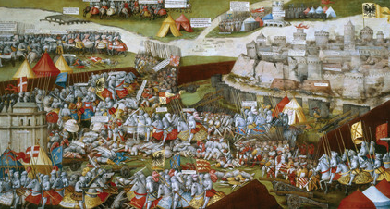
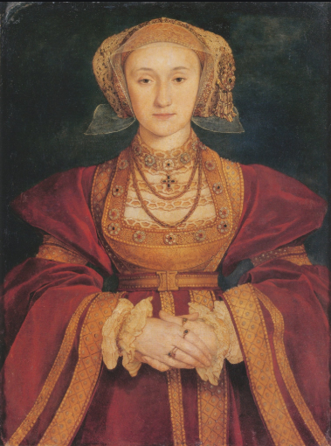
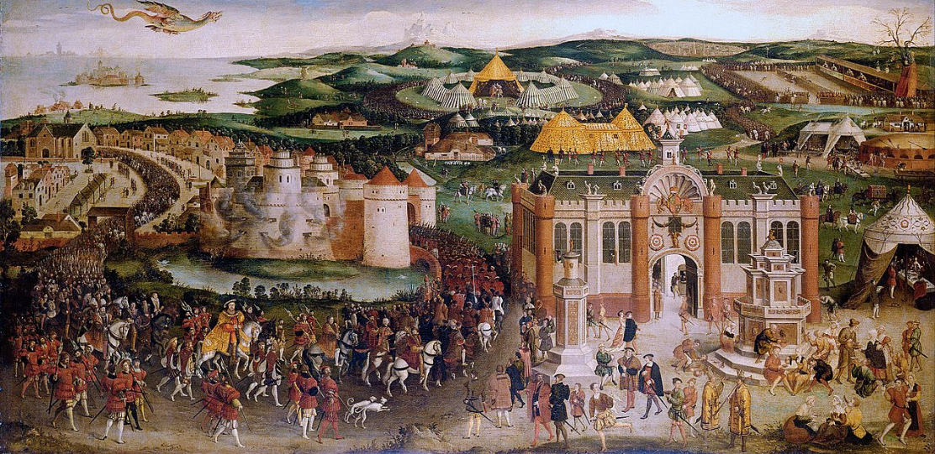
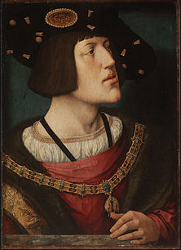
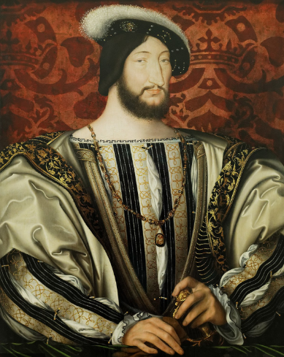
1509-1514 – Early Years (break from his father)
1510 – Treaty of Etaples was renewed – negotiated by Henry’s councillors (not Henry!)
Henry sent Archbishop of York, Bainbridge, to Rome to persuade the Pope to enter an alliance against the French. – created the Holy League (uniting England, Spain, the HRE, Venice and the Papacy against France)
1512 – invasion of France – 10,000 sent to the south of France. Did little. Safeguarded the Spanish border whilst Ferdinand conquered Navarre.
1513 – Invasion of Northern France (organised by Wolsey). Captured Tournai and Therouanne and won the ‘Battle of the Spurs’ (the French fled) – war was costly and forced Henry to liquidate assets inherited. The renegotiated French pension was lost. When Tournai was eventually sold back it was for significantly less than what England had spend of rebuilding after the siege)
1513 – Whilst Henry was in France James IV invaded. Repulsed by the Earl of Surrey. James IV died as did many of the Scottish nobility.
1514 – Ferdinand and Maximillian each made separate peace with France leaving Henry isolated. Wolsey had to pick up the pieces which he did – he recovered the French pension and secured marriage between Henry’s sister Mary with Louis XII. (however this only lasted for one year)
The Treaty of London
Prompted by Pope Leo X who wanted united Christendom vs Ottomans. Each country signed a separate treaty with England of ‘perpetual peace’ and promising that all would attack anyone who broke the Treaty. Separate agreement with France greed that Mary would marry the dauphin, Tournai would be returned in exchange for a pension as well as a promise to keep Albany out of Scotland.
The 1521-1525 – war with France and betrayal!
Siding with Charles | Invasion | Impact
In response to conflict between Francis I and Charles V, (when Francis reconquered Spanish Navarre) Wolsey negotiated the Treaty of Bruges (1521) Henry and Charles agreed to invade France in 2 years. (could give Henry favour with the Pope who wanted to curb French power, Henry thought he could get land, treaty included agreement for Mary to marry Charles V) | England and Spain invaded France in 1522 and 1523 (despite Wolsey’s reservations) Little achieved and cost a lot. Caused financial issues in England. Battle of Pavia in 1525 – Charles V won a decisive victory and took Francis prisoner. Henry suggested they conquer the north of France and then split the territory, but this was rejected by Charles as he made his own peace with Francis. | Showed Henry was not really an equal partner – who could be ignored. Henry couldn’t raise an army to continue war (revolts over Amicable Grant) Invasions in 1522-23 had cost £400,000 Charles repudiated the marriage contract with Princess Mary
The Field of the Cloth of Gold
A meeting to celebrate peace. Both kings set up lavish pavilions (and there was a fountain of wine!) Tension when Henry lost to Francis in a wrestling match. Cost Henry £15,000
Search for the divorce.
Following his betrayal by Charles V Wolsey joined negotiations lead by the Pope for an anti-Habsburg alliance. This brought England together with France, the Pope, Venice and Florence in the League of Cambrai.
1527 – Charles took over most of the Italian peninsula including the sack of Rome that made the Pope his prisoner.
After the failure of scriptural and legal arguments. Henry and Wolsey looked to diplomacy to get the divorce.
1527 – The Treaty of Amiens brought England and France into an alliance.
Wolsey’s embargo against Burgundy (controlled by Charles) lead to an embargo in response which caused widespread unemployment and social problems in England.
1529 - Charles V defeated Francis at the Battle of Landriano. There was no chance of getting the divorce.
1532 – fragile alliance made the France. However, unravelled when Francis sought his son, Henry, to marry the Pope’s niece, Catherine de Medici.
Henry VIII’s foreign policy. 1509-1540
Search for Protestant allies
Schmalkaldic League | 1533-34 - Henry (not Cromwell)sent emissaries in to Germany and Poland. Failure of a Treaty with Lübeck (1534) where Henry agreed to send ships and men to help put Lübeck’s candidate on the Danish throne. – abandoned after a year. Other princes rejected Henry’s proposals due to remembering his title Fidei Defensor and as many felt his religious changes were not Protestant enough and Henry refused to sign the Protestant Confession of Augsburg
Reprieve | 1536 – renewal of fighting between Charles and Francis made the need for allies less acute. 1536 – Catherine of Aragon’s death reduced tension with Charles V.
Fear | 1538 – Truce at Nice – Francis and Charles ended war and later pledged themselves against the enemies of Christendom and froze relations with England. 1539 – Pact of Toledo – sever connections with England, withdrew ambassadors,, Pope excommunicated Henry and sent Cardinal Pole to Scotland to try to raise a Catholic crusade. Henry updated defences and published the Six Articles to restate Catholic beliefs.
Cleves Marriage | Duke William of Cleves was NOT a Lutheran, but had withdrawn Cleves from Papal Authority. He was a powerful German Prince. 1539 – marriage – but Henry did not like her. 1540 sent the Duke of Norfolk to encourage France into traditional role of defender of Spain’s opponents, which worked so the marriage wasn’t needed.
Charles V
Ireland
English authorities remained in control of the Pale, the rest was under Kildare’s control. Kildare was dismissed in 1534 due to issues with Henry. Caused a rebellion which was only suppressed at considerable expense and difficulty. Attempt to refashion Irish government under English control in 1534 failed as it required an English deputy with a substantial military presence. Con O’Neill and Manus O’Donnel invaded the Pale in 1539. the government eventfully regained control. 1541 – established Ireland as a separate kingdom in 1541 imposing English law and creating counties out of Gaelic lordships (giving them peerage titles and protection) Wasn’t followed through and didn’t develop Irish loyalty.
Francis I

Slide 7
Trade
Imports and Exports | Volume of English trade increased in the first half of the C16th. Rise in cloth exports but decline in raw wool Increase in exports of hides and tin Increased imports of wine suggesting there was an increase in spending power amongst the prosperous.
Trading ports | Most trade went through London Decline on east Coast ports like Hull and Boston. Bristol declined. Southampton had a short lived boom in trade with Venice.
Cloth trade | Change with increase in cheaper fabrics like kersey being exported. 70% of cloth exports transported by English merchants from 1550s but it was less prior to this.
Cloth industry
Wool industry grew in the first half of the C16th to keep pace with demand.
Cloth industry was largely domestic with children carding the wool, women spinning and men weaving.
Specialists then treated the wool in dying and fulling which were small scale industries throughout the country.
3 areas of biggest growth: West Riding of Yorkshire East Anglia Parts of the West Country like Gloucestershire)
Some individuals became wealthy through cloth – William Stumpe became MP of Malmesbury, high sheriff of the county and a wealthy landowner (who benefitted from the dissolution of the monasteries)
Social development Henry VIII 1509-1547
Changes in society
Nobility | No. increased by 9 over Henry’s reign. Most achieved peerage by loyal service or a close family relationship (eg Edward Seymour made Earl of Hertford) Nobility still used in government – eg Suffolk given property in Lincolnshire after PoG in 1536 and ordered to move there to ensure control. John Baron Russell also raised to the peerage and endowed with lands in Devon to bolster royal authority in the south West after the Marquees of Exeter’s execution. Nobles still raised men for armies – Eg Earl of Shrewsbury raised 4000 men for invasion of France in 1513. Some limits to power eg when Baron Dacre was hanged for murder in 1541 like a common criminal
Gentry | Around 5000 under Henry. Number increased under Henry More took on roles as JPs or local administration.
Commoners | Little dramatic change in first half of Henry reign but rate of inflation did lead to more pressure. Some rebellion as seen in amicable Grant - strongest resistance in Essex and Suffolk. Grant was hard to pay for unemployed cloth workers.
Regional government | See section on Cromwell and government.
Impact of the Reformation | For more detail see Reformation sections for impact of dissolution Lack of popular support – rebellion as seen in the Pilgrimage of Grace. King took lots of land – lots sold off increasing the size and wealth of landholding gentry. Educational provision from monasteries lost (although some were refounded as schools) Monks and nuns rendered unemployed. Some secured new positions or received pensions. Many monasteries doubled a churches and were the centre of the local community. Eg at Hexam in Northumberland the royal commissioner was prevented from beginning dissolution due to a gathering of armed men.
Prosperity and Depression
John Guy argued: England was economically healthier, more expansive and more optimistic under the Tudors than at any time since the Roman occupation’
Positives | Negatives
Population grew significantly from 1525 with a decline in mortality. From the 1520s agricultural prices rose increasing farming incomes this was enhanced by engrossing (joining farms together as it improved efficiency but did lead to some becoming homeless) Debasement of the coinage created an artificial boom from 1544-1546 (but at the cost of long-term living standards) | Bad harvests in 1520-21 and 1525-27 led to increased food prices. Food prices almost doubled across Henry’s reign. Real wages declined – especially due to debasement at the end of Henry's reign. Urban poverty – Coventry had ½ with no personal wealth. Unemployment amongst rural labourers – many moved to cities so London grew by 5000 per year from migration. Some made homeless by engrossing.
Exploration
Henry VIII was not interested in exploration – he did not build on work by Cabot. Robert Thorne continued to explore the areas near Iceland and the Newfoundland fishery. Explorers struggled to gain royal support for ventures.
Industry
Cornish tin remained a prize export Lead mining in the Pennines grew. Coal mining in the North-East of England grew – Newcastle was important in supplying London by sea. Blast furnaces in Kent produced more iron ore.
Economic development Henry VIII 1509-1547
Enclosure
Enclosure = the fencing off of land thereby ending all common rights to it.
This was perceived to be a moral problem as people living on enclosed land were evicted (normally the poor).
Thomas More criticised it in his book Utopia in which he mentioned sheep eating men!
In 1517 Wolsey launched a commission to ascertain how much land had been enclosed and prosecuted 188 people who were found to have enclosed illegally.
This was a regional problem as it mainly took place in the midlands
Most land enclosed was done before 1485, but there was still further legislation in 1534 attempting to limit sheep ownership and engrossing. This had limited effect.
Population
Population increase caused economic distress as demand led to increased food prices. This was made worse by wages stagnating due to there being surplus labour. Winners = wealthy landowners and farmers as agricultural prices rose. Society became more polarised as the gap between rich and poor widened. As the gap widened social ties weakened as it undermined traditional ideas of good lordship and social responsibility. Increasingly the rich assumed the poor were poor due to idleness.

Slide 8
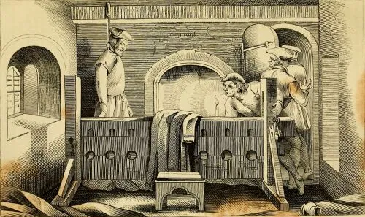
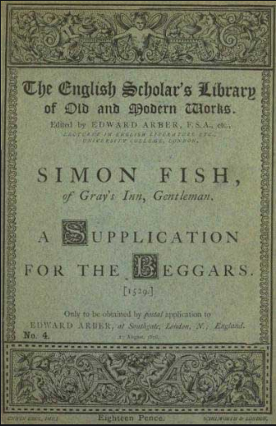
Condition of the Church
Parish Churches and Chapels There was a lot of Church building in the late Medieval period. Nearly two-thirds of English Parish Churches were built or rebuilt in the C15th. For example in Louth, in Lincolnshire, fundraising produced £305 to build the parish Church and more money was raised between 1501-1515 to construct a magnificent spire. Money was left in wills to the Church by a large proportion of people – 57% in Devon and Cornwall between 1520 and 1527. It was however lower in the South East.
Corruption in the Church William Melton was the Chancellor of York Minster from 1496-1528. Melton wrote his Exhortation at the start of Henry VIII’s reign. He criticised clergy for lacking in training and discipline. (In particular being drunk, being with women, time in hunting and hawking, not focused on reading) Wolsey was guilty of pluralism and absenteeism. In the 1520s he became Bishop of Durham in 1523 and Bishop of Winchester in 1529, both important and with a good income. He also was appointed Abbot of St Albans, one of the richest monasteries. HOWEVER In Cardinal Morton’s visitation of Suffolk in 1499 he saw 489 parishes. There were only 8 allegations of sexual laxity, and two priests were suspended for ignorance. 48 were found to be absent, but in all but 2 cases they had appointed appropriate deputies and there was no suggestion of pastoral neglect In the diocese of Lincoln there were about 1006 parishes and over 2000 priests. At visitation of over 1000 priests there were only 25 accusations of sexual misconduct. 17 complaints over services not being done properly and 12 that rituals were not properly performed. Clergy were generally respected although elements of hostility were evident in the South East
Sacraments and Rituals There remained a high attendance at Mass. There was a lot of expensive equipment in churches required for the celebration of mass showing support.
Lay Piety There were works of popular devotion for lay people to encourage them to live holier lives such as Walter Hilton’s The Scale of Perfection and The Mirror of the blessed Life. Between 1486 and 1533 The Scale was published 5 times and the Mirror 9 times! Wills in the C15th show a steady increase in lay ownership of popular liturgical and devotional works, and it appears that these were the staple reading matter of the literate laity.
Anticlericalism Hunne’s Case in 1515 – Hunne was a London merchant who refused to pay his child’s mortuary fees. In 1511. He was later accused of Lollard heresy and was arrested and put in the Bishop of London’s prison where he was found hanged. A London jury returned the verdict of murder adding that the Bishop was an accomplice. There was a lot of tension in London and fear of social unrest. Wolsey, as the most senior Churchman had to kneel before Parliament for forgiveness. Issues such as pluralism, absenteeism and simony were criticised by some. Many criticised ‘benefit of clergy’ – this was where a priest could claim benefit of clergy and be tried and a church court, not the King’s courts. This often led to people escaping the death penalty. Also, those doing the work of absent priests could claim benefit of clergy if they could recite a part of the bible in Latin, or a ‘neck-verse’ as it saved their neck! This could also be accessed by laymen who could read Latin (the people involved in Hunne’s case were originally pardoned by a Church court) There was some dissatisfaction over tithes – a tithe or ‘tenth’ was what the laity paid to the Church (a Biblical practice). However, sometimes if parishioners refused to pay they were taken to the Church courts.
 | Challenges to the Church | Limitations to the Challenge
Lollards | Followed the teachings of John Wycliffe. They wanted reform of the Catholic Church and laid stress on lay piety, that is, the reading of the Bible by ordinary people should be encouraged. minimised the importance of the priesthood and the sacraments. questioned the doctrine of transubstantiation. | Lollards were a small group mainly based in the South East. Even though over 73 people were tried as suspects of being Lollards under Henry VII. Only 11 were burned for their crimes. In 1515 the Bishop of London complained about their heretical views, however this was complaint rather than a real problem.
Humanists – eg Erasmus, Colet and More | Humanists like Erasmus adopted a scientific approach to studying sacred texts. He decided to study the scriptures in their earliest form. He published the Greek New Testament, but also revealed the disparity between the original sources and religious traditions. Erasmus criticised certain groups in In Praise of Folly (1511). He criticised the monks who did not live godly lives. He also criticised how the Pope(s) did not live lives like Christ (who lived a life of poverty and service). Humanists placed emphasis on a religion that was less ritualistic and some criticised transubstantiation and tithes. They attacked the Church’s exploitation of practices such as veneration of saints and the selling of indulgences. Colet’s sermon to convocation in 1512 showed a humanist critique of the clergy not living good lives. He attacked immorality, their pursuit of wealth, issues of pluralism and absenteeism amongst other problems. | Humanists were a disparate group they didn’t all agree. Erasmus focused on reason whereas More focused on faith. They were well-educated and did not have a following amongst the masses.
Protestantism | Luther’s 95 thesis in 1517 started the Reformation and the ideas spread to England through the merchants. It was discussed in the White Horse pub by figures such as Tyndale and Cranmer. | There were clear responses to Lutheranism in England. There were public book burnings of Lutheran texts. In May 1521 Wolsey held book burning outside St Pauls in London. Protestant sympathisers in Universities were punished. Henry also published a book called In defence of the Seven Sacraments Protestant ideas were located mainly in the south Eastern towns and London. No mass following.
Henry VIII – The pre-Reformation Church
Simon Fish’s A Supplication for the Beggars
A pamphlet published in 1529 Written in common English and was only 14 pages long. This was addressed to the King and criticised greedy and over-fed clerics calling them ‘ravenous wolves’ and called monks ‘the great scab’ Some think this was passed to Henry by Anne Boleyn

Slide 9
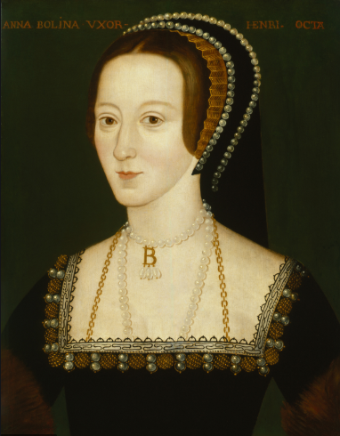
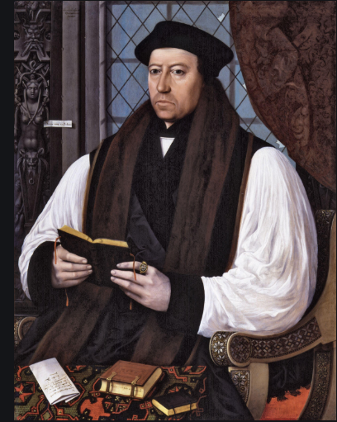
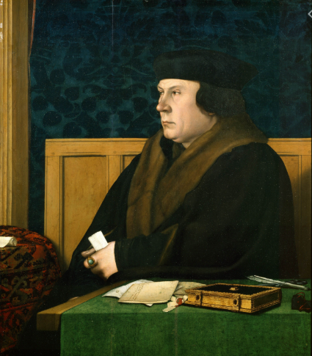
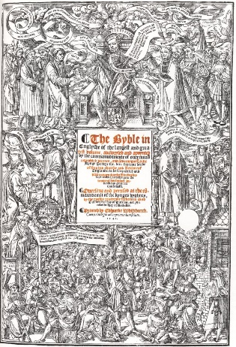
Trying to get the divorce
Collectanea Satis Copiosa Collection of historical documents by Thomas Cranmer and his team to justify Henry’s desire for a divorce on legal and historical principles. They found an account of a Pope telling a king he already had jurisdiction over the Church in England.
1531 Clergy accused of praemunire Forced clergy to accept the king was protector and supreme head of the Church, but the clergy added ‘so far as the law of Christ allowed’.
Act in Restraint of Annates Withheld clerical taxes paid on taking up a post to Rome.
Supplication against the ordinaries Cromwell introduced a petition in the House of Commons calling on the King to deal with abuses and corruption in the Church
Submission of the clergy Forced the clergy to submit to Henry and gave Henry power over Church laws and choose bishops. Thomas more resigned from the role of chancellor.
Henry VIII – Changes in the Church
Changes in doctrine
Ten Articles 1536 - issued by Cromwell , presumably written by Cranmer, passed by convocation. Only 3 sacraments (baptism, penance and Eucharist) were seen as necessary to salvation (Lutheran), but the definition of Eucharist was ambiguous. Confession (Catholic) was praised. Praying to saints for the remission of sins was rejected (Lutheran), but praying to saints for other purposes was deemed laudable.
Bishops Book 1537 Restored the 4 sacraments that had been omitted in the 10 Articles. However, these 4 sacraments were given a lower status. Purgatory was present only by implication.
6 Articles 1539—spearheaded in Parliament by the Duke of Norfolk (Catherine Howard’s uncle) and in climate of threat from France and Spain. This was conservative. It reasserted Catholic Doctrine. It confirmed transubstantiation, private masses and the hearing of confession by priests. It banned priests marrying and people taking communion of both kinds. Denial of transubstantiation was deemed heretical (and was punishable by death, this time without the chance for a recantation)
King’s Book 1543—written by Henry himself. This revised the bishops’ Book and the emphasis was largely conservative with some Lutheran hints. It defended transubstantiation and the 6 Articles. It encouraged preaching and attacked the use of images.
Burning for Heresy November 1538—John Lambert, a schoolmaster, was put on trial for denying transubstantiation. Henry himself presided over the case wearing all white. Henry quoted the bible “Hoc est enim corpus meum” or “This is my body” 1540—3 protestants were burned for denying transubstantiation but 3 Catholics were burned the same day for denying the royal Supremacy 1546—Anne Askew was burned for denying transubstantiation alongside 3 protestants.
Anne Boleyn – reformed leanings. Key to needing a divorce.
Thomas Cranmer– reformer and made Archbishop of Canterbury in 1533.
Thomas Cromwell– King’ chief minister 1532-1540. Made vice-regent spirituals in 1535 allowing him to make religious changed.
Break from Rome
Act in Restraint of Appeals 1533 Based on evidence in the Collectanea – declared the king had an ‘imperial’ kingship and so was not subject to any foreign power. Declared appeals could not be made to Rome regarding the Church in decisions ‘in cases matrimonial’ or other.
Act of Supremacy Gave legislative force to the royal supremacy. It acknowledged the King was Supreme Head of the Church.
Act of Succession 1534 Henry’s marriage to Catherine was void and so Mary was illegitimate. Succession should go through Anne Boleyn’s children. Denying Henry and Anne’s marriage was treasonable and all clergy had to swear their acceptance of the new marriage.
Treason Act Treason could be committed by spoken word, deed or action. Treasonable to call the king ‘heretic, schismatic, tyrant, infidel or usurper of the crown’.
Changes in practice
First Injunctions 1536—passed by Cromwell Restricted the number of Holy Days and discouraged pilgrimages. Clergy ordered to defend the Royal Supremacy in sermons.
Second Injunctions 1538 -passed by Cromwell Pilgrimages and veneration of relics and images were condemned as ‘works devised by men’s fantasies’. Clergy who upheld the value of pilgrimages, relics and images were required publicly to recant. Relics were to be removed. Required each parish church to acquire an English Bible within 2 years and encourage all to read it. (following Cranmer persuading Henry to sanction this)
Great Bible 1539 First edition in 1539. Had a title page showing Henry offering it to the people. It was based on Coverdale’s version.
Act for the Advancement of True Religion 1543 Restricted access to the English Bible to upper-class men and noblewomen in private.
1544 English Litany Cranmer wrote a litany in English. This was to replace the Catholic use of Latin liturgy but priests did NOT have to use it. (Litany= the part of a service where the priest and congregation made requests to God according to a set formula of words)
Changes in structure
Cardinals removed. Cromwell made ‘Vicegerent in Spirituals’/Vicar General’ in 1534. Cromwell was second to only the King and outranked both archbishops and bishops (the post died with him) 6 new diocese were created (but one was soon abolished) - this was done to try and improve the administration of the Church.

Slide 10
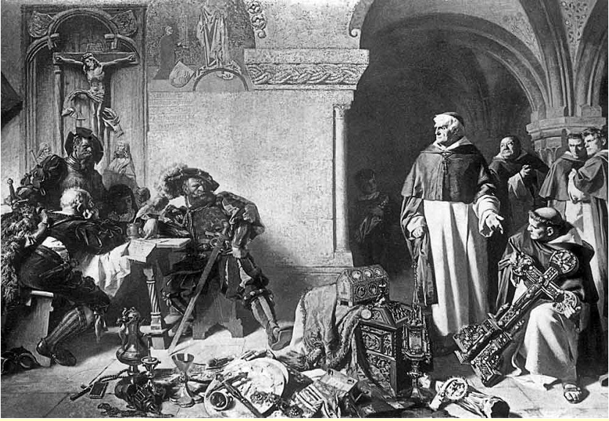
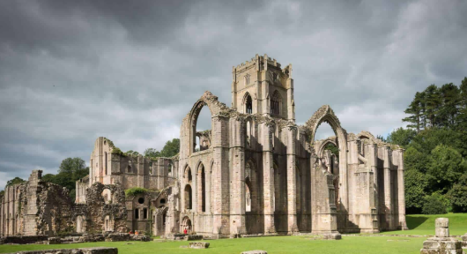
Causes of the dissolution
Monasteries were very wealthy. In 1535 Cromwell, on Henry’s instructions, sent out commissioners to survey the value of property of smaller monasteries – the Valor Ecclesiasticus. The survey revealed the monasteries had the potential to double income at a time when Henry needed money for his ambitions abroad. It showed the annual income of monasteries was £136,000. | Cromwell carried out a survey in 1535 which discovered abuses and corruption to be common throughout the smaller monasteries. Lots of this evidence was based on gossip or rumours. | There had been a decline in monasticism with only 10,000 monks. Some had lost the focus on poverty and had acquired servants and lived luxuries from renting land. | Seizure of monastic lands would give the crown property to distribute to buy support from the nobility and gentry. | Monasteries were reminders of the Catholic Church – even though they swore the oath of supremacy they were potential centres of resistance (notably the Carthusian monks in London). They may still owe loyalty to the Pope. | The primary role of monasteries – to pray for the salvation of souls- was out of keeping with new Protestant direction of individual faith in God.
Henry VIII – The pre-Reformation Church
Dissolution of the Monasteries
Act of Dissolution 1536 Smaller monasteries dissolved – those of under £200. Presented as preserving monasticism. Heads of houses offered a pension for retirement. Monks were transferred to surviving houses.
Voluntary dissolution A number of so-called voluntary dissolutions occurred through pressure from royal commissioners. Key one was surrender of the great priory of Lewes in Sussex to the King. All property passed to Cromwell – clearly all were under attack. 1538 – Cromwell and his remaining agents embarked on the dissolution of remaining large monasteries. Within 16 months 202 houses had surrendered.
Act of Dissolution 1539 Done partly in response to Heads of Religious houses being involved in the Pilgrimage of Grace. By March 1540 all remaining religious houses to be dissolved.
1540 Final monastery surrendered in 1540 – Warham abbey In all 563 houses were dissolved and 8000 monks pensioned off. Crown income doubles from £120,000 pa to £250,ooo pa with resale of monastic land at £1.3million
Chantry Chapels Chantries were where souls of the dead were prayed for. 18 were dissolved in 1540-1543 and 10 in 1544 and 27 in 1545. In 1545 an ct of Parliament allowed for 19 more to be dissolved on secular grounds of needing money to fight France and Scotland. However this was not used due to the war ending and money wasn’t required.
Impact of the dissolution – social impact
Education | The vandalism lead to the destruction of libraries of books, images and reliquaries e.g. Worcester priory had over 600 books, but only 6 survived. Monasteries had previously provided education for children from well-off families. Some of the wealth Henry attained was spent on education – new cathedral grammar schools were set up at Canterbury, Carlisle, Ely, Bristol, Chester and Worcester which can be argued lead to greater education in the middling classes. Christ Church, Oxford and Trinity College, Cambridge were set up by Henry. HOWEVER not clear if this shift to urban education was due to the loss of monasteries of broader impact of printing.
Monks and nuns | Most monks and friars found employment in the Church. About 6,500/8000 were moved on with pensions to other positions in the Church or in the homes of great Catholic families However a significant minority were left in hardship. Nuns were less well off – 2,000 nuns were allowed neither to marry nor to become priests.
The poor | Monasteries had traditionally helped the poor by offering support. For example there was a tradition that food left over from the monks’ table would go to the poor. Dickens argues it only aggravated an already worsening problem – dissolution was not a major cause of poverty (also many monks, as shown above, found new employment)
Profit | The Gold and silver and jewelled possessions were taken to the Court of Augmentations and then given away or sold off. May 1543 there was a rush to sell land to fund wars in France and Scotland. Over half of monastic land remained in Henry's possession in 1547. By 1547 the Crown had made £800,000 form sales (which meant Henrys subjects were spared harsher taxation)
Land ownership and social impact. | On the eve of the dissolution the Church owned 2,000,000 acres of land – 16% of England! Sale of monastic lands transferred power into the hands of the laity at local level. Land ownership extended further down the social scale –some lawyers and younger sons bought land NOT a ‘social revolution/rise of the gentry’ as lots of the land was bought by those already with land to consolidate their existing land. More men with land bought into politics so neither rise of gentry nor decline of aristocracy – Elton argues it was a move to power being held in more hands. Despite land ownership changing, a lot of the land rented out was still rented to the same people and the labourers remained employed.
Dissolution of the monasteries
Financial impact for Henry:
Due to new courts income from Crown lands increased from £25,000 to £86,000

Slide 11
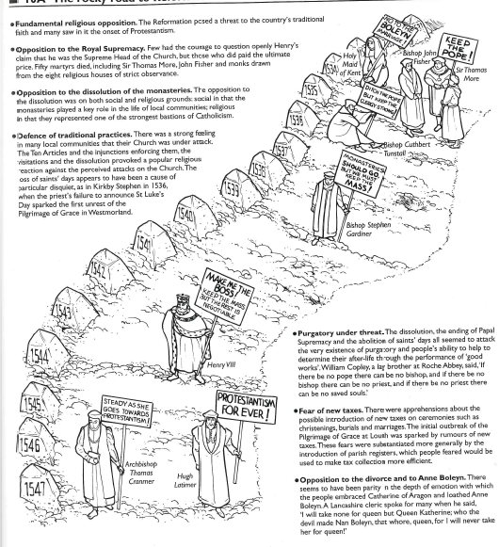
Resistance
Thomas More | High profile opponent of the marriage to Anne Boleyn More refused to swear the oath as part of the Act of Succession – sent to the Tower. Refused to explain why and avoided incriminating himself. According to Sir Richard Rich (one of Cromwell’s supporters) more was allegedly overheard in the Tower saying he did not accept Henry as head of the Church. Slender ‘evidence’ but enough to be executed.
Aragonese Faction | The group following Catherine of Aragon – small group of nobles and courtiers led by Henry Courtenay, Marquis of Exeter, and the northern Lords Darcy and Hussey. Darcy and Hussey joined the pilgrimage of Grace in 1536 following Mary's exclusion from the succession in 1536. Courtenay did not get involved in the Pilgrimage of Grace – he did become inked to his distant cousin, Reginald Pole, who had a claim to the throne. Courtenay was executed in 1539
John Fisher | Bishop of Rochester since 1504 Like more, refused to swear the oath accepting the divorce. Imprisoned in the Tower. The Pope decided Fisher was to be made Cardinal, so Henry had Fisher accused of high treason, tired and executed. This gained some support for fisher’s cause and led to accusations of Henry acting as a tyrant.
Elizabeth Barton – Nun of Kent | Had had visons since her teens. She was sent to a nunnery under the protection of Dr Edward Bocking, a Canterbury monk. 1528 her visions focused on the King’s marriage – warned of disastrous consequences if he left Catherine and threats of Henry being dead within a month of leaving Catherine. By 1530 Bocking developed Elizabeth's visions into a wider campaign against changes in the Church, Humanism, and Anne Boleyn. Rumours were deliberately circulated like Henry at mass having the bread seized by an angel. They developed links with Courtenay and Hussey as well as the Carthusian monks in London. Elizabeth was humiliated in 1533 at St Paul's cross where she confessed her visions were false. Elizabeth and Bocking were executed in 1534
Monastic Resistance | Cistercians and Benedictines were not active as groups, but some individuals preached against the divorce, supremacy n new heresies. 1532-1533 Carthusian monks in London refused to accept the divorce and in 1534 resisted government pressure to agree to a declaration against the authority of the Pope. After the Treason Act was passed they were forced to submit, arrested the most reluctant an executed 18.
Resistance to the Reformation
Pilgrimage of Grace (after Lincolnshire Rebellion)
Religious Causes The dissolution of smaller monasteries and the fear of it continuing. Leader Robert Aske was a supporter of monasteries and a demand was for monasteries to be restored. Fear for parish churches in the 1536 injunctions – seen as attacking traditional religious practices eg celebration of locally important saints like St Wilfred in Yorkshire. Rumours that Church plate and jewels, bequeathed by parishioners, would be confiscated. They called themselves ‘pilgrims’ and sang religious songs. Their logo was the 5 wounds of Christ.
Secular Causes Ordinary rebels more concerned with taxes as in 1534 Cromwell had introduced a subsidy tax – a tax in peacetime. Also opposition to Statue of Uses which was a tax on aristocratic landed inheritances. Crown’s attempt to impose the Duke of Suffolk upon Lincolnshire may have been a cause. Courtiers like Hussey and Darcy were motivated to restore Lady Mary to the succession. Cumberland and Westmoreland show tenants having issues over tenancy agreements and border-tenures (where they got land for military service) Enclosures were a grievance in the Pontefract articles as was ‘rack-renting’ where rents were raised. There had been poor harvests in 1535 and 1536.
Events Begins in East Yorkshire under Robert Aske who heard about the Lincolnshire uprising. Aske had 30,000 men who made York their bae Pontefract Castle surrendered to the rebels. Rebels issues the Pontefract articles – which blamed Cromwell and rich and demanded their punishment (loyal rebellion) Rebels met Duke of Norfolk where rebels presented their demands Rebels disperse after a truce was signed Royal proclamation offering pardon to rebels.
Consequences Shortly after the Pilgrimage ended Sir Francis Bigot decided to try and take Hull and Scarborough in January 1537. Henry retaliated and had 178 rebels executed including Aske, Lord Darcy and Bigod as well as Sir Thomas Percy. The Council of the north was reorganised to ensure better control.
Why wasn’t there more opposition?
Fear of Cromwell’s terror machinery and the treason Act.
Many thought changes wouldn’t last and many expected Henry to remain Catholic – the end goal was not clear!
Self-interest – many benefitted in purchasing land and clergy didn’t want to lose their jobs. Eg the vicar of Bray who kept his living from Henry VIII to Elizabeth and was accused of changing sides – he aid his main principle was to remain the vicar of Bray.
Didn’t notice- most of peoples day to day lives and church services remained the same.
Protestantism was welcomed by some!

Slide 12
Scotland – 1540s
James V increased tensions when he married Mary of Guise in 1538 (a relative of the French King)
James then refused to show up for pre-arranged talks with Henry at York in 1541 (following Henry’s sister, Margaret's death)
1542- Henry sent the Duke of Norfolk to attack Scotland. England won a massive victory at the battle of Solway Moss with over 1000 Scots taken prisoner and James died a few weeks later of a fever. (James wasn’t at the battle) leaving his week-old daughter, Mary, Queen.
Henry wanted to invade France so didn’t pursue military victory. He proposed the treaty of Greenwich in 1543 which wanted Mary to marry Edward to unite the two. However the Scots rejected this.
Henry ordered what became known as the ‘rough wooing’ The Earl of Hertford raided the Scottish border region and Edinburgh and Dunbar with buildings burned and people killed
Cromwell’s Fall
Henry was unhappy with the marriage to Anne of Cleves that Cromwell had organised. Henry wasn’t happy with some of Cromwell’s religious changed. Norfolk, Cromwell’s rival in the council, managed to get the 6 articles passed and lead Henry towards Catherine Howard thereby undermining Cromwell. Cromwell saw it as a temporary setback as Henry made Cromwell the Earl of Essex in 1540. Catherine spread rumours Cromwell was not getting the divorce quickly enough and that he was protecting protestants in Calais – these were declared to be proved by Act of Attainder. Cromwell was executed in July 1528 (the same day Henry married Catherine Howard)
Factions
Conservative Faction | Reform Faction
Accepted break with Rome but opposed doctrinal changes. Led by the Duke of Norfolk and Stephen Gardiner (bishop of Winchester) Associated with passing the 6 Articles in 1539, the fall of Cromwell, Catherine Howard. | Accepted break with Roe and saw an opportunity to make more changes. Led by Edward Seymour (Earl of Hertford – late duke of Somerset) and Archbishop Cranmer Associated with foreign policy success in Scotland, fall of Catherine Howard, rise of Catherine Parr
Henry’s later years 1540-1547
Development on council and Factional conflict
Catherine Howard | Catherine was proved to have been unfaithful. Catherine and the men implicated were executed. This damaged the conservative group.
Cranmer | 1543 The conservatives accused Cranmer of dabbling in heresy. The king rejected these claims and put Cranmer in charge of investigations.
Catherine Parr | Henry married Catherine Parr in 1543. She was close to the Seymour family and a Protestant sympathiser. Se gathered scholars at court and allowed them to manage Edward and Elizabeth’s education.
Plot against Catherine Parr | Members of Catherine Parr’s household were accused of heresy, as was she. Henry knew of the plot and allowed it to continue, but when guards came to arrest her, Henry sent them away.
Gardiner’s fall | Gardiner was accused of suggesting the Pope should be reinstated as head of the Church and narrowly avoided being sent to the tower. His involvement in the plot against Catherine Parr and n accusation of him refusing to give land to the king lead to him being pushed out of the inner circle of royal advisors.
Denny | October 1546 –Denny was made Chief Gentleman of the King’s Privy Chamber meaning he controlled access to Henry. He was also given control of the Dry Stamp. (makes an impression of the King’s signature which can be filled in with ink) This enabled the Reform faction to legalise any document.
Surry and Norfolk’s mistake | December 1546 – Duke of Norfolk and his son, the Earl of Surrey, were arrested. Surrey had spoke about his family’s claim to the throne and also put part of the royal coat of arms of his ancestor, Edward I, on his own family emblem without authority. Acts of Attainder were passed against them. Surrey was executed a week before Henry’s death. Norfolk escaped s Henry died before signing the order
Changes to Henry’s will | By the terms of the will, the regency was to be managed by a council of 16 men named by Henry led by the earl of Hertford (Edward’s uncle). It was balanced between reformers such as Hertford, Cranmer and Denny against Conservatives such as Wriothesley (Earl of Southampton) and Lord St John. However 3 days after Henry’s death Hertford was made Lord Protector’ which followed tradition, rather than the committee Henry had proposed. Then Hertford too the title Duke of Somerset and used promoted supporters and created his own privy council drawing on more men than originally envisaged.
Cromwell’s Fall in 1540
Originally
France 1540s
By 1541 Francis and Charles were at war again and in 1542 Francis allied with the Ottoman Turks against the Habsburgs.
Henry joined with Charles with an agreement to invade France within 2 years.
1544- Henry and an army of 48,000 sailed to Calais and advanced on Paris. However both sides pursued their own objectives. Henry went and captured Boulogne whilst Charles signed a separate peace with Francs at Crepy leaving Henry isolated.
Henry fortified Boulogne and returned home fearing a French invasion.
The French sent troops to Scotland leading to fear of invasion. The French managed to invade the Isle of White and there was disaster as Henry’s flagship, the Mary Rose, sank in the Solent.
Boulogne held out against French attack. An English victory.
1546 – Treaty of Ardres. Henry kept Boulogne and the French would pay a pension. If France paid all the pension money outstanding (£200,000) then Henry would return Boulogne in 1554.
Henry gained glory but at financial cost. It cost £2 million which required large-scale borrowing, the sale of monastic land and the debasement of the coinage.
Succession
1534 Succession Act – Elizabeth as heir and Mary declared illegitimate.
1536 Succession Act – declared Elizabeth illegitimate and Henry to declare heir apparent by will (which could have lead to Henry’s illegitimate son, the Duke of Richmond, being heir, however Richmond's death ended this possibility)
1544 Succession Act – repeals the 1536 act, reinstates Mary and Elizabeth in the succession and reaffirms Henry to determine succession by will.
1546 – Henry’s will confirms 1544 succession Act and lays that it would be Edward and his heirs, then Mary and Elizabeth, then heirs of Henry’s sister, Mary.

Slide 13
Edward VI
Edward was raised to rule. He had tutors such as Richard Cox He was clever, especially languages and theology He argued with his sister Mary over religion. He had traditionally been seen as weak and sickly, with him suffering from measles then smallpox in 1552 (however he recovered well) He died of tuberculosis in 1553, but before this he seemed to be of good health. He knew his own mind and was personally involved in creating the Devyse.
Religious change under Somerset
1547 – Parliament repealed 6 Articles, and the heresy, treason and censorship laws from under Henry. | 1547 – Injunctions – Attacked features of popular Catholicism such as lights, images, processions and stained glass. | 1549 – Act of Uniformity designated English as the language of worship and congregations to have both bread AND wine. Bur priests were dressed and behaved as always.
1547 – Dissolution of chantries and religious guilds – they were abolished and their property seized by the crown | 1547 – Denunciation of images reflected radical attitude of men such as Ridley | 1549 – book of common Prayer – a ‘masterpiece of vagueness’. Translated many Latin services into English (so much looked the same). Did not entirely deny transubstantiation but it also gave the impression of remembrance. (Even bishop Gardiner [in prison] thought it still implied transubstantiation)
Somerset
Brother of Jane Seymour Uncle of Edward VI Made Lord Protector after Henry’s death
Reactions to Religious change under Somerset
1548 – William Body was murdered in Helston in Cornwall for trying to remove objects of veneration | There was iconoclasm in London. In Much Wenlock the bones of a saint were thrown on a bonfire and in Norwich curates and ‘other idle persons’ went round looking for images.
Government under Somerset
Reinforced his owner by appointing Sir Michael Stanhope as Chief Gentleman giving control over the Privy Chamber – this created resentment
The Earl of Southampton was arrested for voicing his resentment at the protectorate.
Faction – brother Thomas Seymour tried to turn Edward against Somerset and tried to plot with Southampton against Somerset. When tried for treason Southampton denounced Seymour leading to Seymour’s execution and Southampton’s readmission into the council.
The council didn’t like his handling of Scotland or his mishandling of the rebellions in 1549 – he seemed weak.
Somerset’s arrogant and dictatorial manner created enemies. He used proclamations, 77 of them in 3 years! (and Somerset kept sole use of the dry stamp)
In 1549 Warwick and Southampton, with the Earl of Arundel and Lord St John tried to bring Somerset’s rule to an end. Mary refused to be involved.
In October 1549 the conspirators were ready to strike, which lead to Somerset retreating to Hampton Court palace with Edward, then retreating to Windsor castle. Somerset surrendered when promised no treason charges would be made against him.
In all of this, both sides knew control of Edward was vital to government, showing the King’s authority was still intact.
Edward VI and Somerset
Somerset’s foreign policy
Inherited Henry’s war against the Scots and wanted to enforce the marriage of Edward to Mary Queen of Scots.
French King died in 1547 and the new king, Henry II, sent 4000 troops to aid Scotland.
Somerset intervened at the Battle of Pinkie and won giving control of the border region, but could not control the whole of Scotland with garrisons – they could not capture the strategically important castles at Edinburgh and Dunbar.
The fleet failed to blockade the firth of forth properly and French ships relieved the Scottish and Mary was moved to France and was to be married the heir (who later became Francis II)
In total the war had cost £600,000 and the link between France and Scotland has been strengthened. He had inherited a bad situation, but England’s aims were not met. It lead to increasing resentment amongst members of the privy council.
Economy and finance under Somerset
Established a commission to investigate enclosures with inspectors touring the country. Poor families in the south and Midlands welcomed inspectors however gentry landowners who made money from sheep farming feared them and hated the new tax on sheep. Both sides were frustrated | Sheep tax 1549 aimed at deterring the conversion of arable land into pastoral land. This made sense for the Midlands. However it was a burden on hill farmers who struggled to make a living on sheep farming in the marginal highlands such as Exmoor and Dartmoor.
Somerset continued to debase the coinage – raised £537,000 but increased inflation. This was coupled with taxes for war against Scotland. Likewise land was sold and more was borrowed creating long-term problems for the crown’s finances. | Rising prices and rising population put pressure on food. This was especially bad in 1548 when there was poor harvest.

Slide 14
Kett Rebellion 1549
Religious Causes | Economic Causes | Political Causes
Rebels demanded the dismissal of inadequate clergy and those who were non-resident Showed support for religious reform by having services based on the book of Common Prayer in their camp. | Resentment at enclosures by landowners. Landowners denied access to the Norfolk foldcourse causing peasant distress. Groups tore down hedges The rebels marched on Kett’s home but he became their leader when he agreed to end enclosure on his estates and offered to lead them to secure their rights. | Hatred of local government officials Frustration at maladministration of the region by the Howard family.
Events and end
tearing down hedges Protestors headed towards Norwich Rebels camped outside Norwich – at height claimed to have 15,000 men. Rebels fired on Norwich Norwich fell to the rebels on 21 July Earl of Northampton failed to recapture Norwich Rebels finally defeated by Earl of Warwick
Western Rebellion 1549
Religious Causes | Economic Causes
Described as the ‘Prayer Book Rebellion’ as rebels called the prayer book as a ‘Christmas Game’. Other religious grievances were against the attacks on traditional Catholicism. In their demands they wanted ‘mass in Latin, as was before’ and ‘images to be set up again’ and ‘other ancient old ceremonies’ Resentment of gentry families who had bought Church land after the Reformation for their own use. | Cornwall - Resentment at the sheep tax which hurt hill farmers (as land was not good for arable farming) Hated the insensitive imposition of the sheep tax by local officials. In Somerset and Bristol mobs tore down hedges and fences that had enclosed land.
Events and End
Formation of rebel camp near Bodmin. Then Devon rebellion began and the two converged at Crediton. Rebels camped near Exeter Rebeles besieged Exeter Lord Russel advanced on the rebels and defeated them.

Slide 15
Northumberland and government
Tried to avoid Somerset’s mistake by making himself Lord President of the council – not Lord Protector.
Warwick (Northumberland) turned on his conservative allies (Southampton, and Arundel) out of fear
Warwick promoted himself to be Duke of Northumberland.
Appointed his ally, sir John Gates as vice-chamberlain of the household to ensure control over court.
Paget drew up guidelines for the more effective operation of the council – Northumberland instituted some.
William Cecil rose to prominence due to his skill and became Northumberland’s chief administrator. William Cecil had to liaise between Northumberland, the Council and the Royal Household.
Somerset plotted to recover his old position, showing faction, but was defeated and executed.
Northumberland used proclamations less than Somerset, and when he did he was cautious to found them on parliamentary statute.
After Somerset’s execution he became less concillar and removed threats such as Paget from the council.
Northumberland increasingly kept power with him and Gates who had possession of the Dry Stamp
Northumberland’s religious policy
1552 Treason Act – became treason to question the royal Supremacy or an beliefs of the Church
1552 – Second Act of Uniformity - became an offence to not attend Church services. Offenders fined or imprisoned.
1552 – Prayer book – removed all traces of Catholicism. Last Supper/Eucharist now remembrance and the wafer was replaced with bread. Vestments were banned and Church music was restricted. The baptism, confirmation and burial services were all re-written by Cranmer
1553 – instructions sent out to replace all altars with communion tables.
1553 the Church started to confiscate Church plate.
In 1553 Cranmer published the 42 articles setting out the essentials of the faith of the Church of England. They showed a more reformed slant, but were never passed into law.
Combined the diocese of Gloucester and Worcester, with 2/3 of the Worcester estate going to the crown.
Reasons for more radical religious change under Northumberland.
1)Cranmer was moving in a more radical direction | 2) Radical clergy such as Hooper and Ridley were becoming more influential.
3)Continental reformers like Martin Bucer and Peter Martyr moved to England. | 4)Edward VI took an increasing role. He took his role as Head of the Church seriously and wanted to purify the Church (like Josiah)
Responses to Religious Change
Churchwarden accounts show that the Crown’s orders in destroying Catholic habits were gradually put into effect, however restoration under Mary was swift. | Expenditure on Church good declined after 1540
 | Decline in Church attendance in Exeter
People were less likely to leave money to the Church in their wills. Northern wills it went from 70% between 1540-1546 to 32% under Edward. In Lincolnshire and Huntingdonshire it declined from 66% in 1545 to 10% in 1552. | Some parishes sold their Church plate or hid it before the Crown confiscated it.
 | Decline in number of candidates for ordination.
Northumberland’s foreign policy
Signed a peace treaty with France – Treaty of Boulogne. Boulogne was returned in exchange for £133,333. England also had to abandon garrisons in Scotland. Agreed Edward to marry Henry II’s daughter Elizabeth. Represented a humiliating defeat to many However it helped stabilise finances
Edward VI and Northumberland
The Devyse to alter the succession
Henry’s Act of succession set out it was to be Edward (and his heirs) then Mary, then Elizabeth. Edward became ill in 1553 and was dying. Edward was keen to avoid Catholic Mary becoming queen Edward decided to declare his two sisters illegitimate (as had been done under Henry) and pass the throne on to Lady Jane Grey who was married to Northumberland’s son, Guildford Dudley. Edward’s involvement can be seen by him editing the Devyse in his own handwriting. However Edward died before parliament could ratify the Devyse as law, therefore the Devyse was illegal. Northumberland retreated with Lady Jane Grey when Edward died Mary gathered supporters in Norfolk where many resented how Northumberland had put down Kett’s rebellion. The navy declared loyalty to Mary. The other members of the council declared Mary queen. Northumberland and Lady Jane grey were arrested and sent to the Towe.r Northumberland was executed. It showed the only successful coup lasted 9 days and demonstrated how well established the Tudors were.
Economic/financial Problems | Northumberland’s economic and financial policy
Expensive war with Scotland and France Debased coinage led to inflation. Population increase increasing pressure on food supplies and prices. Poor harvests in early 1550s increased grain prices. Cloth trade with the Netherlands suffered problems with drop in exports in 1551 created unemployment amongst textile workers. | Ended war with France and Scotland which cut expenditure and brought in £133,333 Did debase one final time, then he abandoned the practise. Coinage was called in and reissued to the same value as it was in 1527. Cecil and Gresham sold off chantry lands to pay off loans Customs and Excise rates increased. Sheep tax repealed in 1550 New poor law passed in 1552 Anti-enclosure legislation was enforced but the unpopular enclosure commissions ended. Encouraged trade – eg with West coast of Africa

Slide 16
Marian government
 | Weaknesses | Strengths
Monarch | Mary herself had not been brought up to rule. Mary frequently ignored council having had discussions with Renard. | She was decisive and had a clear idea of what she wanted. He seizure of the throne showed strength.
Council | Loyal and trusted supporters, who were in her council, such as Rochester and Bedingfield, had little governmental experience. May appointed 50 councillors – some say this council was large and therefore ineffective. Some suspicion of councillors – Paget served under Edward and Gardiner had not supported Catherine of Aragon. Accusations of faction between Catholics led by Gardiner and moderates led by Paget. | Had men such as Stephen Gardiner who had experience of government under Henry VIII (was secretary) Swore in more moderate members of Northumberland’s council in October, such as Paget, to provide ability. The working council was much smaller than the large number of men with the title ‘councillor’ – men such as Paget and Gardiner dominated the working council. Stories of faction were started by Simon Renard, the Spanish ambassador in an attempts to cajole Mary into relying on him more.
Parliament | Opposition in parliament over property rights and opposition to element of her religious settlement that wished to restore monastic land. Parliament opposed a bill in 1555 to seize property of protestant exiles. Division over the succession. | Only a minority (80MPs) opposed her religious changes. Taxes were granted and parliament generally did what Mary wished.
Finance | Gave away crown lands to re-establish some monastic foundation's Remitted final part of Edward’s last subsidy – bought popularity but at financial cost. Level of royal indebtedness increased. | Restored the Exchequer which took over from the Court of First Fruits and Tenths and Court of augmentations whilst taking on some of the courts’ more updated methods. Plan made to recoin to end debasement – this was not achieved in her lifetime – Elizabeth put it in place and benefitted 1552 customs rates raised (first time since 1507) and in 1558 a new book of rates was issues which increased customs revenue from £29,000 to £85,000 per annum. 1555 – survey of Crown lands to raise entry fines and rents in 1557.
Spanish Marriage | Succession
Mary wanted to marry Phillip – Phillip’s father, Charles V had supported Mary for a long time. The English public opposed the marriage. Parliament drew up a marriage treaty Phillip given title of king but no power. No foreigners could hold English offices. If Mary died before Phillip, then Phillip had not claim to the crown. Parliament opposed treason laws that included Phillip and in 1555 prevented his coronation. Phillips did not like the marriage – Mary was 11 years older, didn’t like the weather and the court and people were unwelcoming. | Mary had false pregnancies in 1554 and 1557. Phillip spent much time away – he visited in 1554 for the marriage and then in 1556 to persuade her in joining war against France. According to the 1544 Succession Act, Elizabeth was next in line, however Mary did not like her (Elizabeth’s mother, Anne Boleyn, was the reason for Catherine of Aragon’s divorce) Mary considered Elizabeth illegitimate. Mary was not able to implicated Elizabeth for treason in the 1554 Wyatt rebellion. Phillip was instrumental in persuading Mary to accept Elizabeth as her heir. (Phillip was more concerned about Mary Queen of Scots taking the throne with her French blood and marriage)
Mary I
Government
Wyatt Rebellion
Nationalist Causes | Religious causes | Economic Causes | politics
Opposition to the Spanish marriage and fear of a Spanish takeover. | Many of Wyatt’s supporters came from Maidstone – a protestant stronghold. | The local Cloth Industry had declined leading to some poorer rebels using it to express grievances. | Some of the gentry had lost office within the country
Events
Plan was for four simultaneous uprisings – in Devon (led by Edward Courtenay, Earl of Devon), Hertfordshire, Leicestershire and Kent (under Wyatt). Only Kent experienced a serious uprising with 3000 men assembled. Their aim was to remove Mary and replace her with Edward Courtenay who would marry Princess Elizabeth. (However, the involvement of Lady Jane Grey’s father implied he wanted her to be restored showing conflict of plan) Wyatt outmanoeuvred the Duke of Norfolk. The rebel army reached London but could not cross London Bridge due to the Crown’s forces.
Impact
It showed protestants, even if a minority, could not be ignored. Led to Lady Jane Grey’s execution. Elizabeth was arrested and confined to the Tower of London – but eventually released as no charges could be found.
Social and Economic problems
Rapid increase in the population put pressure on food and housing increasing prices.
Debasement of the coinage continued to lead to inflation.
Harvest failures of 1555 and 1556 brought food shortages and increased prices – was also seen by some as a sign of God’s punishment on a Catholic monarch.
‘sweating sickness’ swept through the country in 1557-1558
Taxation was high in order to pay for the war against France.
Laws were made against those who hoarded grain to try and ease pressure and Mary encouraged people to turn pastoral land to tillage (growing crops)

Slide 17
Mary’s Religious Policy and conflict.
1553 First Act of Repeal | Doctrine and order of service of the Church was restored to what it had been at Henry VIII’s death. All of Edward’s changes were removed. Clergy who had married when permitted were to be deprived of their livings (fired)
Heresy Laws | The Heresy Laws from under Henry VIII were restored. This meant denial of transubstantiation was punishable by death.
1555 Second Act of Repeal | Abolished all doctrinal legislation since 1529. Removed the Act of Supremacy
Pastoral improvements | Pole’s legatine synod in 1555-1556 made expectations clear: Bishops were to reside in their diocese and had to preach and oversee their priests. Proposed (although never happened) that every Cathedral should have a seminary attached to train and recruit priests. New editions of the Prayer Book and Bible were issued for training and guidance.
Disagreement over land | Land from dissolved monasteries had gone into private hands when sold. The Pope and Pole were told there was no chance of it being restored. There were furious debates between Pole and councillors. Pole’s attitude on land meant councillors were suspicious of him.
Disagreement with the Pope | Pope Julius III died in 1555 and was succeeded by Pope Paul IV who was anti-Spanish. Paul was also suspicious of Pole. Pole was stripped of his role as papal legate in 1557 and accused of heresy and summoned to Rome. Mary refused to send Pole to Rome Mary refused to accept Peto, the Pope’s new papal legate, as having higher authority than Pole as Archbishop of Canterbury – this showed disagreements over supremacy.
Burning of Heretics
There was little opposition to Mary. Around 80MPs votes against her Act of Repeal, but this was a minority and the legislation was passed. Around 800 people, normally more wealthy and education, went into exile at centres of European Protestantism, but this again was a tiny fraction of the population.
Protestants who refused to renounce their faith were burned at the stake – a symbol of purifying the body politic.
In total around 289 Protestants were burnt at the stake.
Some victims were famous such as Cranmer, Latimer (former Bishop of Worcester), Hooper and Ridley.
21 clergymen suffered and 8 victims were from the gentry.
The bulk of people burnt at the stake were common – this suggests it was not just those who benefitted financially from Protestantism who believed.
The geography of burnings shows a heavy slant towards the South East. More than 3/4 of martyrs were in the south East and east Anglia. 60 burning were in London. Other areas were Canterbury (Kent), Lewes (Sussex) and Colchester (Essex). On the other hand there were no burnings in Durham in the North.
Policy seemed to backfire – the first two victims were two popular preachers, John Rodgers and Rowland Taylor were burnt at Smithfield in London and Hadleigh in Suffolk attracted widespread sympathy.
Extending the victims to a range of humble people seemed to strengthen sympathy for their martyrdom.
The Council seemed worried about the burnings – they banned servants, apprentices and the young in general from attending.
Mary I
Religion and foreign Policy
Foreign Policy
Mary wanted to return to papal supremacy and marry Phillip.
Married Phillip as part of the Marriage treaty in 1554 and the marriage in 1554
Phillip wanted Mary to aid him in war against France. Mary wanted to avoid this. She had some success getting them to sign the Treaty of Vaucelles in 1556 agreeing to a 5 year peace.
However Mary joined the war in 1557 – Pope Paul IV was a cause of the war and anti-Spanish – Mary was now at war against the Pope!
In 1557 Scarborough was raided by Thomas Stafford and French troops – defeated.
England successfully assisted the Spanish at the siege of St Quentin and dealt with a minor incursion by the Scots.
1558 – loss of Calais – humiliating and the attack on the Port of Brest failed.
Mary had plans to reform the Navy – she set aside £14,000 for the Navy in peacetime and built 6 ships. This benefitted Elizabeth.
Militia reforms were passed by Act of Parliament. It made it easier to raise troops when required. John Guy called this a ‘landmark in English military organisation.’

Slide 18
The Council
Key Councillors William Cecil (Lord Burghley 1571) Robert Dudley (Earl of Leicester 1564) Sir Christopher Hatton In the 1580s Sir Walter Raleigh became a favourite Sir Francis Walsingham was one of the Queen’s Principal Secretaries – he wanted more radical Protestantism.
Factional Rivalry There have been accusations of faction under Elizabeth, in particular between Cecil and Dudley (with Cecil as more moderate and pragmatic vs Dudley and his Protestant ideologues, also between Robert Cecil and the Earl of Essex from the 1590s) Differences in opinion over supporting Huguenot rebels in XXXX – Cecil urged caution, Dudley wanted action. Cecil worked against Dudley’s attempts at marriage to Elizabeth in 1560 (for example spreading the rumour about Amy’s death that Dudley was responsible) Marriage in 1567 to Charles of Austria – Cecil for and Dudley against (Leicester won citing their religious differences) Differences over the arrival of Mary Queen of Scots in England – Cecil wanted to establish n alliance with foreign protestant powers, Dudley wants to find an agreement with Mary and France. Differences over supporting the Dutch Rebels eg in 1578 – Cecil urged caution, Dudley wanted action and for England to become the European defender of Protestantism. (Elizabeth sided with Cecil avoiding direct conflict until 1585) 1579 – Elizabeth’s proposed marriage to the Duke of Alencon. Cecil for, Dudley against. The council worked united against the Queen over Mary Queen of Scots in creating the Bond of Association and pressuring her to execute Mary. 1593 – Essex wanted an aggressive protestant foreign policy and he secretly negotiated with James VI of Scotland. He was opposed by Robert Cecil who wanted a maritime war policy. 1596 – Essex opposed Cecil who wanted to end war with Spain after France and Spain made peace. 1598 Essex opposed proposals that he should be sent to Ireland as Lord Deputy as he saw it as a plan by the Cecil faction to remove him from court. In a heated discussion he turned his back on the queen (who then slapped him!) 1601 – after a disastrous campaign in Ireland and the Queen’s failure to renew his sweet wine monopoly, Essex plotted rebellion. He failed.
Limits to Faction: Councillors were broadly aligned on key ideas Protect the Queen Establish Protestantism (especially after the Duke of Norfolk was removed in 1571) The Queen should marry/name an heir At the start of her reign all agreed she should intervene in Scotland.
Growing Weaknesses in the later years From the late 1580s a number of key ministers died in quick succession eg Leicester in 1588. The queen often was slow to make replacements or tended to rely on her ministers’ middle-aged sons who didn’t always have their fathers’ ability The lack of senior noblemen shows it no longer included the country’s most important families. She refused to allow Burghley to retire even though his effectiveness diminished in the 1590s.
Parliament
Overview: Neale proposed thesis that the Elizabethan era saw the rise of conflict between Crown and Parliament citing that there was the rise of the gentry, organised opposition (like the so-called Puritan choir), more conflict and increased tactics and organisation. However others, such as Elton have disproved this.
Examples of ‘conflict’ in Parliament | Neale’s view | Revisionist view | Elizabeth’s response
1559 – Bill introduced to restore the supremacy. Parliament voted it down | It was the organised opposition from Puritans who wanted further change | Little evidence of cohesive group in the commons. More opposition came from Catholics in House of Lords. | Elizabeth imprisoned 2 Bishops after their public disputation. Then all bar one bishop agreed.
1563 and 1566 – Elizabeth needed money for foreign policy. Parliament demanded she name a successor. | It was the puritan choir lead by Wentworth. He also demanded freedom of speech. | The campaign was orchestrated by Elizabeth’s council after her health problems. The petition included 8 privy councillors and in 1566 it was created by Cecil | Elizabeth reminded them of her status. She also forbade further discussion (but then said she would marry).
1571 – following Revolt of the northern Earls and Excommunication – request for Parliament was from Council | New Puritans like Thomas Cartwright. They had a new document in 1572 by John Field called Admonition to Parliament which wanted to remove all elements of the ‘Popish dunghill’ from the English Church | Council feared for Elizabeth’s life and wanted Mary removed from the succession. This was spearheaded by 2 councillors Knollys and Croft (as well as Cecil) | Elizabeth agreed to executed Norfolk but refused to execute Mary.
1576 – Queen wanted taxes even though at peace. | Wentworth demanded freedom of speech, | Wentworth was sent to the Tower by the Commons for offensive remarks made against the Queen. | Elizabeth continued with her limited version of freedom of speech eg that issues like marriage, religion and foreign policy were her prerogative.
1584-1585 – Parliament called for Queen’s safety after William of Orange was assassinated and discovery of plot by Mary to kill Elizabeth | Puritans used this to start their ‘Bill and Book’ campaign to replace the Prayer book and church structure with a Presbyterian one (no bishops). They also demanded freedom of speech. | Not actually organised and was only a handful of people. The Commons refused to hear Turner’s proposal about the prayer book and system of Church government. The Parliament passed the Act for the Queen’s safety and acts against Jesuits, and money for the Navy. | Elizabeth stopped Burghley’s attempts to make the bond of association statue law. Elizabeth also ensured regardless of what happened to Mary, her son, James kept his rights.
General working was good. Of the 13 parliaments, all bar 2 were asked to grant revenue. As finances hadn’t been updated Elizabeth relied on ‘extraordinary’ revenue to cover ‘ordinary’ expenses. However she nearly always got the money she asked for. There were issues in her 1598 and 1601 parliaments over monopolies However, even in 1601 Parliament ended well after her ‘Golden Speech’

Slide 19
Finances
Local government
JPs William XXXXXXXXXXXXXXXXXXXX
Lord Lieutenants There
Use my Elizabeth access to history!
For ALL lizzy sections

