Slide 1
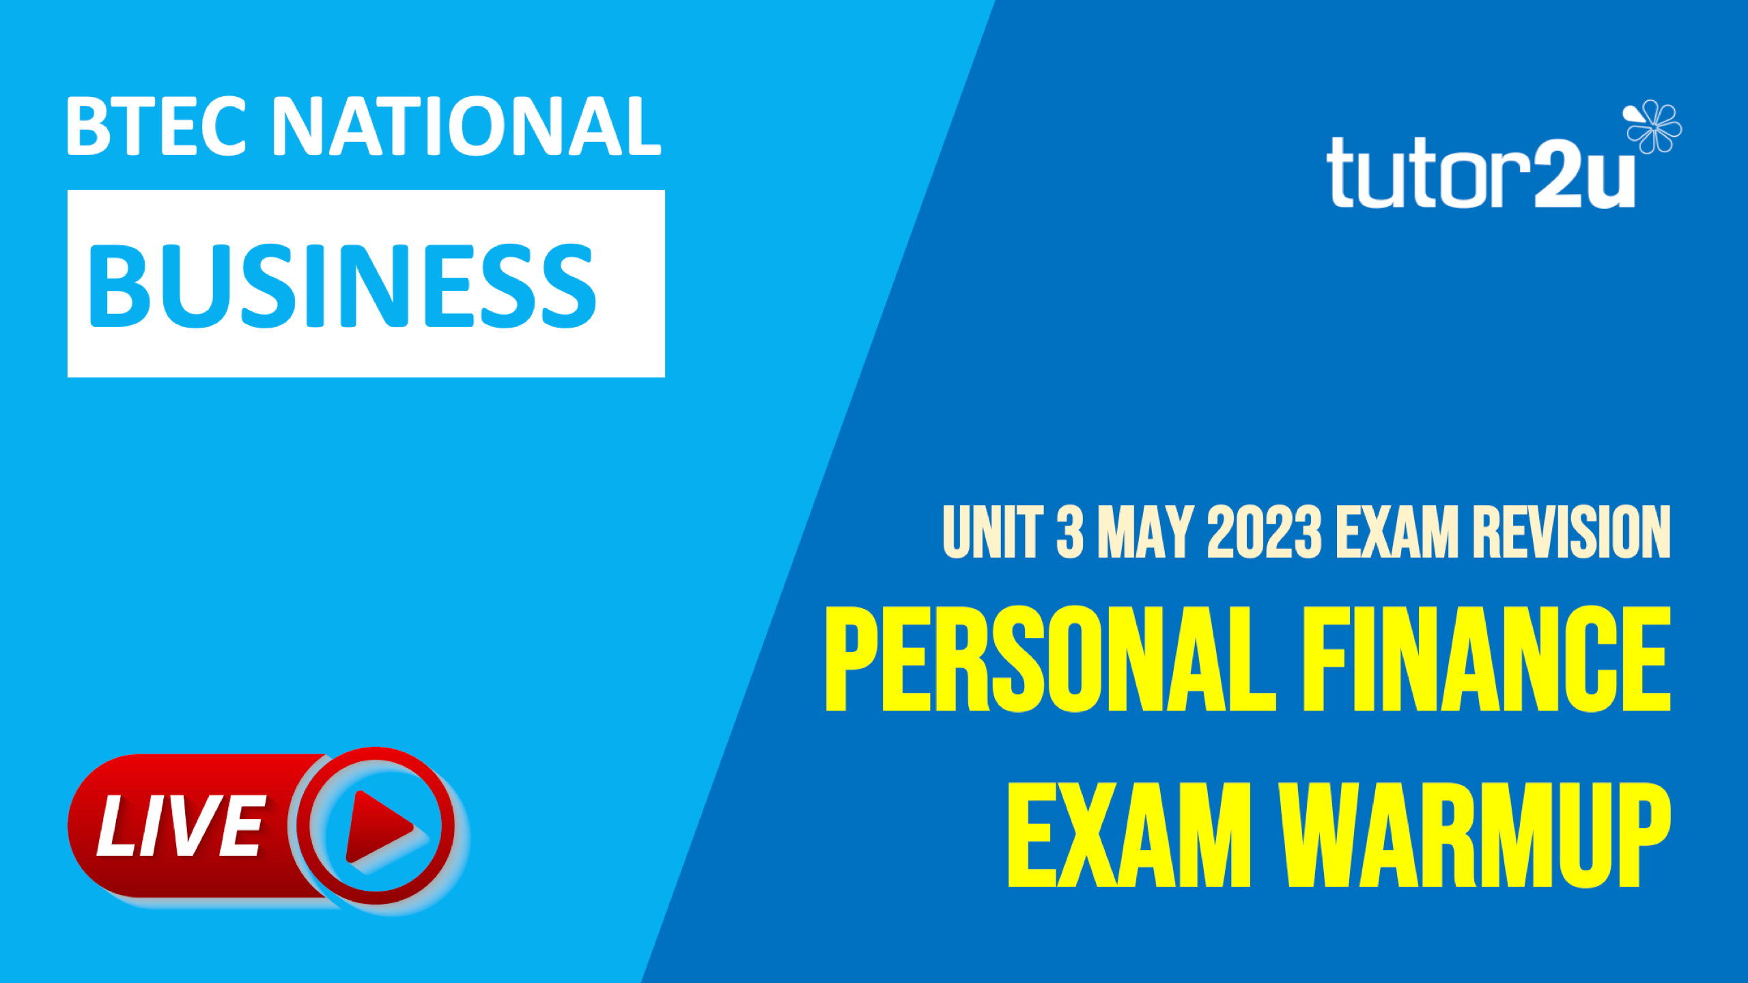

Slide 2


Which one of these is NOT a method of payment?
A
B
Cheque
Payday loan
C
D
Standing order
Cash
BTEC NATIONAL BUSINESS
UNIT 3

Slide 3
Which of the following is a life event?
A
B
Young adult
Middle age
C
D
Old age
Retirement
BTEC NATIONAL BUSINESS
UNIT 3

Slide 4
The Bank of England decides to lower interest rates. This is likely to result in
A
Lower cost of borrowing and lower savings returns
B
Lower cost of borrowing and higher savings returns
C
Higher cost of borrowing and lower savings returns
D
Higher cost of borrowing and higher savings returns
BTEC NATIONAL BUSINESS
UNIT 3

Slide 5



GIVE ME 2…
Providers of financial information or guidance
BTEC NATIONAL BUSINESS
UNIT 3

Slide 6
GIVE ME 2…
Providers of financial information or guidance
Citizens Advice - a charity that provides free and confidential advice to people in the UK on a wide range of issues, including money, housing, employment, and relationships
Money Advice Service - government-funded organisation that provides free and impartial advice on personal finance.
The Pensions Advisory Service: a charity that provides free and impartial advice on pensions.
Commercial personal finance websites: such as MoneySavingExpert
BTEC NATIONAL BUSINESS
UNIT 3

Slide 7
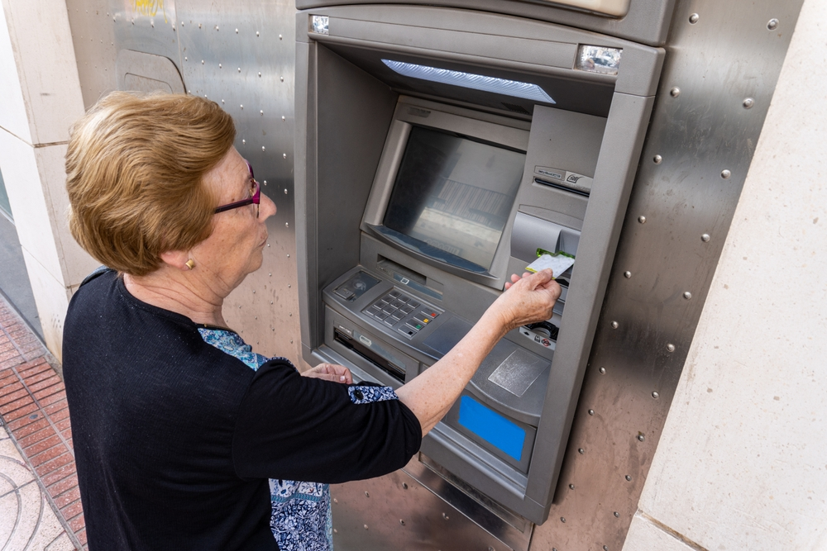
GIVE ME 2…
Reasons why cash is becoming less popular as a method of payment
BTEC NATIONAL BUSINESS
UNIT 3

Slide 8
GIVE ME 2…
Reasons why cash is becoming less popular as a method of payment
Convenience of contactless card or digital payments: more convenient than cash. They allow people to pay for things quickly and easily, without having to fumble with change or worry about losing their cash.
Security of card or digital payments: more secure than cash. They are less likely to be lost or stolen, and they are more difficult to counterfeit.
Much wider availability of card or digital payment options: Card and digital payment options can be used in most stores and online, while cash is not always accepted.
BTEC NATIONAL BUSINESS
UNIT 3

Slide 9

GIVE ME 2…
…features of student current accounts
BTEC NATIONAL BUSINESS
UNIT 3

Slide 10
GIVE ME 2…
features of student current accounts
Free or low-cost banking. Student current accounts typically have no monthly fees or low monthly fees. This can save students money, as they often have limited income.
Free or low-cost overdrafts. Student current accounts often offer free or low-cost overdrafts. This can help students to manage their finances if they are short of money.
Student-friendly features, such as contactless payments, mobile banking, and online banking
Discounts and offers on spending such as travel, insurance, and shopping
BTEC NATIONAL BUSINESS
UNIT 3

Slide 11

GIVE ME 2…
…reasons why young adults might save or invest
less than people in middle age
BTEC NATIONAL BUSINESS
UNIT 3

Slide 12
GIVE ME 2…
reasons why young adults might save or invest
less than people in middle age
Income. Young adults typically have lower incomes than middle-aged people. This means that they have less money to save or invest..
Living expenses. This is because young adults are typically paying for things like rent, student loans, and car payments.
Lifestyle: Young adults often have a more active lifestyle than middle-aged people. This means that they may spend more money on things like travel, entertainment, and dining out.
Less financial experience: young adults may not have as much financial experience as middle-aged people. This can make it difficult for them to make informed decisions about saving and investing
BTEC NATIONAL BUSINESS
UNIT 3

Slide 13

GIVE ME 2…
…life events which can have significant negative consequences for someone’s personal finances
BTEC NATIONAL BUSINESS
UNIT 3

Slide 14
GIVE ME 2…
life events which can have significant negative consequences for someone’s personal finances
Job loss: Losing a job can have a major impact on a person's financial status. Loss of income whilst normal living expenses such as rent & food remain
Health problems: may have to pay for medical expenses, such as treatment and prescription drugs. They may also miss work, which can lead to a loss of income.
Divorce or separation: may have to pay child support or split assets such as homes or other investments.
Retirement: no longer have a regular employment income; need to rely on savings, investments & pension.
BTEC NATIONAL BUSINESS
UNIT 3

Slide 15
GIVE ME 2…
…benefits of maintaining a good credit rating
BTEC NATIONAL BUSINESS
UNIT 3

Slide 16
GIVE ME 2…
benefits of maintaining a good credit rating
Lower interest rates on loans and credit cards: to borrowers with good credit ratings
Easier to get approved for loans and credit cards. Lenders are more likely to approve borrowers with good credit ratings
Lower insurance rates: insurance companies may offer lower rates to borrowers with good credit ratings.
Mental wellbeing: peace of mind knowing personal finances are in decent shape
BTEC NATIONAL BUSINESS
UNIT 3

Slide 17

GIVE ME 2…
Consequences of being declared personally bankrupt
BTEC NATIONAL BUSINESS
UNIT 3

Slide 18
GIVE ME 2…
Consequences of being declared bankrupt
Restrictions on credit & negative credit rating: a person who is declared bankrupt will have a hard time getting credit in the future. This is because creditors will be hesitant to lend money to someone who has already defaulted on their debts.
Loss of assets: a person who is declared bankrupt may have to sell some of their assets in order to pay off their debts. This could include their home, car, or other valuable possessions.
Psychological impact: bankruptcy can have a significant psychological impact on a person. They may feel ashamed, guilty, or stressed.
BTEC NATIONAL BUSINESS
UNIT 3

Slide 19


THE PERSONAL FINANCE
CONSULTANTS
Susan, a divorced 62-year-old, has recently retired from her job as a teacher. She has received a lump-sum from her pension of £40,000. Susan has an outstanding mortgage of £25,000. Her two children live away from home and both work in full-time jobs. Susan is considering using some of her pension lump-sum to repay the remaining mortgage.
List the potential advantages and disadvantages for Susan of using her savings to pay off her remaining mortgage
BTEC NATIONAL BUSINESS
UNIT 3

Slide 20
THE PERSONAL FINANCE
CONSULTANTS
SUSAN AND HER PENSIONS LUMP SUM
ADVANTAGES
DISADVANTAGES
Susan would save money on mortgage interest payments
Susan would have more financial security in retirement
Susan would have more disposable income each month
Susan would be able to leave a larger inheritance to her children
Susan would have less money to invest
Susan would have less money to spend on her retirement lifestyle
Susan would have less money to cover unexpected expenses
Susan would be less able to help her children financially if they needed it
BTEC NATIONAL BUSINESS
UNIT 3

Slide 21

THE PERSONAL FINANCE
CONSULTANTS
Jim is a 55-year-old man who is married and has two teenage children. He is currently self-employed as a YouTube content creator and does not have health insurance. He is considering taking out health insurance for himself and his family, but he is not sure where to start. He has heard about different types of health insurance, but he is not sure which one is right for him. He is also worried about the cost of health insurance.
List the factors that Jim will want to consider in choosing a suitable health insurance policy
BTEC NATIONAL BUSINESS
UNIT 3

Slide 22
THE PERSONAL FINANCE
CONSULTANTS
JIM’S HEALTH INSURANCE
Age: Jim is 55 years old, which is considered to be an older adult, so he may be at a higher risk for certain health conditions, such as heart disease and cancer. He will want to choose a policy that covers these conditions
Family history: Jim should also consider his family history. If he has a family history of certain health conditions, he may want to choose a policy that covers those conditions
Health status: Jim should also consider his own health status. If he is in good health, he may be able to get a lower-cost policy. However, if he has any pre-existing conditions, he will need to make sure that the policy he chooses covers those conditions
Cost: Jim will also need to consider whether the cost of health insurance premiums are affordable,
Coverage & exclusions: Jim will also need to consider the coverage that each policy offers
BTEC NATIONAL BUSINESS
UNIT 3

