Slide 1
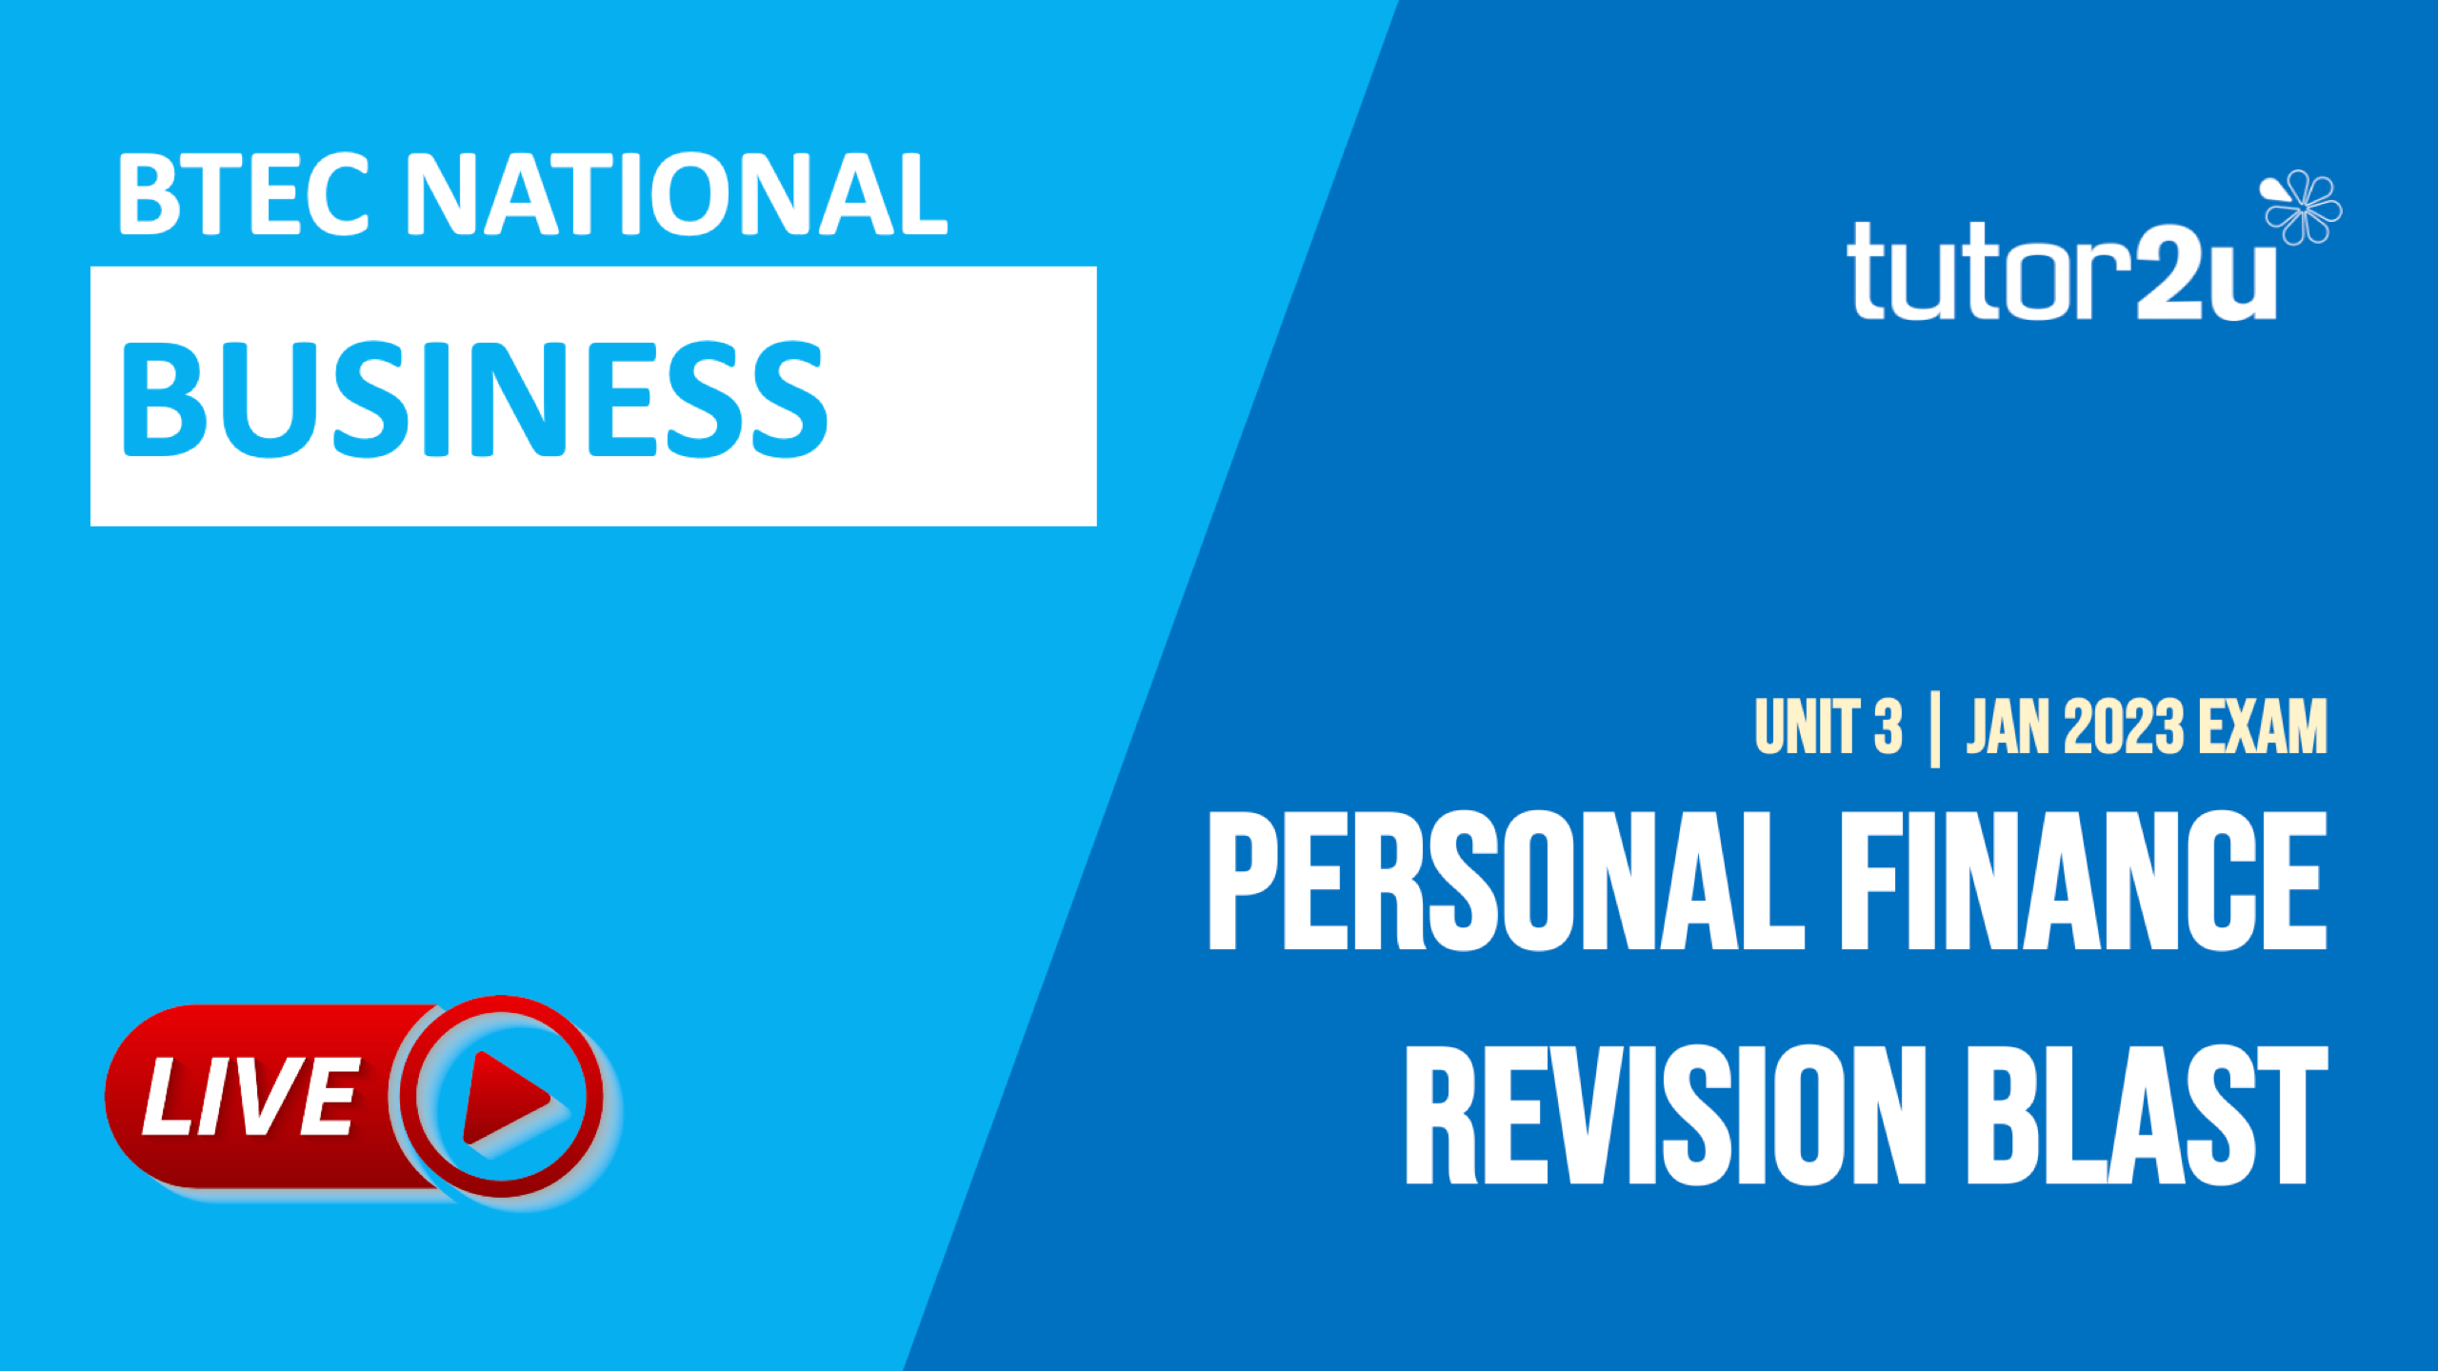

Slide 2


Which one of these is NOT a function of money?
A
B
Purpose of accounting
Legal tender
C
D
Means of exchange
Store of value
BTEC NATIONAL BUSINESS
UNIT 3

Slide 3
In which life stage is a person most likely to access the financial benefits of making pension contributions?
A
B
Young adult
Middle age
C
D
Old age
Adolescence
BTEC NATIONAL BUSINESS
UNIT 3

Slide 4
The Bank of England decides to increase interest rates. This is likely to result in
A
Lower cost of borrowing and lower savings returns
B
Lower cost of borrowing and higher savings returns
C
Higher cost of borrowing and lower savings returns
D
Higher cost of borrowing and higher savings returns
BTEC NATIONAL BUSINESS
UNIT 3

Slide 5
Which organisation helps resolve disputes between consumers and financial service providers in the UK?
A
Citizens Advice
B
Financial Conduct Authority (FCA)
C
Financial Services Compensation Scheme (FSCS)
D
Financial Ombudsman Service (FOS)
BTEC NATIONAL BUSINESS
UNIT 3

Slide 6
Jim has been out of work for many years and needs to obtain some cash very quickly for a few days. He recently inherited a valuable diamond necklace. Which of these is most likely to make a loan to Jim?
A
Payday loan company
B
Building society
C
D
Pawnbroker
Credit union
BTEC NATIONAL BUSINESS
UNIT 3

Slide 7
Heavily in debt, Jim decides to enter into a legally binding agreement with his creditors that allows Jim to repay his debts over an agreed period of 5 years. What is Jim using?
A
Money advice service
B
Individual voluntary arrangement
C
D
Bankruptcy
Debt counsellor
BTEC NATIONAL BUSINESS
UNIT 3

Slide 8
Which one of these is a kind of credit card?
A
B
Store card
Debit card
C
D
Contactless card
Pre-paid card
BTEC NATIONAL BUSINESS
UNIT 3

Slide 9


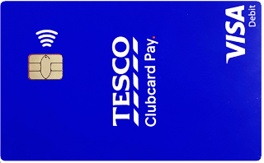

GIVE ME 2…
…advantages of using pre-paid cards
BTEC NATIONAL BUSINESS
UNIT 3

Slide 10
GIVE ME 2…
Advantages of pre-paid cards
Good for budgeting: a good choice for those on a budget, e.g., for parents who want to keep an eye on their children's spending. You can only spend or withdraw the amount added to the card.
1
Easy to obtain: don't require a credit check and, as a result, they are easier to get hold of than credit or debit cards.
2
BTEC NATIONAL BUSINESS
UNIT 3

Slide 11

GIVE ME 2…
…features of price comparison websites
BTEC NATIONAL BUSINESS
UNIT 3

Slide 12
GIVE ME 2…
Features of price comparison websites
Product/service search: Users can search for a specific product or service, such as insurance policies, mortgages, or broadband deals, and view a list of available options
1
Comparison and filtering: users can usually compare products by filtering and sorting the results based on criteria such as price, coverage, or provider, to help them find the most suitable options.
2
BTEC NATIONAL BUSINESS
UNIT 3

Slide 13
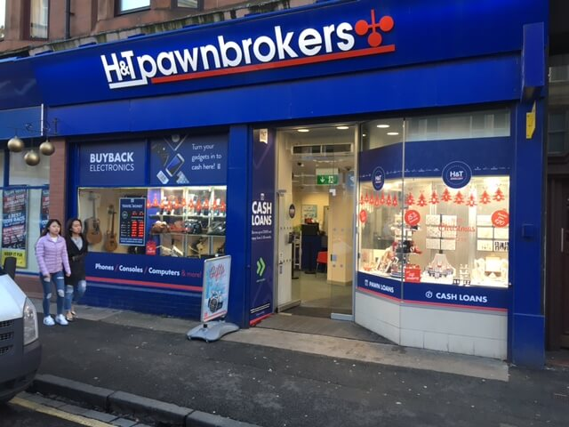
GIVE ME 2…
…disadvantages of using a pawnbroker to obtain personal finance
BTEC NATIONAL BUSINESS
UNIT 3

Slide 14
GIVE ME 2…
Disadvantages of using a pawnbroker
Very high interest rate. This can make it difficult for borrowers to repay the loan and may result in additional financial hardship
1
Risk of losing pledged item. Pawnbrokers lend money by accepting valuable items as collateral. If the borrower is unable to repay the loan, the pawnbroker may sell the item to recoup their losses.
2
BTEC NATIONAL BUSINESS
UNIT 3

Slide 15
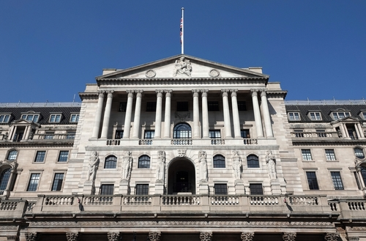
GIVE ME 2…
…advantages of investing in gilts
BTEC NATIONAL BUSINESS
UNIT 3

Slide 16
GIVE ME 2…
Advantages of investing in gilts
Very low risk. UK government bonds (gilts) are considered one of the safest investments available as the government will almost certainly not default on the interest and principal payments
1
Predictable income. UK gilts typically pay a fixed rate of interest, which is known as the coupon. This allows investors to predict the income they will receive from their investment,
2
BTEC NATIONAL BUSINESS
UNIT 3

Slide 17
GIVE ME 2…
…ways in which someone can maintain a good credit rating
BTEC NATIONAL BUSINESS
UNIT 3

Slide 18
GIVE ME 2…
Ways to maintain a good credit rating
Pay bills on time. Late payments can have a negative impact on a credit score. It is important to settled credit card balances, loans when due, and pay utility bills such as energy and water.
1
Keep credit balances low. High credit balances can indicate that someone overextending financially, which can negatively impact a credit score.
2
BTEC NATIONAL BUSINESS
UNIT 3

Slide 19
GIVE ME 2…
…ways in which a family could counter the effects of rapidly rising prices
BTEC NATIONAL BUSINESS
UNIT 3

Slide 20
GIVE ME 2…
Ways for a family to counter rising prices
Budgeting. Create an expenditure budget and stick to it. This will help a family better manage its expenses and identify areas where they can cut back.
1
Buy in bulk. Buying non-perishable items such as toilet rolls and canned food in bulk can save money in the long run, as bulk items usually have a lower unit price.
2
BTEC NATIONAL BUSINESS
UNIT 3

Slide 21
TRUE OR FALSE?
The earliest age you can start drawing a workplace or private pension is from the age of 55
TRUE
TRUE
FALSE
FALSE
BTEC NATIONAL BUSINESS
UNIT 3

Slide 22
TRUE OR FALSE
The limit on investing in an Individual Savings Account each year is £2,000
TRUE
TRUE
FALSE
FALSE
BTEC NATIONAL BUSINESS
UNIT 3

Slide 23
TRUE OR FALSE?
Most student current accounts include an interest-free overdraft facility
TRUE
TRUE
FALSE
FALSE
BTEC NATIONAL BUSINESS
UNIT 3

Slide 24
TRUE OR FALSE
UK Premium Bonds can’t be cashed in
TRUE
TRUE
FALSE
FALSE
BTEC NATIONAL BUSINESS
UNIT 3

Slide 25
TRUE OR FALSE
Investing in shares provides the investor with a guaranteed return through dividends
TRUE
TRUE
FALSE
FALSE
BTEC NATIONAL BUSINESS
UNIT 3

Slide 26
TRUE OR FALSE
Investment usually involves more risk than saving, but always better returns
TRUE
TRUE
FALSE
FALSE
BTEC NATIONAL BUSINESS
UNIT 3

Slide 27
TRUE OR FALSE?
Life assurance pays out a lump sum upon the death of the policyholder, whereas insurance provides a financial safety net in the event of specific types of loss or damage
TRUE
TRUE
FALSE
FALSE
BTEC NATIONAL BUSINESS
UNIT 3

Slide 28


THE PERSONAL FINANCE
CONSULTANTS
Michelle has just bought a 9-week-old Labrador puppy. Michelle has never owned a pet before. Michelle lives alone and earns over £100,000 per year. Michelle is risk averse and likes to be well prepared for things that might go wrong.
What factors should Michelle consider when deciding which pet insurance policy is the most appropriate for her?
BTEC NATIONAL BUSINESS
UNIT 3

Slide 29
THE PERSONAL FINANCE
CONSULTANTS
PET INSURANCE | FACTORS FOR MICHELLE TO CONSIDER
1
Full coverage. Some policies may only cover accidents and illnesses, while others may also include wellness care and routine check-ups
Exclusions: Michelle should check for any exclusions in the policy, such as pre-existing conditions or certain breeds.
2
3
Claim process: Michelle should research the claims process and make sure it is simple and straightforward.
BTEC NATIONAL BUSINESS
UNIT 3

Slide 30

THE PERSONAL FINANCE
CONSULTANTS
Grace is 18 years old. She is going into higher education later this year and wants to open a student bank account. Grace has limited savings and expects to have to work part-time whilst studying. Grace finds it hard to budget for her personal expenditure and often finds herself asking her parents for a “loan”. When not studying hard, Grace loves travelling and shopping.
What factors should Grace consider when deciding which student bank account is best for her?
BTEC NATIONAL BUSINESS
UNIT 3

Slide 31
THE PERSONAL FINANCE
CONSULTANTS
STUDENT BANK ACCOUNT | FACTORS FOR GRACE TO CONSIDER
1
Overdraft limit and terms. Student accounts usually offer overdraft facilities, which can be useful for students who may struggle to budget their money effectively.
Fees and charges. Grace should check for any fees and charges associated with the account, such as monthly maintenance fees or ATM withdrawal fees.
2
3
Perks and rewards. student bank accounts come with perks and rewards such as discounts on certain products or services, or cashback on certain types of purchases.
BTEC NATIONAL BUSINESS
UNIT 3

Slide 32

THE PERSONAL FINANCE
CONSULTANTS
Josh is a 45-year-old sales director. He recently inherited a significant cash sum. Josh is married and has two teenage children who plan to study at university. Josh and his wife would like advice as to whether to save or invest the inheritance.
What factors should Josh consider when deciding whether to save or invest the inheritance?
BTEC NATIONAL BUSINESS
UNIT 3

Slide 33
THE PERSONAL FINANCE
CONSULTANTS
SAVINGS OR INVESTMENT | FACTORS FOR JOSH TO CONSIDER
1
Attitude to risk. Investing typically involves more risk than saving. If Josh & his wife are not comfortable with the idea of potentially losing some of the inheritance, they may want to opt for saving instead.
Liquidity: they should consider if they might need access to some of the inheritance at short notice and choose the options that provide liquidity.
2
3
Taxation: For example, investments in some types of accounts may be taxed differently than savings.
BTEC NATIONAL BUSINESS
UNIT 3

Slide 34
PERSONAL FINANCE LIFE STAGE
LIFE EVENTS AND PERSONAL FINANCE
BTEC NATIONAL BUSINESS
UNIT 3

Slide 35
LIFESTAGE SPINNER
Middle
Age
Childhood
Supporting children through education
Helping children into housing market
Divorce
Bereavement & inheritance
Life events impacting personal finance
Young
Adult
Old
Age
Adolescence
BTEC NATIONAL BUSINESS
UNIT 3

Slide 36
LIFESTAGE SPINNER
Middle
Age
Childhood
Receive pension (monthly or lump-sum)
Mortgage paid off; kids left home
Health care needs
Life events impacting personal finance
Young
Adult
Old
Age
Adolescence
BTEC NATIONAL BUSINESS
UNIT 3

Slide 37



  PERSONAL FINANCE CHILLI QUIZ
  You have 60 seconds to answer one of three questions. Choose your question carefully. Each question has a different level of difficulty as rated by our chilli rankings below.
1
2
3
BTEC NATIONAL BUSINESS
UNIT 3

Slide 38
  PERSONAL FINANCE CHILLI QUIZ
1
Give me a way in which someone might get into debt
Failing to pay a credit card balance
Not meeting repayments on a loan or mortgage
2
Give me some events or other circumstances that can lead to problems with debt
Redundancy
Addiction (e.g., gambling)
3
Why should an
individual try to avoid personal bankruptcy?
Stress and emotional burden
Can restrict ability to work in some jobs
Severe impact on ability to obtain credit in the future
BTEC NATIONAL BUSINESS
UNIT 3

Slide 39
