Slide 1
E – Break Even & Cash Flow Forecasts
Cash Flow Forecasts - KEY DEFINITIONS
What is it? | A document showing the predicted flow of cash into and out of a business over a period of time, usually 12 months
Why is it important? | Cash flow forecasting allows businesses to ensure they have a healthy cash balance so they can meet their financial commitments. It enables them to identify any possible shortfalls and make plans to prevent this causing problems for the business.
Inflows | Cash inflows include: cash sales, credit sales, loans, capital, sale of assets, bank interest received.
Outflows | Cash outflows include: cash purchases, credit purchases, purchase of assets, VAT, general expenses and bills, rent/rates, salaries, wages etc
Net Cash Flow | The difference between Cash Inflows and Cash outflows (Inflows – Outflows)
Opening Balance | The amount of cash expected to be in the bank at the start of the month
Closing Balance | The amount of cash expected to be in the bank at the end of the month
Liquidity | How able the business is to meet its short term cash payments
Insolvent | When a firm is unable to meet its short term cash payments
Problems within the cash flow forecast
Problems occur for businesses when their outflows are greater than inflows. If this occurs frequently the business will run out of cash and fail to meet its short term and long term liabilities and become insolvent. Many businesses have irregular or fluctuating cash flows which vary throughout the year. It is important for businesses to prepare for periods when their inflows may fall or costs rise. A good example is seasonal business like tourism, when businesses need to make enough money in touristy periods to cover their expenses for the whole year.
Cash flow solutions
Overdraft arrangements | By arranging an overdraft with the bank businesses may be able to use bank funds to help meet their short term needs, when they are short of cash.
Negotiate with creditors | When businesses owe creditors money they normally have to pay them back within 30 days. They may be able to negotiate longer credit periods, giving them longer to pay the money back.
Review/reschedule capital expenditure | The business may have items of expenditure they are committed to buying. They may need to review these outgoings, find cheaper alternative or even cancel these purchases/expenditures altogether.
 | January | February | March | April
Opening Balance | 0 | (3,500) | (1,520) | 2,500
Total Inflows | 30,000 | 16,800 | 19,950 | 19,950
Total outflows | 33,500 | 14,820 | 15,930 | 16,350
Net Cash Flow (Inflows – Outflows) | (3,500) | 1980 | 4,020 | 3,600
Closing Balance | (3,500) | (1,520) | 2,500 | 6,100
Cash Flow Forecast Advantages & Disadvantages
ADVANTAGES | DISADVANTAGES
Encourages planning for cash inflows and outflows | Based on forecasts and therefore may be inaccurate
Enables cash flow to be monitored and corrective action taken if necessary | Cannot plan for unexpected events such as a rise in the cost of raw materials
Can be used as part of a business plan to help raise finance | Time taken to produce a cash flow forecast could have been spent on other tasks
Identifies in advance times of negative closing balances allowing the business to plan for these
Opening Balance plus inflows minus outflows=Closing Balance

Slide 2
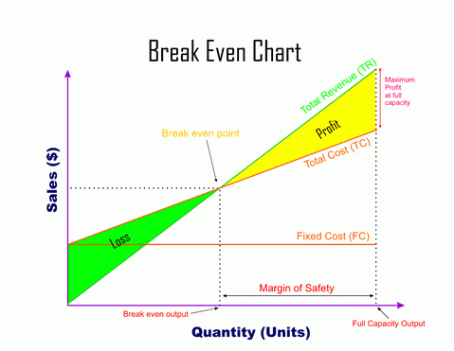
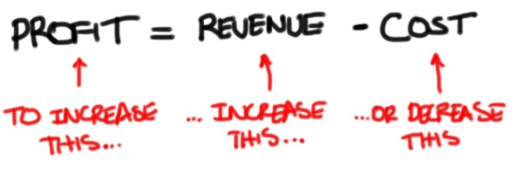
E – Break Even & Cash Flow Forecasts
Break Even Definitions & Calculations
Break even | This occurs when Total Revenue = Total Costs. Profit/ loss = 0. Break even point (no of units) = Fixed Costs / (Price – Variable Costs)
Variable costs | Change directly with the number of products made. e.g. stock, wages.
Fixed costs | Do not change at any level of output e.g. rent, salaries.
Total Costs | The sum of all costs at a any level of output. TC = Fixed costs + variable costs
Total Revenue | Money earned by a business by selling products. It increase directly with the number of products sold. Total Revenue = Price X Output
Profit | Money left after all costs have been repaid. Profit = Total Revenue – Total Costs.
Margin of Safety | The amount of output between the actual level of output where profit is being made and the break even level of output. Margin of Safety = Actual Output – Break even point output.
Contribution | Price per item – Variable cost per item. Price – variable cost.
Total Contribution | (Price – Variable Cost) x Quantity sold (P-VC)Q
Break Even Analysis Advantages & Disadvantages
ADVANTAGES | DISADVANTAGES
Business knows how many it must sell to cover its costs | Doesn’t take into account variations in costs or selling prices
Business can set targets | Doesn’t factor in businesses usually have a range of selling prices for different services
Helps identify fixed and variable costs | Forecasts may not be achieved
Can help identify if costs are too high and work on how to lower them | Targets set may be too high.
Can set staff/management targets | Doesn’t offer a time scale to achieve break even point
Easy way to calculate profit/loss
Why Use Break Even Analysis
Break Even | To set a target & understand risk. To understand how different Fixed or Variable costs or higher or lower prices would effect the break even point (What if analysis). To calculate their margin of safety – so a business understands how safe they are from making a loss To use in a business plan to obtain a bank loan. BUT, remember, it does not consider the impact of external factors, assumes that all output is sold and most businesses sell more than one product.
BREAK EVEN FORMULA
Break Even Point (B.E.P=
Fixed Costs
Contribution per Unit

