Slide 1
Language Paper One Revision Sheet
Question One
Q: Multiple Choice Question
Our Strategy:
Box off the right section of the text
Don’t make inferences (work anything out)
Don’t try to be too clever.
Question Two
Q: How does the writer use language to…?
Our Strategy:
Plan by boxing off the right section. Highlight juicy quotations that answer the question.
Explode these quotations.
Focus on effects rather than naming methods.
Look for patterns of language/semantic fields and discuss together to push for higher marks.
Sentence Starters:
The writer creates the impression that…
This is clear when…
The (method) suggests…
When we hear this word, we usually think of…
Therefore when applying this to… it suggests that… x2
Question Three
Q: How does the writer structure the text …. (you will be given a specific focus such as create suspense/tension etc )
Our Strategy:
Plan by summarising each paragraph with one word/phrase.
Ask 'Why is it in this order?' rather than how is the text structured to interest you?
Look at the beginning, middle and end of the text and talk about what you notice in these in three paragraphs.
For higher marks - use the phrase 'because we already know...' make links between different parts of the text.
Sentence Starters:
In the opening/exposition of the text, we learn that…
This makes the reader…
In the middle, there is a shift in focus onto…
The reader begins to…
At the end, we are told…
This has the effect that…
Question Four
Q: To what extent do you agree?
Our Strategy:
Plan by dividing the statement into two parts using two different colours. Highlight evidence to prove each one in the extract. Finally, use a third colour to find anywhere you might disagree with the statement.
Explode four key quotations remembering to think about methods and their effects.
Sentence Starters:
Yes I agree that the writer…start with a thesis statement if you feel confident
This clear when…
The use of the (methods) suggests…
And therefore the writer… x4
Question Five
Q: Use an image or the theme given to write your own piece of creative writing.
Our Strategy:
Plan by mind-mapping key vocabulary, character info, flashback ideas.
Write down a list of what you need to include and tick this off as you write.
Stick to the following structure: Setting/Weather, character description, character has a flashback, return to the weather/setting but with a change to reflect the tone of the flashback. For example, if it is a horrible memory, it might start to rain.

Slide 2
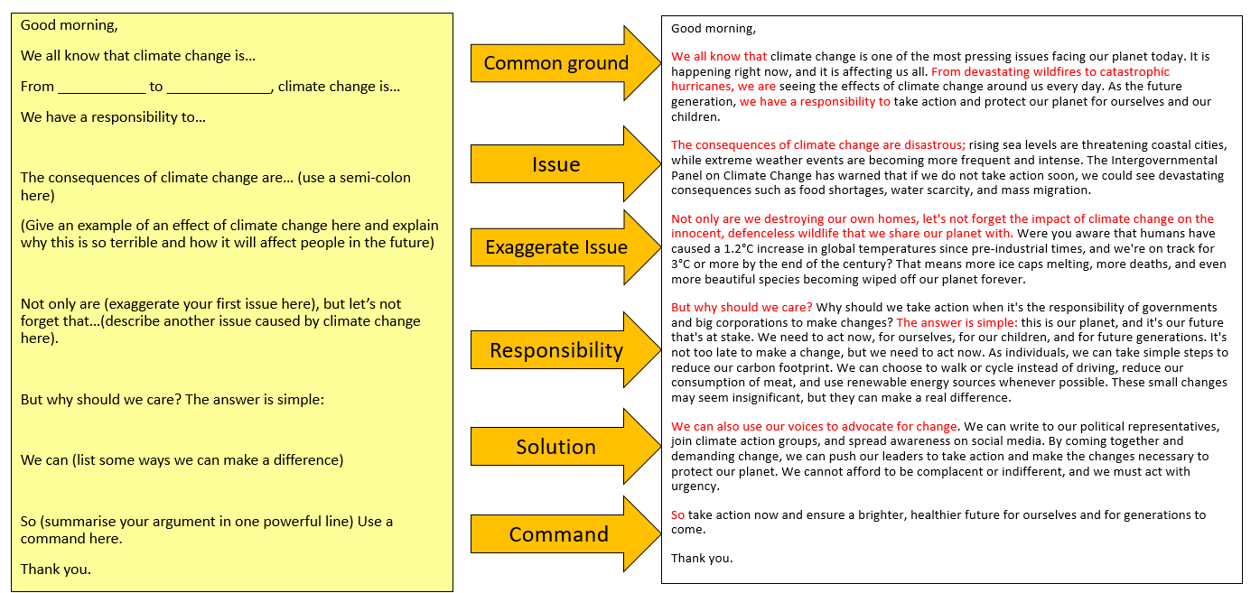
Language Paper Two Revision Sheet
Question One
Q: True or false…
Our Strategy:
Find evidence for the statements in the text and highlight this.
Don’t try to just remember if it is true or false.
Practice at the side until you are sure before colouring in the circles.
Question Two
Q: Write a summary of the differences/ similarities between Source A and Source B.
Our Strategy:
Plan by drawing a table with Source A on one side and Source B on the other side.
Fill in the table with the key differences or similarities between the texts.
Find evidence to prove each one.
Add an inference to your table.
Use the structure Point, Evidence, Inference.
Sentence Starters:
One similarity/difference between the two texts is that in Source A…whereas in Source B…
This is clear when…
From this, we can infer that../This implies that…
Question Four
Q: Compare how the writers present their opinions/attitudes/perspectives/ideas on…
Our Strategy:
Plan by considering the overall tone of the text first. Is it positive or negative? Break this down into more detailed feelings using the vocabulary below:
cynical, critical, complacent, celebratory, judgemental, condescending, joyful, optimistic, pessimistic, sarcastic, astonished, incredulous, dubious, resentful, frustrated, dismissive, disapproving, approving, disappointed, hesitant, horrified, remorseful, victimised, in awe, sad, overwhelmed, persecuted, excited, happy
Draw a table with Source A and Source B on either side.
Fill your table in with the feelings/ideas in both sources and then add evidence to prove each one.
Annotate with the methods used by the writer.
Consider WHY the writers feel this way to develop your analysis further.
Sentence Starters:
Firstly, the writer of Source A shows he feels ______ when he initially states … The use of the (method) shows that…
In contrast, Source B opens very differently, instead with the writer showing feelings of ______ when he describes… The use of (method) _________ shows that…
Later in Source B, the writer feelings change and he appears to feel ______ when he informs the reader of…
This is similar to/different to Source A as the writers feelings also change to ______ which could suggest…
Question Three
Q: How does the writer use language to…?
Our Strategy:
Plan by boxing off the right section. Highlight juicy quotations that answer the question.
Explode these quotations.
Focus on effects rather than naming methods.
Look for patterns of language/semantic fields and discuss together to push for higher marks.
Sentence Starters:
The writer creates the impression that…
This is clear when…
The (method) suggests…
When we hear this word, we usually think of…
Therefore when applying this to… it suggests that… x2
Question Five

