Slide 1
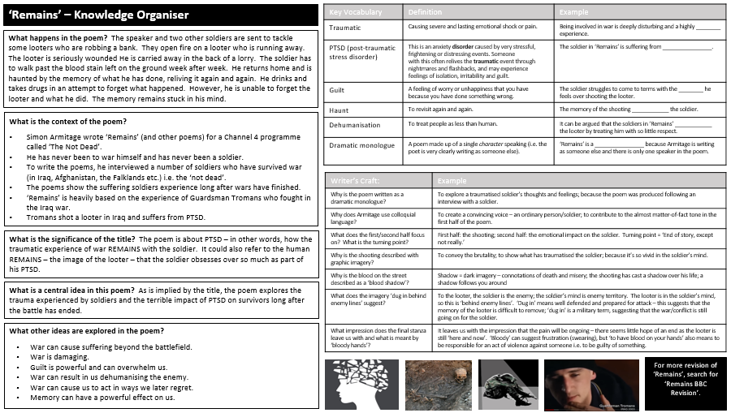
LO: How do I revise (poetry) so that I don’t forget what I’ve learnt?
SUBHEADINGS
Look at the subheading.
Write down everything you know about that topic without looking at the KO.
Check what you’ve missed; add this to your notes in a different colour.
Do something else (e.g. revise something else).
Return to this and repeat from the beginning.
VOCABULARY
Cover the vocabulary and definition columns. Try to work out what the missing word is in the example. Check. Move to the next word. Repeat until you can do this with all the words you’ve studied so far.
Try the same as above, but this time by looking at just the definition column.
Try the same as above, but this time just look at the vocabulary and try to explain what the definition is.
WRITER’S CRAFT
Cover the explanation.
Look at the writer’s craft column.
Answer the questions.
Check your answers; add anything you missed; correct anything you got wrong.
Do something else (e.g. revise something else).
Return to this and repeat from the beginning.
BIG IDEAS
Look at the list of ideas the writer is trying to convey.
For each idea, write down HOW the writer does this.
MINDMAP
Create a mindmap of what you know about the poem from memory.
Check your mindmap against the KO.
Add 5 things that you’ve missed using a different colour pen.
Do something else (e.g. revise something else).
Repeat.
PICTURES
Look at just the pictures.
Explain how each of these pictures is relevant to the poem.

