Slide 1

GCSE 9-1 Business
Paper 1
Unit 1-4
Topic Review

Slide 2
Unit 1 Topics
1 Basic Topics:
Goods & Services
Needs & Wants
Factors of Production
Opportunity Cost
Business Sectors (Examples)
Characteristics of an entrepreneur – what one is like
Objectives of an entrepreneur – what they want
Dynamic Nature (constant change)

Slide 3
Unit 1 Topics
2 Business Ownership Forms
Sole traders
Partnerships
Private limited companies (ltd)
Public limited companies (plc)
Not-for-profit organisations
PLUMS
  Profit Distribution
  Limited or Unlimited Liability
  Management & Control
  Sources of Finance

Slide 4
Unit 1 Topics
3 Aims & Objectives
Business Objectives (not always profit!)
  Depends of size of business
  Depends on how much competition faced
  Depends on type e.g. could be a not for profit organisation
Business objectives will evolve!
  May become dominant business
  May want to expand internationally
  May pursue shareholder value
  Ethical/Environmental considerations?

Slide 5
Unit 1 Topics
4 Stakeholders
Know your types of stakeholders
Know what the stakeholder objectives are ….
Awareness of conflicts between stakeholders

Slide 6
Unit 1 Topics
5 Business Location
Proximity to the market
Availability of raw materials
Labour
Competition
Costs

Slide 7
Unit 1 Topics
6 Business Planning
Types of costs
Profits = Revenue – Total Costs
Why create a business plan?
Issues of business plans

Slide 8
Unit 1 Topics
7 Expanding a business
Methods of growth – internal (organic) vs. external
Economies of scale (EOS) – purchasing and technical
EOS – lowers ACPU – lower prices (useful in a competitive market)
Diseconomies of scale – ACPU goes up (poor communication, co-ordination reduced motivation

Slide 9
Unit 2 Topics
1 TELE (Dynamic Nature)
Technology – Digital Communication & E-Commerce
Environmental/Ethical Profits and Ethics trade off/Types (Sustainability profit trade off)
Legislation – Employment, H&S and Consumer
Economic – Interest rates, consumer spending

Slide 10
Unit 2 Topics
2 Globalisation
World has become more interconnected….
How UK businesses compete globally….
Exchange rates therefore matter….
  SPICED – strong pound imports cheap exports dear

Slide 11
Unit 2 Topics
3Competitive Environment
Market & Competition – KNOW THE DIFFERENCE
Risk (try to minimise this)
Uncertainty (all businesses face this)

Slide 12
Unit 3 Topics
1 Production Methods
Job Production
Flow Production
When is each appropriate?
Lean Production – Less waste
Type of Lean: Just in Time (JIT)

Slide 13
Unit 3 Topics
2 Stock Management
Just in Time
  Type of lean production (improved efficiency)
  Saves on storage costs (cost of holding buffer stock)
Just in Case
  Purchasing Economies of Scale (lower ACPU)
  Have spare stock to satisfy (unexpected) demand

Slide 14
Unit 3 Topics
3 Choice of Suppliers
QPR!
Quality
Price
Reliable (useful for JIT)

Slide 15
Unit 3 Topics
4 Procurement and Logistics
Procurement – deals with suppliers
Logistics – Transportation
Both – seek to be efficient – lower unit costs
Effective Supply Chain Management – reduced costs (streamlined process)/better customer service/higher profits

Slide 16
Unit 3 Topics
5 Quality
Consequences of quality issues – lost customers, lower productivity, increased costs and damaged reputation.
TQM – maintaining CONSISTENT quality
Total Quality Management (TQM) is management philosophy that emphasises the continuous improvement of quality in all aspects of a business.

Slide 17
Unit 3 Topics
6 Maintaining Quality
Benefits of maintaining quality – more sales, better image, higher price
Costs of maintaining quality – inspection costs, staff need training
Remember for growing businesses – franchising/outsourcing – quality is HARD to maintain

Slide 18
Unit 3 Topics
7 Good customer service
What is good customer service?
Benefits of good customer service.
Danger of poor customer service
How customer service has evolved….

Slide 19
Unit 4 Topics
1 Organisational structures
Span of control
Chain of command
Delayering
Delegation
Centralisation – leads to consistency/need for control/efficiency

Slide 20
Unit 4 Topics
2 Recruitment & Selection 1
Internal recruitment
  Increased morale (more opportunities) – productivity improves
  Reduced costs of advertising for jobs
  More knowledge and skills = more likelihood to be successful?
External recruitment
  Wider pool of candidates
  Add diversity to organisation
  New perspectives/ more innovation/creativity?

Slide 21
Unit 4 Topics
2 Recruitment & Selection 2
Stages of recruitment and selection
  Job Analysis
  Person specification
  Selection methods (such as interviews)
Why effective recruitment is important?

Slide 22
Unit 4 Topics
2 Recruitment & Selection 3
Types of contracts (once you have selected):
  Part-time
  Full time
  Zero hours – more flexible organisation
  Job share

Slide 23
Unit 4 Topics
2 Recruitment & Selection 4
Benefits of full time contracts
Benefits of part time contracts

Slide 24
Unit 4 Topics
3 Motivating employees
Importance of motivating staff – higher productivity/improved quality/higher staff retention/better customer service
Financial methods of motivation – salary, wage, profit sharing & commission
Non-financial methods of motivation – management styles, training, give responsibility and fringe benefits

Slide 25
Unit 4 Topics
4 Training 1
Why offer training?
  Leads to higher productivity
  Able to adjust to tech change
  More motivated staff
  Higher staff retention
  Better quality goods
  Improved customer service

Slide 26
Unit 4 Topics
4 Training 2
Types of training?
  Induction Training
  On the job training
  Off the job training

Slide 27
Unit 4 Topics
4 Training 3
Benefits of each
  Induction Training
  On the job training
  Off the job training

Slide 28
Question Structures

Slide 29
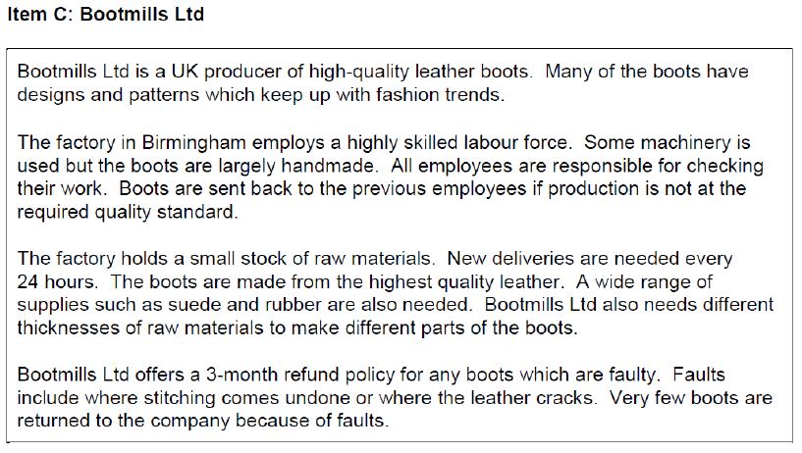
Notes:
Application:
• The production needs the highest quality leather with a wide range of supplies needed such as suede and rubber. Bootmills Ltd also need a range of different thicknesses of raw materials to be able to make different parts of the boots. Suppliers are chosen based on quality of materials and range of products which can be supplied. This limits defects and returned items.
• Local supplier likely to be able to meet needs as factory holds a small stock of raw materials and needs new deliveries every 24 hours. This ensures the business has stocks when needed and doesn’t need to hold too many materials in a warehouse.

Slide 30
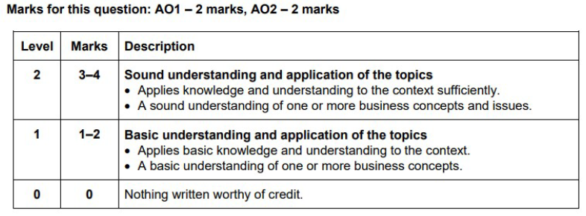
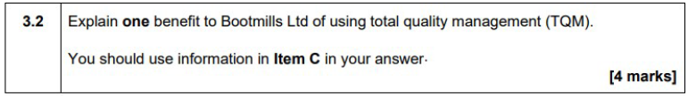
4-mark extended responses – Need to demonstrate clear knowledge and application
Need to start with a definition to show knowledge and then apply to the context of the question
Knowledge : TQM is an approach where all employees focus on preventing errors (1) and all employees are responsible for checking their own work and meeting standards in what they produce (1).
Application: Employees at Bootmills Ltd are responsible for checking the boots as they complete each stage of the manufacturing process. (1) Boots are sent back to the previous employees if production is not at the expected quality standard. (1)

Slide 31
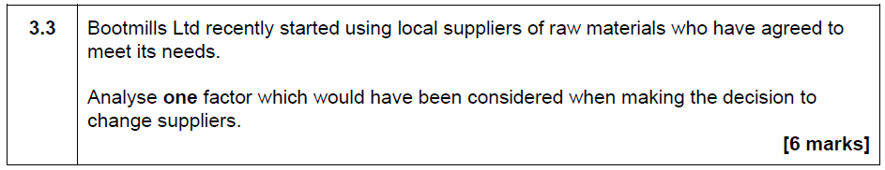
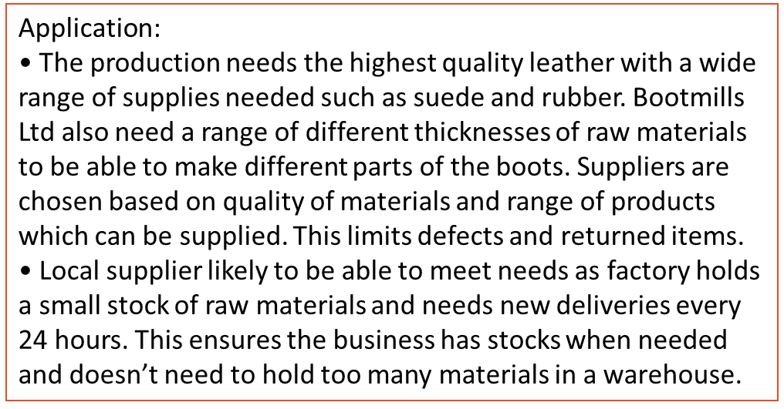
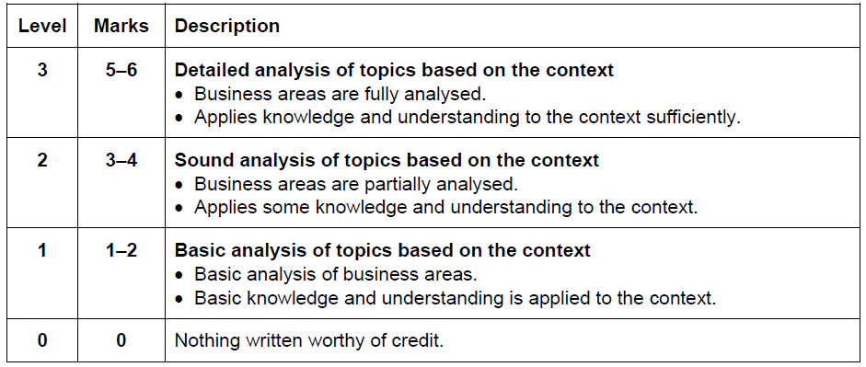
6-mark extended responses – Need to demonstrate clear application and analysis
Marks for this question: AO2 – 3 marks, AO3 – 3 marks
A factor such as the range of products a supplier can provide will have been considered as this will ensure that the business has the range of raw materials needed to produce the different parts of the boots. (1) As the business uses a range of different leathers and thicknesses (1) in the production process, a supplier being able to supply all of the different raw materials will be an important factor in the decision (1) as it will ensure that the production process runs smoothly.(1) Should a supplier not be able to provide a type of leather, for example suede, then this style of boots will not be able to be manufactured, (1)therefore the choice of supplier ensures that no styles of boots are delayed in being made and the business is able to meet demand of the retailers and customers.(1)

