Slide 1
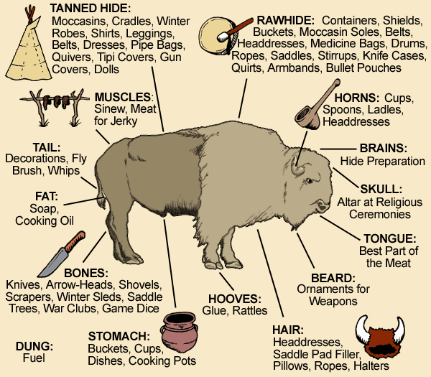
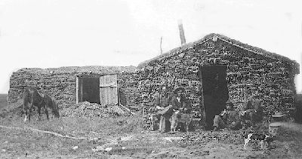
a) Plains Indians – social and tribal structures
Bands Most people in a band were related. They were led by chiefs, They had councils. Survival and protection of the band were most important. | Chiefs Selected for wisdom/skill as warriors and hunters Would decide what the band would do. Did not have to be obeyed ( so later treaties signed by one chief could be ignored by others, the US did not understand this)
Tribes Made up of multiple bands. Tribal meetings took place each year for marriages, trade horses and discuss issues. Some tribes were part of bigger groups called Nations (eg the Sioux) | Warrior societies Supervised hunting Protected from attack.
d)Factors that encouraged westward expansion
Push Factors | Pull Factors
Economic crisis in the East from 1837-the mid 1840’s due to the banks collapsing. Corn prices also collapsed leaving farmers facing ruin. Unemployment was as high as 25% in some places. People who had jobs faces wage cuts. People were living in poverty and struggling to survive. Overcrowding in fertile areas like the Mississippi valley. | There was the promise of free farmland in the West The Oregon Trail : This was a route to the West established in 1825. the numbers using this route grow and grew as economic problems pushed people west. (400,000 people used it!) The US government encouraged people to move to Oregon so that they could establish a US territory there. They spent $30,000 for an expedition to map the Oregon trail. The Gold Rush of 1849 was when 100,000 people travelled west hoping to find gold. Manifest destiny: the belief that white Americans had the right to populate all areas of America from coast to coast. This encouraged Americans to move West/ The idea of Manifest destiny – the idea that God gave American to White Americans to settle.
KT1 Early Settlement of the West – c.1835-c.1862
e) Example of migration.
Failed Migration - The Donner Party | Successful migration – the Mormons
A group 300 migrants They were led by the Donner brothers They started the Oregon Trail in 1846 The Group split and 80 migrants tried to take a short cut (Hastings Cutoff) The short cut caused delays as it wasn’t marked and had never been tried before. They eventually got trapped in the snow. The first migrants died of starvation. Only half of the original 80 survived by eating those that had died. | A religious group who were shunned by other Christians because of their beliefs like polygamy. Their leader Brigham Young believed that God had called them to move to Salt Lake Valley south of the Oregon trail. They hoped that they could escape persecution there. Forced to leave Illinois in Feb 1846 and got to Omaha too late to start their migration – stayed until April 1847 in winter quarters In April 1847, a small party of around 150 Mormons, led by Young, set off for the Salt Lake Valley. The advance party marked the most suitable route o follow and cleared the route for others. They also found sources of water, set up river crossings and ferries and planted vegetable crops at places along the way. Between 1847 and 1869, 70,000 Mormons followed the Mormon Trail to Salt Lake City
b) Beliefs
Nature | The plains Indians believed that everything in nature had a spirit. These spirits would sometimes help humans. Nature had to be respected. They could contact the spirit though dances. Eg the buffalo dance to call the buffalo and be successful in hunting
Land | Land was seen as sacred- the ‘mother’ of the Plains Indians. Some areas were sacred such as the Black Hills of Dakota for the Sioux. Farming or mining was seen by some Plains Indians as disrespectful to the land (cutting open mother earth)
War | Lots of conflict but tried to avoid too much killing Counting coup – touching and enemy with a stick and getting away.
c) Survival – Buffalo and Horses
Horses | Buffalo
Used for hunting buffalo and moving as part of their nomadic lifestyle. | Every part was used (except the heart which was left on the plain)
Wealth and status were measured in horses. | Believed the heart gave life to a new herd.
Used in war and for raids | Women and children cut up the buffalo after the men hunted it.
Nomadic lifestyle | Bands and survival
Followed the buffalo migrations in summer and autumn. Used tipis made of wooden poles and buffalo hide. Shaped like a cone to protect them against winds and provide ventilation through flaps. Easy to move. | Size of bands changes based on food. If there wasn’t enough food they split.
f)Impact of migration in the Gold rush
Problems of lawlessness in mining camps | Migration to California – 300,000 by 1855. | Farming boom in California | Gold from California boosts US economy
Racial Tensions due to immigration (including migration from China | Manifest Destiny – white Americans see their ‘destiny’ coming true. | Tension with Plains Indians due to increase in migration along the Oregon trail | Genocide of former Californian Indians by Migrants
g)Problems for homesteaders
Ploughing – the tough, tangled grass broke the ploughs! | Crops – Plains were too dry and too cold in winter for ordinary crops | Prairie Fires – the long, hot dry summers could cause fire which wold destroy crops and kill people.
Grasshopper – some years, swarms of grasshoppers ate all the crops. | Water – water could be 300 feet down and so getting water was hard. | Isolation – living miles and miles away meant that it was lonely.
h)A sod house that homesteaders lived in.
With no trees for wood, settlers made houses out of sods of earth. They were warm and fire proof but always dirty.
With no wood for fuel settlers burnt buffalo chips that had dried in the sun. a lot was needed to keep the house warm in winter

Slide 2
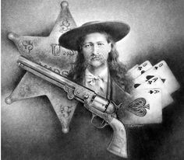
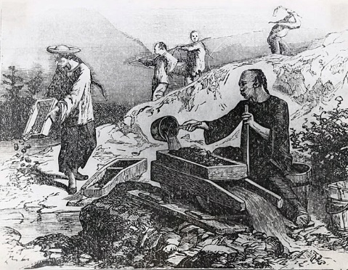
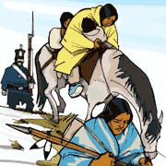
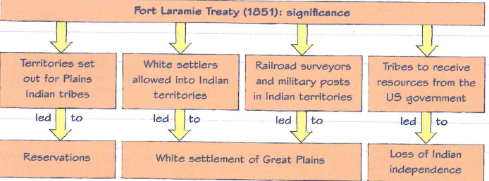
i) Plains Indians and white settlers - conflict
White settlers’ concerns | Plains Indians’ Concerns
White settlers scared each other with stories of attacks. White settlers were racist and thought whites were superior. Fear of being scalped. | Discovery of Gold in California caused more migration along the Oregon trail which disrupted buffalo hunting. Migrants killed many buffalo or caused stampedes. Migrants animals ate lots of the good grass.
Problems of lawlessness in early towns and settlements
The official systems for law enforcement were stretched thin in the West as they were not ‘States’ and so Federal government was in charge.
New crimes
E.g. claim jumping
Isolated communities
Racial tension from immigration
Lawlessness in the West
Not enough law enforcement
Social factors e.g. alcohol, gambling and prostitution
Mining camps were a target for criminals
j)US government policy towards Plains Indians
May 1830 Indian Removal Act | Indian Removal Act forced American Indians in eastern states to move west of the Mississippi River (forced 46,000 to move)
June 1834 Permanent Indian Frontier | Indian Trade and Intercourse Act sets out the Frontier between the USA and Indian Territory. It also banned whites from settling on American Indian Lands. Frontier was guarded by the US army.
February 1848 War with Mexico | The US victory in the Mexican – American War. The US gained huge new territories in Oregon (like California) and in 1845 Texas had become part of the US. This increase in new land encouraged migration creating tension.
February 1851 | Indian Appropriations Act fund the moving of American Indians to reservations so whites could get the land they wanted.
September 1851 Fort Laramie | US forced access into the Plains and set out land for each tribe. Treaty did not represent all tribes and the maps went against Plains Indians understanding of land.
Mass settlement meant rapid population increases
l)Issues for law and order
Mass Settlement | Population of California in 1846 was 8000, in 1850 it was 120,000. In 1855 it was 300,000. This made it hard for lawmen to police as many areas were still not ‘States’ and so were under control of Federal government.
Mining Problems | Mining camps were often isolated an a long way from the law. They also had lots of men and alcohol, gambling and prostitutes. There was racism against Chine migrants who worked in the mines and there were issues of ‘claim jumping’ where one man took over another man’s promising claim (land).
Racism | In 1852 a famine in China led to and increase in migration from 2000 to 20,000.
Gangs | Many failed prospectors returned to San Francisco and could not find work. They turned to crime where rival gangs took control of city areas. It reached the point where gang members would walk into a saloon, kill people, take their money and leave.
KT1 Early Settlement of the West – c.1835-c.1862
k) Fort Laramie treaty 1851
Plains Indians agree to… | US government agreed to….
End fighting between tribes Allow migrants across land in safety. Allow surveyors from railroad companies to enter in safety. Allow the government to build roads and army posts. Pay compensation if any individuals broke the terms of the treaty (eg by attacking migrants) | Protect Plains Indians from white Americans. Pay the tribes $50,000 per year as long as the Treaty’s terms were kept.
m)Law men and attempts at tackling lawlessness
US Marshal: | a police officer in charge of a district. A US marshal was a federal law officer appointed to an area. Could appoint deputies and force men into a ‘posse’
Sheriff | an elected law officer with the responsibility of keeping the peace in his area and carrying out orders of a law court, such as issuing warrants, making arrests and delivering prisoners to jail.
Posse | a group of men called together by a sheriff or marshal; to help him in enforcing the law.
Vigilance committees | Townspeople in San Francisco thought the courts were corrupt so became vigilantes and took the law into their own hands.. They captured suspected criminals, tried them and punished them. In 1851 they tried 89 men! Some were hanged. Others copied this example.
Settling claim disputes | In mining communities they often got together to agree rules which were recorded The recorder recorded all claims and who claimed them and the community created a court with a respected member as the judge.

Slide 3
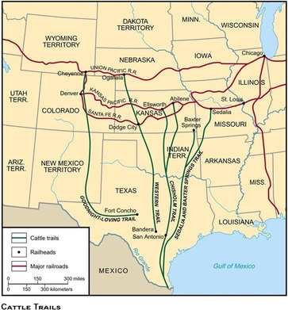
a)Key Acts after Civil War to encourage growth in the West
The Civil War | Before the civil War, the southern States had blocked plans to give away land in the West. North and south had disagreed over where an East to West railroad should start. When the southern States left the Union, the north could pass these Acts without opposition.
Pacific Railroad Act 1862 | Created 2 companies, the Union Pacific and Central Pacific to build the transcontinental Railroad The government gave the companies $16,000 in a loan for every mile of track laid and $48,000 per mile in the mountains 45 million miles of land for them to sell
Homestead Act 1862 | This allowed any men who did not fight against the Union to claim 160 acres public land for free, Had to live on the land and farm it for 5 years.
Timber Culture Act 1873 | Gave settlers a further 160 acres of free land if they planted 40 acres of trees. Designed to provide windbreaks and a source of timber/fuel for the USA. Failed for two reasons. 1) Trees didn’t grow because of poor soil. 2) People found legal loopholes and claimed land in other peoples names so that they could acquire more land.
d)Homesteaders – finding solutions
Problems | Solution
Lack of timber (not enough for houses and fences) | Building sod houses Creation of Barbed wire in 1874 which as quick and cheap to erect.
Lack of water for plants and cleaning. | Drills were developed to find water. The self-governing windmill (1854) moved with the wind to pump water up. Steel blades (1870) made windmills stronger.
Lack of suitable crops for the arid land | Use of Turkey Red Wheat from Russia was suitable for the land.
Land holdings too small (Homestead Act only 160 acres) | Timber Culture Act 1873 allowed an extra 160 acres if trees were planted on half.
Isolation | Railroads improved travel and reduced isolation. Railroads brought supplies – eg Sears and Roebuck products. As communities grew they built schools and churches which created social networks.
Ploughs breaking due to the long grass. | The Sulky plough was a plough you could sit on and was pulled by horses. It cut through prairie grass more easily. 50,000 were sold in the first 6 years of production.
KT2: Development of the Plains – 1862-1876
b)Impact of the Homestead Act
Positive | Limitations
By 1876 over 6 million acres of government land had become homesteads. | 60% of homestead claims were never proved up.
80 million acres of land were homesteaded by the end of the Act in the 1930s. | The rich found ways to buy up land using the Homestead Act.
By 1875, more than half of Nebraska’s population of 123,000 were recent immigrants. | More homesteads were formed by people who bought land from railroad companies.
e)Growth of the Cattle Industry
1855: quarantine | Quarantine laws stop Texan cattle from entering Missouri and Kansas. This meant new routes were needed.
1861-1865: Civil War | During the Civil War the cattle herds run wild and grow to 5 million cows by 1865.
1861-1865 Demand | There was increased demand for beef in northern cities so cattle owners wanted to sell their cattle. However, Drives were blocked due to Texas Fever and Kansas wouldn’t let them in.
1866: Goodnight-Loving Trail | Goodnight and Loving created a trail to Fort Sumner to sell their cattle there to the US army. The Army needed this to feed the Plains Indians on the Reservations. (800 cattle sold for $12,000 which was four times the normal price.
1867: McCoy and Abilene | Joseph McCoy set up Abilene, the first ‘cow town’. He built stockyards and hotels. He built a railroad spur so the cows could be loaded on the trains. He spent $5000 on advertising. By the end of 1867 35,000 cattle were driven to Abilene. Between 1867 and 1872 it was 3 million!
1868: Goodnight-Loving extension | In 1868 the trail was extended up to Colorado where there were mining towns and to Wyoming where the Union Pacific Railroad was. This caused cattlemen to use it to drive to Wyoming and caused cattle ranches in Wyoming to grow.
1870: Iliff and Ranching | John Iliff saw opportunity to sell meat around Colorado. Denver was not on a railroad until 1870 and it was difficult to get supplies. In 1866 Iliff started Ranching near Denver. By 1870 he had 26,000 cattle. He sold his beef to miners, Indian Reservations and railroad workers.
1870: Beef bonanza | There was massive growth in cattle ranching as costs were low (there was lots of grass) and profits were high. A few men who were backed by rich investors dominated with their massive ranches. These men were cattle barons and controlled local politics. This had consequences for law and order.
1870s: Refrigerated Cars | Gustavus Swift developed refrigerated cars which meant that cattle could be slaughtered and then boxed and kept fresh in refrigerated wagons.
c)Impact of the Railroad on Migration and lawlessness
Railroad companies sold their land along their routes and created towns.
Railroad ‘Bureaus of Immigration’ encouraged Europeans to buy their land – eg C.B.Schmidt was responsible for 60,000 Germans moving to Kansas.
The Railroad companies used effective marketing to sell the idea of settlement – by 1880 200 million acres of land had been settled, sold by railroad companies
Railroad towns became known as hell on wheels due to rowdy cowboy behaviour, guns and alcohol lead to violence.

Slide 4
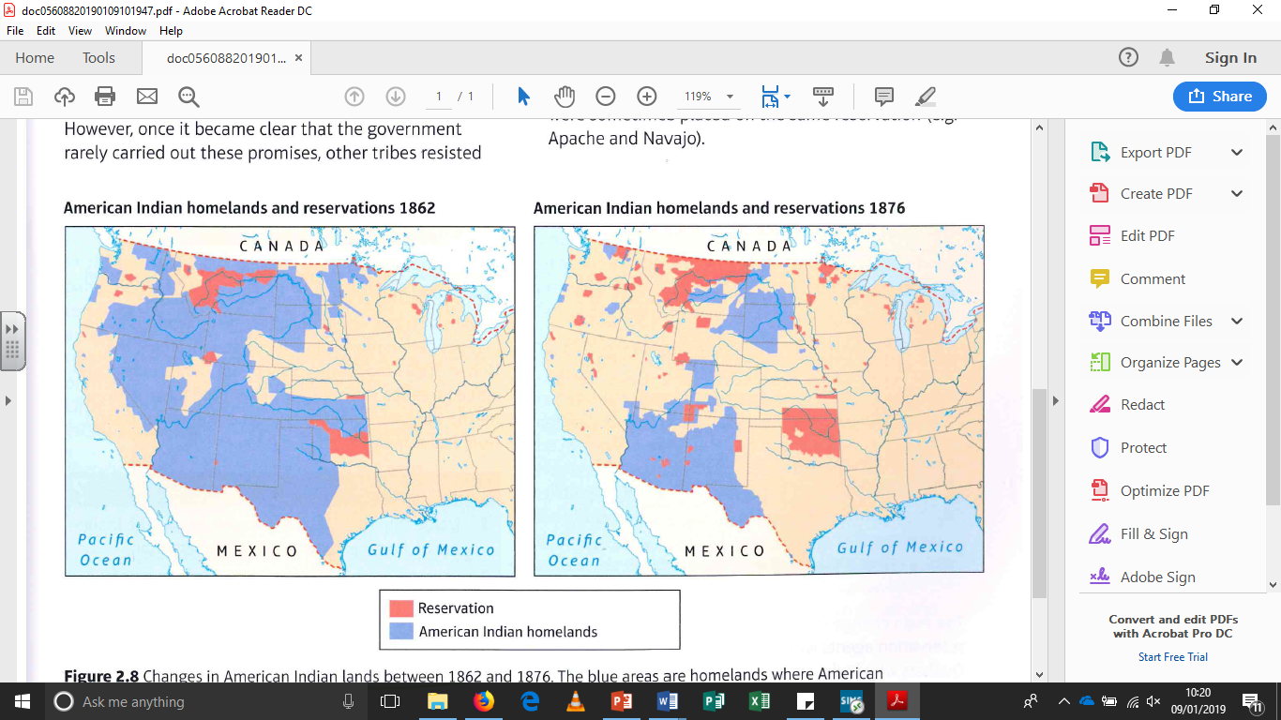
f)Changes for Cowboys
Life on the Drives | Life on the Ranches
Work was seasonal from Spring to Autumn Round up, branding and then the drive Went 20km per day Dangers of stampeding cattle, wild animals, rustlers, weather and hostile Plains Indians The slept in the open air and cooked over camp fires After the drive, once they got paid for delivering the cattle, they spent their free time going to saloons or brothels. | Worked all year, but fewer were needed. Rounded up and branded cattle. Checked fences and boundaries. Slept in bunkhouses and used cook houses. Drinking, gambling, guns and knives were banned.
i)Plains Indians and Reservations
Why did they move to reservations? | Impact of Reservations
White expansion meant there was less land to hunt on. US government promised protection and land and food. Tribes desperate for food would sign to survive. Some tribes sided with the US for support against enemies. US army forced Indians and kept them there. | Reservations were made smaller so they couldn’t survive by hunting. And farm land was poor – creates dependency on government. Bureau of Indian Affairs agents ran the reservation and were corrupt. When conflict arose, the government used it to take more land. Reservations were made smaller due to complaints by White Settlers. This made it even harder to survive. Reservations were often far from traditional lands and sacred places.
g)Ranchers vs Homesteaders
Ranching’s reliance on Public Land | Open-range ranching needed land for the cattle to eat. Federal law said everyone could use public land for free. When homesteaders came to claim their 160 acres of public land it created tension.
Blocking homesteaders | The ranchers tried to block homesteaders by filing homestead claims themselves to all area others might want (eg with water sources). Some fenced off enough land to stop other plots. Some took homesteaders to court as the homesteaders couldn’t afford it
Fences | Framers and ranchers argued over fencing. Farmers said ranchers should fence the cattle in a specific area to stop them eating homesteaders’ crops. Ranchers said homesteaders should fence off their own land to protect themselves.
Issues with Sheep Farming – In addition to the issues between homesteaders and ranchers, there were issues between Ranchers and sheep farmers. Large scale sheep farming began in 1870. Ranchers said sheep ate grass down to the roots leaving nothing for cows and the sheep spread the disease ‘sheep scab’. When ranchers fences off land, sheep farmers cut it. Ranchers then sometimes went and killed many sheep.
j)President Grant’s Peace Policy (1868)
President Grant saw bad reservation management was a problem and caused conflict. He wanted to make the system fairer by: Have new reservation agents who were religious and fair (Quakers) Made a Plains Indian, Ely Parker, the Commissioner for Indian Affairs. Gave a budget of $2 million to improve conditions on reservations. Ely Parker argued the government should treat Plains Indians as ‘helpless wards’ so the government didn’t make treaties with tribes, the government did what it thought was best.
l)Sand Creek Massacre 1864
The Fort Laramie treaty of 1851 had granted the Cheyenne lots of land. But the gold rush of 1858 caused more prospectors to cross the land. They used up grass and scared the buffalo.
In 1861 the Cheyenne moved to a reservation as part of the Treaty of Fort Wise. Not all accepted it like the Dog Soldiers who attacked wagon trains.
After 3 years of attacks, Black Kettle negotiated with the government and army to end the conflict.
November 1864 Colonel Chivington attacked the camp killing more than 150 Indians even though they waved white flags.
Some escaped and told others. It caused attacks on Forts and settlers.
The US Senate Committee of Enquiry condemned Chivington. Both whites and Indians were horrified.
However, after the Civil War, the US forced the Cheyenne onto a reservation half the size and were not paid any compensation.
m)Red Cloud's War 1866-68
John Bozeman created the Bozeman trail to cross Plains Indian lands to get to gold in Montana. This broke the Fort Laramie Treaty 1851.
Red Cloud attacked the travellers using the trail.
The government tried to talk with him, but Red Cloud stormed out when he discovered the US were already planning 2 more forts along the trail.
This caused a 2 year fight. Red Cloud was followed by Sitting Bull and Crazy Horse creating a force of 3000 warriors.
In December 1866 Captain Fetterman and 80 soldiers rode into a trap and were massacred.
The Sioux also surrounded Fort Phil Kearny. Sioux victory proved to the government that old approaches were not working. The government signed the Second Fort Laramie Treaty 1868.
k)Little Crow’s War 1862
Little Crow was chief of the Santee Sioux. They had moved to a reservation in 1851 but due to debts with traders they had to give up half of the reservation land in 1858.
In 1861 the crops on their reservation failed and the food promised by the government didn’t arrive. Many had started eating grass. They would starve.
In August 1862 Little Crow attacked the agency that ran the reservation and stole food and burned the buildings. Despite Little Crow saying not to, some warriors killed several soldiers. Some warriors killed 600 settlers.
Troops arrived and arrested and tried 400 Sioux warriors. Most sentenced to death with no evidence of guilt. Lincoln said only those who were proven to be guilty of murder or rape were to be executed. 38 were executed.
The rest of the Dakota Sioux were sent back to the reservation where many died in the winter 1863-64 or moved to other reservations.
h)Impacts on the Plains Indians
Railroads | Cattle | Gold
Disrupted buffalo migration in settled areas. Railroads encouraged migration onto land. Railroads and the government persuaded tribes to give up land along the railroad route and move to reservations. | Cattle and buffalo competed for the same grass so as the cattle industry grew, buffalo herds dwindled. Cattle trails crossed Indian lands. Many tribes accepted this for a fee, but others like the Comanche attacked. | The 1849 Gold rush had lead to white trespasses and eventually to fort Laramie and Indian Appropriations Act (1851) 1859 Gold Rush in the rocky mountains led to whites trespassing and eventually to the fort Wise Treaty (1861) and the Sand Creek Massacre (1864) 1863 Gold Rush in Montana led to whites trespassing leading to Red Cloud’s War (1866) and the Fort Laramie treaty (1868)
n)Second fort Laramie treaty 1868
US agreed to abandon forts on the Bozeman trail. Red Cloud to move to a reservation (which went from the Black Hills of Dakota to Missouri River) – this also split the Indians into separate sites. Some like sitting Bull and Crazy Horse refused to sign.

Slide 5
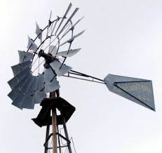
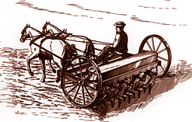
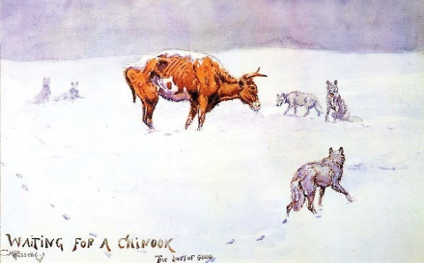
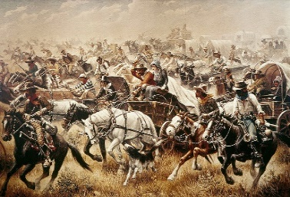
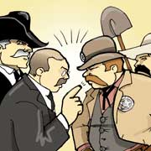
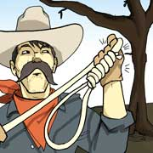
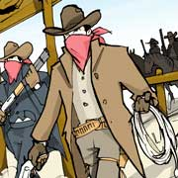
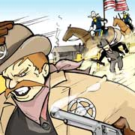
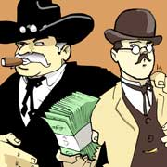
a)Improvements in Farming
Dry farming – 1879 where water was trapped in the soil. Worked well with Turkey red Wheat. | Wind Pumps – Halladay’s wind mill was improved s that it only needed oiling once per year. Also they were made of steel. | Barbed wire – barbed wire was introduced in 1874 but was often brittle and rusted. A new coating made it stronger and long-lasting. | Mechanisation – seed drills were pulled behind a plough and planted seeds at the right depth.
b)Changes in the Cattle Industry
Cause of changes
A fall in demand There was so much beef that prices dropped. Ranchers kept hold of cattle hoping prices would go up again. | Soil erosion and loss of pasture Overstocking (too many cows on land) eroded soil and the grass was all eaten. The drought in the summer of 1883 also reduced the amount of grass. | The ‘Great Die Up’ Winter 1886-87 was harsh. (-55 degrees!) Cattle couldn’t reach the grass through the snow so died. Many cattlemen went bankrupt.
Impact of changes
Smaller ranches coped better so many ranches copied this and became the model from 1887 because Smaller herds could be more easily found. And brought closer to the ranch when there was snow. Easier to provide water during a drought. Easier to guard and stop rustling. Reduced the supply of beef so prices rose. After 1887 they moved towards high-quality meat by buying expensive cows (like Herefords and Holsteins) these had to be kept safe.
Change in lives of cowboys
Less demand for cowboys. Now de-horned cattle, looked after horses and calves. Mended fences and harvested hay. Lived in bunkhouses which poor beds (full of lice) and thin walls. Had to follow rules. Responsible for ‘riding the line’ – patrolling the boundaries between ranches.
c)Increased migration - Exodusters
Cause of the Exoduster movement
Freed slaves after the civil War were still oppressed and treated badly. | Bible story of the Exodus – God delivering the Israelites from Egypt into a promised land. |  | Benjamin Singleton – promoted Kansas and helped migrants
Kansas’ reputation for fighting slavery. | 1879 a rumour spread that the US had given Kansas to ex-slaves (not true but did trigger movement) |  | Homestead Act 1862 – the promise of 160 acres of land.
The Exodus
By 1879 - 40,000 had set off west to Kansas.
Impact
Problems with Farming Good land had already been taken. Most Exodusters had no land for setting up farms. |  | Responses Whites opposed the migration Whites thought Exodusters shouldn’t be helped. Kansas governor gave some money to help. | Consequences By 1880 there were 43,000 black migrants Exodusters typically stayed poorer than white settlers.
KT3: Conflicts and Conquest c.1876-c.1895
d)The Oklahoma Land Rush
After the Indian Removal Act in 1830 the Plains Indians had each been given specific land. The middle Section was seen as open to Plains Indians and should not be settled by Whites.
The Dawes Act (1887) changed this. Instead of a tribe owning land, individual Plains Indian families were given 160 acres (like in the Homestead Act). All land left over was put up for sale. Some Plains Indians sold the land given because they didn’t want to be farmers.
In 1889 the government decided to open up the middle section of the Indian Territory for white settlement. The land was divided up into 160-acre sections. It was announced that at 12 noon on 22 April 1889 it would be opened for claims. Thousands waited at the boundary and then rushed to stake a claim – a ‘Land Rush’.
There were several land rushes in Oklahoma, starting with the first in 1889 (two million acres of former Indian Territory) with the last in 1895 (88,000 acres). The largest was in 1893 when 8 million acres were opened up for settlement.
e)The Johnson county War
Tensions | Killing of Watson+Averill | Conflict Begins | The ‘invasion’ | Consequences
Population increase in Wyoming created tension over land – homesteaders vs ranchers. In the ‘Great die Up’ smaller ranches survived – big ranches thought the smaller ones had stolen their cattle. Newcomers didn’t like the way big ranchers had power over politics and juries. | Watson and Averill were homesteaders who claimed land that rancher Albert Bothwell used for his cattle. Jim Averill wrote rude letters about Bothwell in the local newspaper. 1889 Ella Watson obtained a small herd of cows. Bothwell accused her of rustling and had Watson and Averill murdered. | The small ranchers held their round up earlier than the WSGA (Wyoming Stock Growers Association – the big ranchers). This way the smaller ranchers could claim the unbranded calves. | The WSGA raised $100,000 and hired 22 gunmen to ‘invade’ and kill 70 suspected rustlers. The invaders went to the KC ranch as 2 targets were there. The invaders were held up there in a shoot out. The sheriff raised 40 men and others went after the invaders. The invaders fortified themselves at the TA Ranch until the US Cavalry rescued them! | The WSGA hired the best lawyers. The lawyers got the trial moved to Cheyenne where the juries liked the WSGA WSGA lawyers kept the trial going until Johnson county could no longer afford to keep the prisoners in jail.
Even though the invaders were set free, it is significant because it showed how much people hated vigilantism.

Slide 6
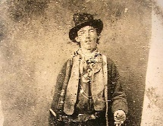
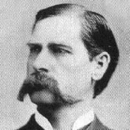
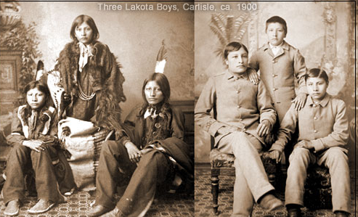
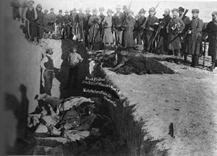
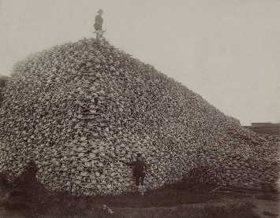
f)Law and Order
Billy the Kid | Wyatt Earp
Grew up in poverty. Got in trouble for rustling. 1878 became involved in the Lincoln County war between Cattle Baron John Chisum and smaller ranchers – Billy’s gang were killed. After the war Billy swore to kill everyone responsible for the death of his friend. Local ranchers appealed to the president to help – the president sent a new sheriff, Pat Garrett. Garrett tracked Billy and arrested him. The judge sentenced him to death but Billy escaped. Garrett tracked Billy again and killed him at Fort Sumner | Earp first got into law enforcement after helping a deputy Marshall deal with some rowdy cowboys. 1879 – moved to Tombstone where rich businessmen were fighting for control of the area with ranchers and cowboys led by the Clantons and McLaurys. In 1880 the businessmen hired Earp as deputy sheriff. After clashes, Earp killed two McLaurys and one Clanton at the OK Corrall. This was after Earp tried to disarm the men (some doubt this story). Cowboys then killed Morgan Earp leading to Wyatt Earp killing the two men he thought were responsible. Public opinion in the town turned against Earp and he left Tombstone in 1882.
g)Great Sioux War – Battle of Little Big Horn 1876
Causes | In 1868 the Sioux were given a large reservation, including the Black Hills of Dakota.. Whites were not allowed to settle there according to the Treaty.
 | In 1874 George Custer found gold in the Black Hills of Dakota and settlers broke the treaty by settling there.
 | The government tried to buy the Black Hills for $6 million. The Sioux refused and many left the reservation in raids. This caused the US to say the Sioux had broken the treaty.
 | December 1875 the Sioux were given 60 days to return to the reservation or be declared hostile. Due to snow it was impossible to return.
Events | By Spring over 7000 Sioux were ready for war at Little Big Horn.
 | Custer was part of a force to attack the Sioux. He had little information and rode so quickly that he arrived for the attack with 600 men before the rest of the army.
 | Custer attacked with his 600 men having split them in 3 groups. The Indians were prepared and massacred Custer's forces.
Impact | Public opinion of white Americans changed. They used to want to help, but now many wanted the Plains Indians destroyed.
 | The US built 2 new forts and sent 2500 soldiers West to pursue the Sioux.
 | Sitting Bull surrendered and Crazy Horse was murdered.
 | The Sioux ended up on reservations having sold the Black Hills and other land.
h)Extermination of the buffalo.
Economic reasons Buffalo had been hunted for warm coats. In 1871 a process was discovered that turned buffalo into leather – this caused people to kill more buffalo. Railroads developed and brought hunters to the Plains who killed buffalo to feed workers and for sport. | Extermination south and North Hunting Southern Buffalo peaked in 1872-74 – Plains Indians killed 1 m. Whites killed 4 ½ m. 1880 around 5000 whites were killing northern buffalo. By 1883 the northern Buffalo Herd was gone. | Government policy Killing buffalo forced Indians onto reservations as there was nothing to hunt. Plains Indians had to learn to farm and assimilate or rely on the government for food. Buffalo were in the way of railroads and cattle farming.
j)The Wounded Knee Massacre 1890
Causes | By 1890 most Sioux were on reservations.
 | In 1890 the rations were cut and the crops failed.
 | However an Indian called Wovoka, had a vision that said if they kept dancing the Great Spirit would carry the White People away and the buffalo would return. This dance was called the Ghost Dance.
 | The Us forces were worried about this and tried to stop it, killing Sitting Bull.
Events | Big Foot fled from the army and they were caught at Wounded Knee.
 | The army caught them and began to disarm them but shooting broke out when one Indian resisted and others began to dance.
 | After 10 minutes, 250 Plains Indians were dead (only 25 soldiers were dead).
Impact | It was the end of Sioux resistance
 | It confirmed White people’s views that the plains Indians needed to be exterminated.
 | It was the end of the Indian Frontier – no land now belonged to Indians.
i)Destruction of Plains Indian Life on reservations.
Shrinking reservations The government shrunk the size of the Sioux reservation in 1876. The Dawes Act further reduced the size of reservations. | Tribal Chiefs lost power 1880s the government set up special councils to look after tribes – but these were bribed. 1883 special councils took over chiefs’ power to judge and punish plains Indians. 1885 these courts were abolished for federal courts – they lost their right to govern themselves.
Government Agents Agents used bribes by giving or withholding food to ensure good behaviour. The Indian Agency Police were Plains Indians responsible for keeping order. This created divisions in tribes. | Education and religion. Children were sent to schools and taught to be Christians and speak English. By 1887 2020 children were ta boarding schools. If parents refused, rations were withheld. Aim was to ‘kill the Indian in him and save the man’.
k)Dawes Act 1887
A homestead Act for each Indian Family. Each family got 160 acres. It broke up tribes and their power by making Indians individuals. It encouraged farming. It freed up land for settlers. It reduced the cost to the government of running the reservation system. By 1890 Plains Indians lost half of the land they had in 1887! Many Plains Indians were cheated out of their land.

