Slide 1
Year 11 Mrs Vukasovic – HOD English
Examinations 2025
English Literature Paper 1: 12 May 2025
English Literature Paper 2: 20 May 2025
English Language Paper 1: 23 May 2025
English Language Paper 2: 06 June 2025

Slide 2
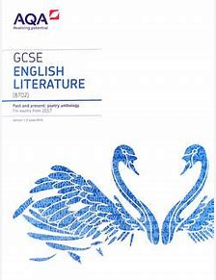
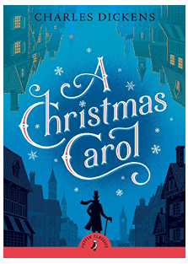
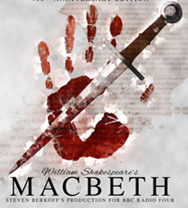
English at GCSE…
English Literature
English Language

Slide 3
Mock Exam Content…
English Language
In the November mock exams, year 11 are being tested only on language paper one and paper two.
This is due to there being a huge crossover in terms of skill – we can judge the literature based on the language outcomes.
It also involves less knowledge revision, so students have less to remember at this stage in the year when the content has not all been covered yet.

Slide 4
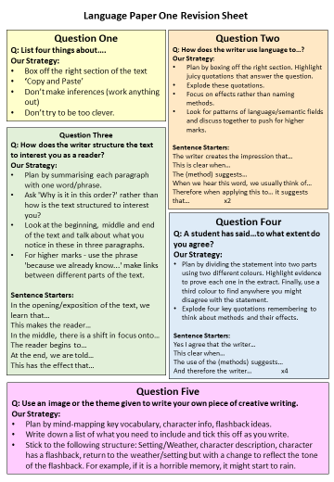
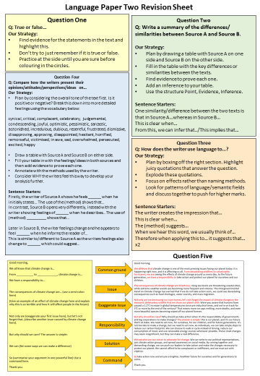
English Language
Revising for the Mocks…
Students have all been given a language revision pack including a knowledge organiser for both papers and practice papers. This is the most effective way of revising for language:
-learn sentence starters to structure responses.
-complete timed practice papers and individual questions, focusing on weakest areas.
-read widely including fiction and non-fiction to expose students to the type of texts they will need to understand, analyse and write themselves.

Slide 5
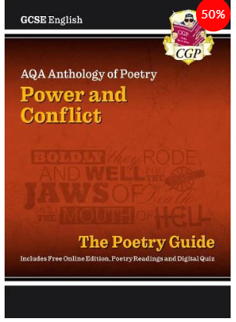
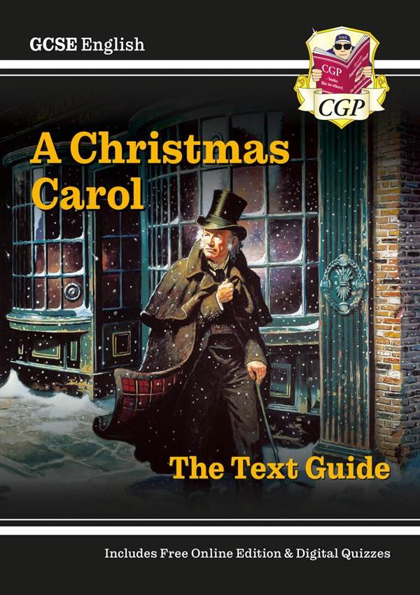
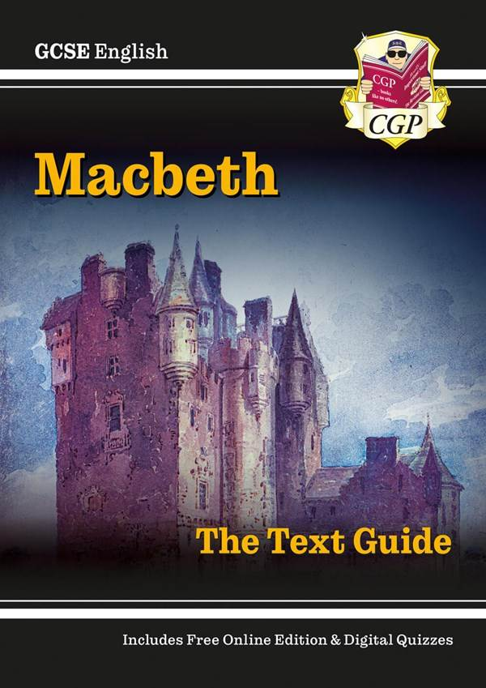
Revision Guides and How to Use Them…
All students have been loaned a copy of all four revision guides for the literature texts. This is on the condition that they will be returned at the end of year 11.
Some useful ways to encourage your children to use these:
Wider reading
Look, cover, write, check
Completing a practice essay and using the revision guide to support initially
Consolidating knowledge into mind maps, flow charts etc, posters, revision cards etc.
Teaching a friend/sibling or parent

Slide 6
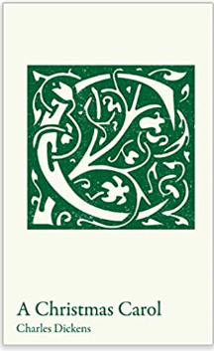
Copies of the Set Texts
Purchasing copies of the set texts for your child will prove really helpful when revising.
If they can bring this to the lessons with them, they can jot down key notes and make annotations, whereas they cannot do this with school copies.
This also means they can re-read the texts in their own time.
Both of these texts can be purchased for £1 on ParentPay.

Slide 7
Revising for Literature
Revision
Help or Hindrance?
A 2010 study (Perham and Vizard) found that music did not improve learning.
In the same study, people talking, music disliked by students and music liked by students all had similar distracting effects.
The best condition for learning and study was SILENCE
Revision Strategies;
Mind maps
Post-it notes
Copying notes/ re-writing them and checking for any errors
Completing past papers
Videos
Podcasts
Quizzes – create your own or use ones already made online
Flashcards
Teaching a friend/ sibling/ parent etc
Summarising
Highlighting
Mnemonics
Using images to remember key ideas
Re-reading
Aim to revise for 45 minutes at a time and take 5–10-minute breaks in between.

Slide 8
You could record yourself reading specific notes or quotes and then play that back to yourself whilst on car journeys or travelling!

Slide 9
Using Tutors/TikTok/YouTube…
It is absolutely fine to provide extra support for your child in the form of tutors and the internet, however it is important that you communicate to your children and any tutors you may employ the importance of following the advice they are given in school.
We see your child for 5 lessons per week, know them the best and have devised specific strategies to best help them to succeed based on their individual needs. A tutor can end up actually undoing this work if they aren’t aware of how we are asking students to do things in school. The knowledge organiser they have all been given is a really easy way of letting tutors know how we do things here.
The Examiner’s Report:
A warning about TikTok and YouTube as a revision tool:
A lot of students turn to these platforms in the last few weeks before an exam.
Lots of content creators claim to have quick tips and cheats that can get you a grade 9, but these are often not actually effective. They cannot learn a few phrases without being able to apply this and explain their ideas in detail.
Your child would be much better off using their exercise books and advice given by their class teachers.

