Slide 1
Year 10
Autumn Homework
Wider Reading and Thematic Revision
Name: __________________
Class: ____________

Slide 2
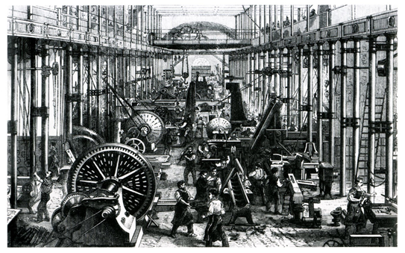
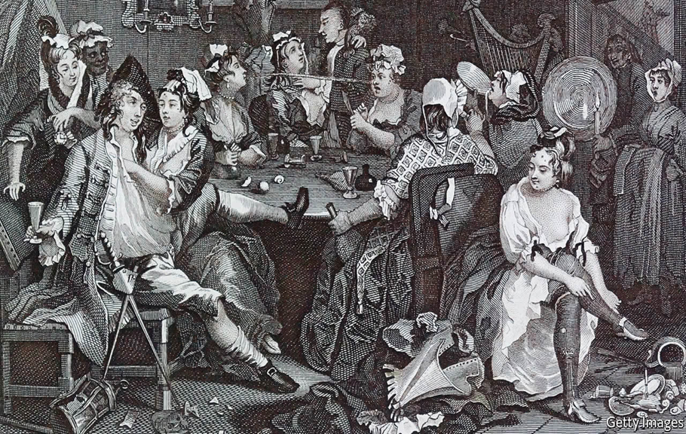
Week One Thematic Homework: Blake’s Society (Georgian Britain)
What technique is being used in this quotation? How is it effective?
What does this quotation suggest about the situation these people in Georgian Britain are in?
What views did Blake have on London during this time?
1. What does the term ‘harlot’ refer to? What are the connotations of ‘curse’?
2. What does this quotation suggest about the impact of misery and despair upon the attitude of these people?
3. What technique is ‘marriage-hearse’? How is this effective?

Slide 3
Week Two Wider Reading Homework: Children in Dickens’ England
Why did Dickens write ‘A Christmas Carol’ ?
1. What do you understand by the phrase ‘bight of the poor’? .......................................................................................................................................................................................................................................................................................................................................................................................................................................................................................................................................
.
5. How do you think Dicken’ early experiences affected his attitude towards those in poverty? ........................................................................................................................................................................................................................................................................................................................................................................................................................................................
2. Explain in your own words why Dickens was so passionate about the welfare of the children of the poor. .........................................................................................................................................................................................................................................................................................................................................................................................................................................................................................................................
6. Dickens wanted to strike a ‘sledgehammer blow’ on behalf of the children of the poor. Why do you think he used the metaphor of a sledgehammer? ..................................................................................................................................................................................................................................................................................................................................................................................................................................................................................................................................................
3. What kind of government report did Dickens read in early 1843 and how was he affected by it?
.........................................................................................................................................................................................................................................................................................................................................................................................................................................................................................................................
7. ‘Dickens was right to throw away the idea of a pamphlet.’ To what extent do you agree? .............................................................................................................................................................................................................................................................................................................................................................................................................................................................................................................................................
4. What was Dickens’ initial response to the report that he read and why did he change his mind? ........................................................................................................................................................................................................................................................................................................................................................................................................................................................................................................................................
8. What can we infer from the last bullet point about Dickens’ feelings about education? ........................................................................................................................................................................................................................................................................................................................................................................................................................................................................................................................

Slide 4
Week Three Thematic Homework: The Supernatural
Tier 2 Vocabulary Definitions:
spectre
apparition
phantom
ghostly
spectral
metaphysical
eldritch
transcendental
preternatural
Draw an image/ symbol to represent the supernatural:
How was the supernatural used in your Year 9 novel, ‘Wuthering Heights’?
How is the theme of the supernatural used in Stave 1 of ‘A Christmas Carol’?
________________________________________________________________________________________________________________________________________________________________________________________________________________________________________________________________________________________________________
How are readers prepared for the ghostly appearance in Stave 1? What clues are there in the early part of the stave that foreshadow the arrival of the ghost? ________________________________________________________________________________________________________________________________________________________________________________________________________________________________________________________________________________________________________
What do the readers learn from the ghost in Stave 1? Why has the ghost visited Scrooge?
________________________________________________________________________________________________________________________________________________________________________________________________________________________________________________________________________________________________________________________________________________________________________________________________________________________________________________________________________
Find the definitions of the vocabulary above
How have views towards the supernatural changed over time?

Slide 5
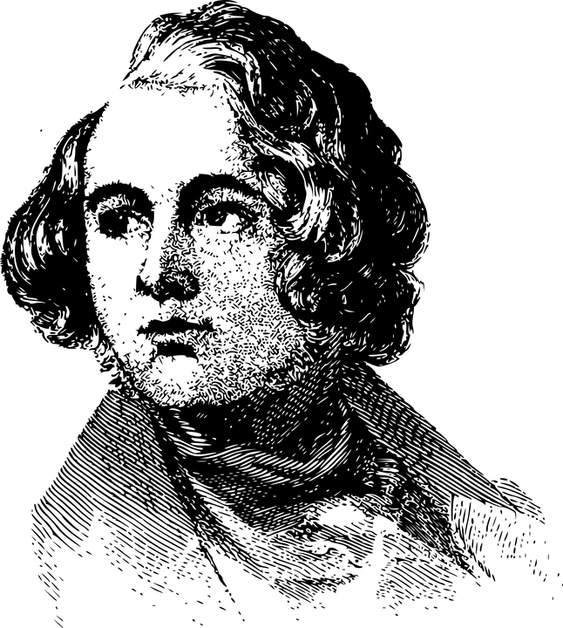
Week Four Wider Reading Homework: Religion in the novella ‘A Christmas Carol’
Charles Dickens was born into a Christian family. Although he was not a Catholic, Dickens draws upon Catholic ideas about the destination of the soul after death. This is seen in the characterisation of Jacob Marley.
In the Catholic church there are different types of sin. A mortal sin is a serious act that is committed with full knowledge and deliberate consent. An example of this would be murder. A venial sin is one that is not as serious and one that can be forgiven through prayer or confession.
The concept of Purgatory as a third realm or potential destination for the soul after death is essentially a Catholic view. Purgatory is a place of suffering for the souls of sinners who have not atoned for their sins.
Protestants (non-Catholics) tend to believe that the soul either goes to Heaven or Hell.
Dickens, it is thought, did not agree with the idea of eternal punishment in Hell with no possibility of redemption of the soul.
Look at the flowchart and answer the questions
on the next page
Notes:
Teachers select or learners self-select.

Slide 6
Week Four Wider Reading Homework: Religion in Victorian Britain
According to this flowchart, do you think Scrooge would be able to get into Heaven? Why?
What does this flowchart suggest about the purpose of Purgatory?
Based on this flowchart, what do you think is the difference between mortal and venial sin?

Slide 7
Week Five Thematic Homework: GENDER
Tier 2 Vocabulary Definitions:
Gender
Equality
Identity
Dominance
Aspiration
Opportunity
Patriarchal
Discrimination
Hierarchy
In Stave 2, Scrooge’s sister, Fan, is a significant figure in Scrooge's time travel journey into his past. It was Fan who played intercessor between Scrooge and his estranged father producing a kind of healing in the relationship.
What adjective does Scrooge use to describe his sister?
Why does Dickens introduce Fan into the story do you think?
Dickens uses his female characters to show 3 important points
Find the definitions for the vocabulary above
FAN
Restoration and Reconciliation
BELLE
Material versus spiritual rejection
In Stave 2, we are introduced to the character of Belle, Scrooge's one-time fiancee, where she shows great insight and power to speak her own mind. She sees Scrooge's "changed nature" as he is influenced by greed. She tells Scrooge he, "fears the world too much," and breaks off the relationship.
How important was marriage for a woman in Victorian Britain?
Read the next page to show the roles of men and women in the novel.

Slide 8
Week 6 Thematic: Gender in the novella
What is meant by gender roles?
At different times and in different places, men and women have been expected to play different parts in society.
In Victorian society, men had more rights than women. For example, women could not vote in elections (though most men could not either) and married women could not own property (until 1882).
Victorian society saw women as being wives and mothers. When married, they were expected to obey their husbands. In return, men were expected to provide for their wives.
How are gender roles presented in the novel?
Mrs Cratchit is a wife and mother. Her job is looking after the house and children; not just cleaning and cooking but also making the family’s money stretch as far as it can, for example, by repairing old clothes. She is seen as a ‘good wife’.
Belle too becomes a model wife, devoting herself to her many children. However, when she is young, she is in a very precarious position. She has no dowry to bring to a marriage with Scrooge. A middle-class girl without money might have trouble finding a husband.
Younger middle-class women such as Fezziwig’s daughters and Fred’s sister-in-law are seen in terms of their romantic prospects. Pretty and lively, they should have no trouble finding husbands.
Other women work for a living. The charwoman and laundress are in badly paid casual work and resort to stealing from the dead. Martha Cratchit is also poorly paid but she has an apprenticeship: millinery is skilled work and she should be able to contribute to the family expenses until she marries.

Slide 9
Week 7 Wider Reading Homework:
Education in Victorian Britain
1. Why did so many families end up on the streets in Manchester in the early 1840s? ........................................................................................................................................................................................................................................................................................................................................................................................................................................................................................................................................
4. Re-read the fifth bullet point. What evidence is there to suggest that Dickens was confident that his novella was a much more appropriate text type for his social messages? ....................................................................................................................................................................................................................................................................................................................................................................................................................................................................................................................................................................................................................................................................................
2. Why do you think so many industrialists felt that educating their workforce was a waste of time and money? What was Dickens’ opinion in this matter? ..................................................................................................................................................................................................................................................................................................................................................................................................................................................................................................................................................................................................................................................................................................................................................................................................................................................................................................................................................................................................................................................
5. Re-read the fifth bullet point. Why do you think Dickens used the phrase ‘rest assured’ in his letter to Dr. Thomas Southwood? ................................................................................................................................................................................................................................................................................................................................................................................................................................................................................................................................................................................................................................................................................................................................................................................................................................................................
Challenge:
Dickens created the characters of Ignorance and Want which appear in Stave 3. ‘Want’ means poverty; ‘Ignorance’ means lack of education. Dickens added that the character ‘Ignorance’ had DOOM written on his forehead. What do you think Dickens might have meant by this?
3. When Dickens returned from Manchester, he resolved upon writing a narrative with the social messages he wanted to convey. What does this suggest about Victorians’ love of fiction? ........................................................................................................................................................................................................................................................................................................................................................................................................................................................................................................................................

Slide 10
WEEK 8 A Christmas Carol – Stave 1 Learning Review
How is Scrooge described in this stave? (AO1)
adjectives
Simile 1
Simile 2
What do beggars do when they see him?
What do dogs do when they see him?
WHAT? How? Why? PARAGRAPH (AO1/AO2)
Using the information from your notes on Scrooge, write a WHAT HOW WHY paragraph: What happens to Scrooge? How does Dickens present Scrooge in Stave 1? Why does this happen?
Jacob Marley (AO1)
How is Jacob Marley described in this Stave?
What has happened to Jacob Marley – why can’t he rest in peace?
Fred (AO1)
How is Fred different to Scrooge?
What does he say?
What does he do?
How does he act?
Give key quotations for his character from this Stave:
Themes (AO2)
What does Dickens have to say about money and happiness?
Context (AO3)
How do the following contextual factors link to Stave 1?
Victorian poor (charity collectors)
Class systems in Victorian Britain
What happens in this Stave? (AO3/AO1)
Themes (AO2)
How is the theme of the supernatural explored in Stave 1?

